Slide 1
GDPR support tool
GN4-2 JRA4 T2
Radovan Igliar
CESNET
TF-GDPR, Berlin
28 August 2017

Slide 2
GDPR & Cloud services
Universities are using several services:
  Office 365
  G-suite
  E-learning platforms
  … IaaS services (Géant IaaS Framework)
Universities (CONTROLLER) have to exercise their Data Protection Assessments.
Service providers providing services to our community.
NRENs as legitimate umbrella of community interest.
Service providers (PROCESSOR) have to describe their Data-protection mechanisms.
Roles, processes and responsibilities.
Universities and Cloud providers have to set up contractual relationship (Data Processor Agreement) in CONSENT.
3rd party consultants (legal firms) seeking opportunity to provide their service and charge per case.
We have good position and relation with several providers (Géant IaaS Framework, Cloud catalogue).

Slide 3
GDPR support tool
GDPR support tool
Standardization process for both sides (Providers and Universities)
Self-declaration process using a GÉANT assessment tool to verify Vendor contractual commitments to meeting the GDPR requirements.
GÉANT perform evaluation check and facilitate reference (chain of trust) within community.
Define common use-cases / scenarios
i.e. student administration, research, medical data, e-learning, …
Make Risk assessment model studies
Make R&E Data processor agreement
Watch changes in Vendors Security Audits Updates and distributed to community.
GÉANT can be a market channel toward Service providers. - NRENs can be communication channel for joint approach.
Unique value:
  do it once (pay once) & use many & update regularly
  build a platform
    for the providers to easily address R&E community
    for NREN to give a TOOL for different products and model cases
    for Universities to easily adapt to their institutions
  build a credibility and trust – certification?

Slide 4
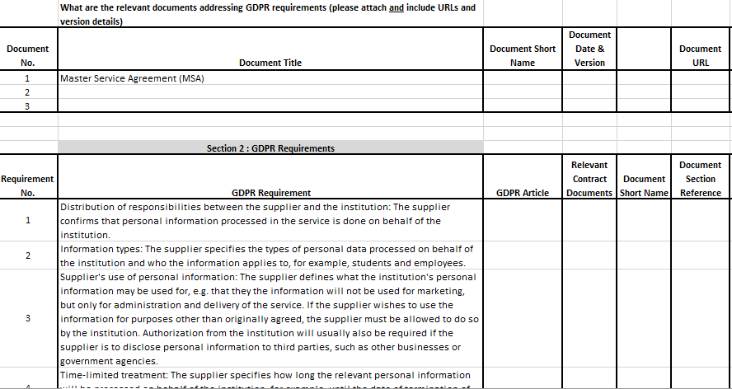
GDPR support tool

Slide 5
GDPR support tool
  Assessment - Self-declaration process using a GÉANT assessment tool to verify Vendor contractual commitments to meeting the GDPR requirements. (To help where to look – not quantitative )
  Evaluation check -> Packages
  Per Vendor / Product / Model case
  Checklists
Updated regularly
Can be part of Cloud catalogue
3. R&E general Data processor agreement (or use Standard Contract )
Subscription fee – access to all packages / or „Article fee“ (with Minimum threshold).
Institution still must do its Risk assessment (DPA), but with easy to referring/using above packages.

Slide 6
Discussion
Cloud team has good position and relation with several providers (Microsoft, Amazon, Google, …) within Géant IaaS Framework, Cloud catalogue.
Is vendor/data processor contract assessment something
the NREN/institution considers important and a service which is of value?
What are the key cloud vendors that you would like to see in scope for the service?
Would be NREN/institution willing to pay a fee for such service?

