Slide 1


WP3/NA3:
Status and Trends
GN4-1 EC Review
22-24 November 2016
Brussels
Nadia Sluer, GÉANT
Jari Miettinen, CSC
Notes:
In February
In February this year –my managers asked me to take over the management of the NA3 activity. This was only 3 months before the end of the GN4.1project! The activity leader John Dyer who has been leading the activity since the G3 project, went on retirement. I had been assisting John for all these years and worked closely with all the task leaders. There was no doubt in my mind that together with the strong task leaders we could bring the activity to a successful completion.

Slide 2
Agenda
NA3 Activity: Status and Trends
Organisation & Structure
  Organisation (Team & Tasks)
  Resources (Manpower and Partners)
  Activity Objectives & Accomplishments
Results of the Tasks
  Achievements
  Task Objectives and Results
Overall Challenges
Conclusions
Notes:
Jari
One of the task leaders is here with me to present the task achievements to you. Jari Miettinen of the T2 Campus Best practice will also talk about the challenges we came across and will share some interesting success stories with you.

Slide 3

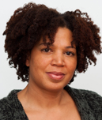
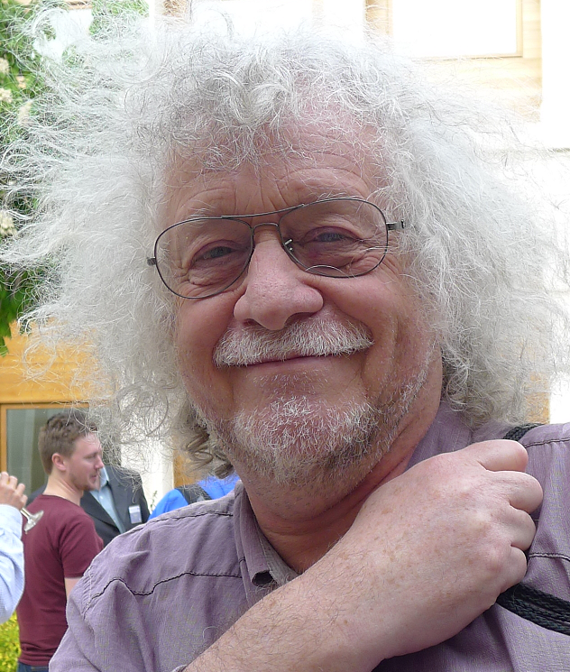

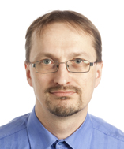
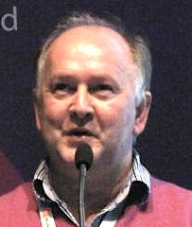




















Organisation
Team & Tasks
T1: NREN
Compendium
T2: Campus Best
Practice (CBP)
T3: The GÉANT
Green Team
T4: Task Forces and Special Interest
Groups
Activity Leaders
  Nadia Sluer
  GÉANT
  John Dyer
  GÉANT
Bert van Pinxteren
GÉANT
  Jari Miettinen
  NORDUnet
  Andrew Mackarel
  HEAnet
  Valentino Cavalli
  GÉANT
Partners
Notes:
But before, I will introduce to the team and the tasks : slide 3
Team
My name is Nadia Sluer from GÉANT association and based in Amsterdam, and I was deputy activity leader in GN4-1 NA3. I followed up John Dyer in the last few months of the project
task introduction
NA3 Status and Trends is a networking activity driving the innovation chain. It comprises 4 tasks : T1 Compendium, led by Bert van Pinxteren; T2 Campus Best Practice led by Jari Miettinen, T3 Green ICT, led by Andrew Mackarel and T4 Task forces and SIGs led by Valentino Cavalli.
What we do
What we do is develop best practice on IT practices and write them in documents,
encourage energy-efficient practice, share NREN intelligence and explore emerging issues in research and education networking and then we inform members of GN4-1, the
NRENs and the research and education community in general about these things.
Wider team
We had some very experienced partners like AMRES, Nordunet , Renater, Surfnet, Cesnet have been working in this activity for several years and who were very dedicated to help new NRENs in the tasks ( there were 5 new NRENs in the Green team and 6 new in CBP.
Unique example
A good example to mention here is a training module for NRENs that was developed to introduce new participants to Green ICT and get them started with developing sustainability policies and reporting processes. 2 trainings were held in Macedonia and in Armenia. As a result of the cooperation between new comers and old NRENs environmental policies were adopted in all the new NRENs in this task and also in GEANT and led to further research in to how to optimize performances in terms of power consumption and so better be able to reach out and support communities.
The effort and lessons learned from this knowledge-sharing was also used to inform students from universities in Macedonia and Montenegro, as well as to coach additional staff from those two NRENs.
Digital divide
Helping in this particular case new and advancing NRENs by sharing knowledge was a very important exercise which contributed in a positive way to decreasing the digital divide, which has been high on the GN4-1 agenda.

Slide 4
Resources (1 May 2015 to 30 April 2016)
Manpower and partners
AL
T1
T2
T3
T4
NREN Compendium
Bert van Pinxteren
12.18 MM/
8.00 MM (152%)
Campus Best Practice
Jari Miettinen
72.13 MM/
73.00 MM (99%)
The GÉANT Green Team
Andrew Mackarel
44.61 MM/
41.50 MM/ (107%)
Task Forces and Special Interest Groups
Valentino Cavalli
23.33 MM/
22.50 MM/ (104%)
  Nadia Sluer
  6.94 MM/
  6.0 MM (116%)
GN4-1 budget (used / budget) | € 980k / €1.12 M (87%)
Total manpower | 159.20 MM / 151.01 MM (105%)
Participants | 30 persons (core group) 23 partners
4 Tasks + Task 0 - All tasks completed successfully Including 3/3 deliverables
✓
Notes:
budget
As you can see on this slide we spent 980k (87%) of the budget. NA3 is a networking activity therefore the budget – next to the indirect cost of 23 partners, 101 persons working in the activity with a core group of 30.
Travel budget
The second biggest amount of roughly 120k was in the travel budget to support experts presenting at the many workshops, meetings, conferences and training, a networking activity typically takes part in.
Travel policy
Because of pressure on travel budgets, the task leaders kept to a strict travel policy and procedure to justify all the travel.
Compendium challenge
T1 Compendium task was challenged with staff issues at a later stage of the project causing re-allocation of staff and duties.
Across the activity the budget remained stable.
Deliverables
deliverables
All tasks completed successfully with 3/3 deliverables; The Annual Compendium 2015, and the annual reports on the Campus Best Practice and annual report of the Green team in which you can read about the worksplans, objectives and achievements in GN4.1.

Slide 5
Activity Objectives and Accomplishments
Objectives
✓
Provide expertise and intelligence to inform GN4-1 participants, NRENs and the R&E community
✓
Engage local expertise, driving forward GÉANT service innovation
✓
Identify global status and trends of current and emerging network techniques and interpreting / disseminating findings and recommendations across the GÉANT community
✓
To ensure that GÉANT and its connected NRENs and institutions develop and follow best practice in delivering products and services and engaging through to campus level
✓
Innovate best practice for the achievement of the highest possible levels of energy efficiency and reduction of GHG emissions across the GÉANT supply chain, NRENs and connected institutions
Notes:
So, What did NA3 stand for?
Here on this slide you can see the activity objectives. Rather than reading them one by one, I tried to capture a few words that would best resonate to the mission of NA3.
Words such as:
expertise and intelligence, disseminating, follow best practice, Innovate, NRENs and connected institutions
and I came up with this phrase:

Slide 6
Working and Learning Together to Build Strong Communities

Slide 7
Activity Objectives and Accomplishments
Accomplishments
Produced a collective 40 campus (26) and Green ICT(14) best practice documents for the benefit of NREN staff and IT professionals in campus and other institutes across Europe and beyond
Reached over a collective 5000 R&E professionals in Europe at workshops, conferences and meetings
Captured data of 55 NRENs in Compendium of NRENs to share intelligence and learn from each other
Notes:
Working and learning together, we
we produced a total of 40 (26 on Campus Best Practice) and (14 on Green ICT) best practice documents for the benefit of IT staff at NRENs, institutes and campuses
we exposed our activities to more than 5000 R&E professionals in Europe at workshops, conferences and meetings; A total of nearly 100 presentations, trainings, workshops and meetings organised and featured in Connect articles
Collected data of 55 NRENs in the Compendium to share intelligence and learn from each other

Slide 8
Agenda
NA3: Status and Trends
Organisation & Structure
  Organisation (Team & Tasks)
  Resources (Manpower and Partners)
  NA3 Activity Objectives
  and Accomplishments
Results of the Tasks
  Achievements
  Task Objectives and Results
Activity Challenges
Conclusions

Slide 9
WORKING AND LEARNING TOGETHER TO BUILD STRONG COMMUNITIES
Agenda
TASK 1: Compendium
Notes:
Strengthening by producing Compendium
in T1 we have been working and learning together to strengthen the NREN community by producing the Compendium of NRENs

Slide 10

Compendium
Strengthening the NREN community
The Compendium is valued by NRENs because it helps demonstrate their successes:
How well they are serving users
How many services they offer
How service portfolios are developing, and how service use increases the overall strength of the R+E networking environment
Promote inter-NREN collaboration on identified trends
Benefits of funding for both NRENs and end-users
Notes:
What is it?
The Compendium is a leading publication from the Community and for the community, that tracks the growth and development of NRENs in Europe.
What is Compendium
The Compendium is a yearly publication that tracks the trends and development of NRENs in Europe.
It’s valued by NRENs because it helps demonstrate their successes:
How well they are serving users
How many services they offer
How service portfolios are developing, and how service use increases the overall strength of the R+E networking environment
Promote inter-NREN collaboration on identified trends
Benefits of funding for both NRENs and end-users

Slide 11
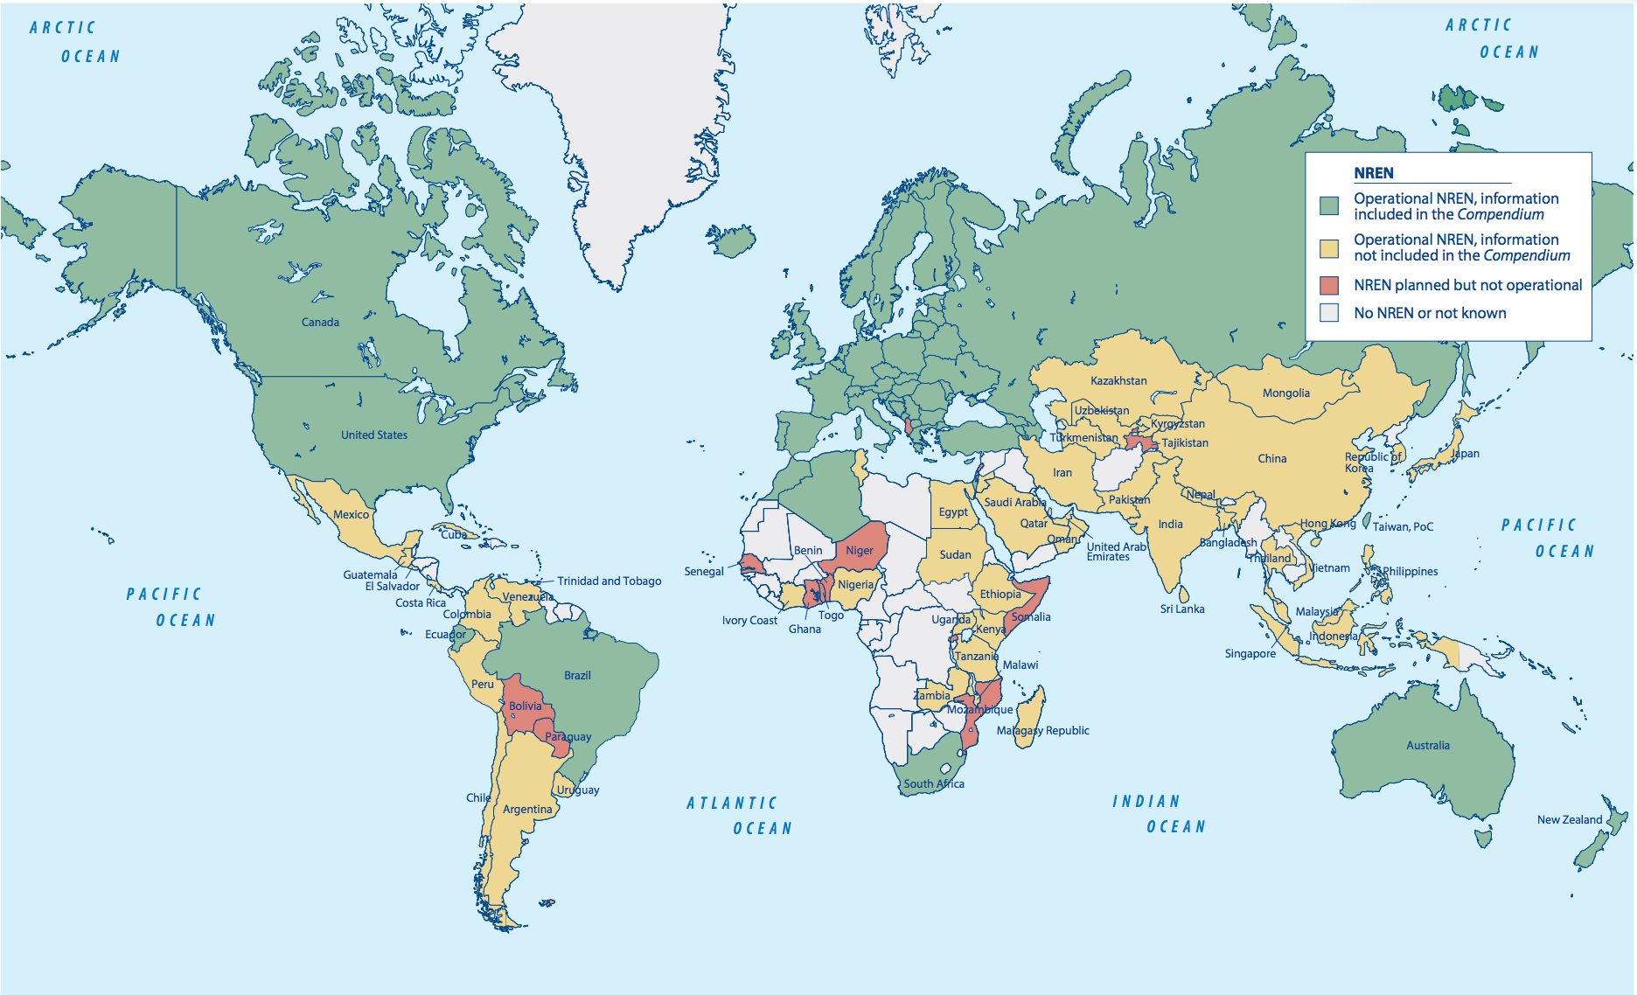
Compendium
Growing in step with expanding NREN base
55 countries included
47 responses Europe
8 responses outside Europe
75 known NRENs in other countries
Notes:
Data collection process
The data collections is done through an extensive survey and contains data and responses from 55 NRENs (42 x GEANT, 5 x other European and 8 non-Europeen NRENs. In addition, the Compendium has identified 75 NRENS known to be operating in the world; which gives potential for global growth.

Slide 12

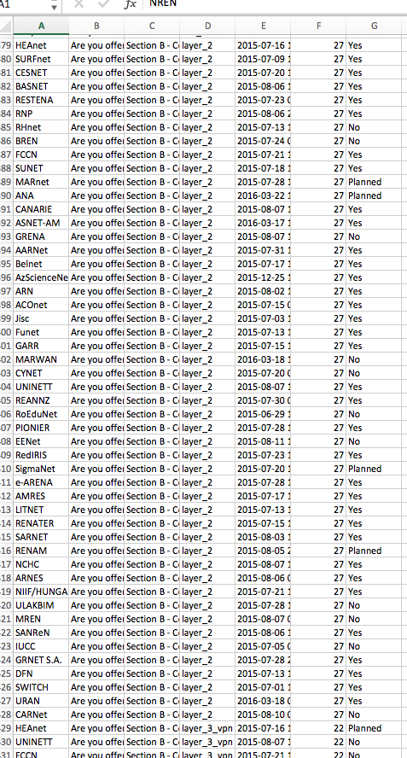
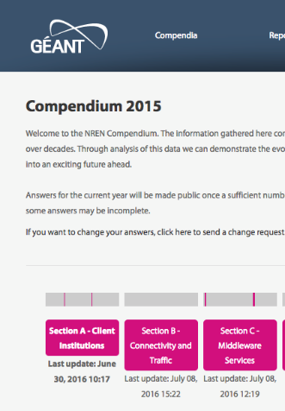
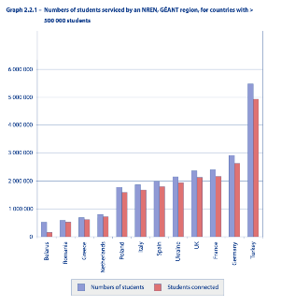
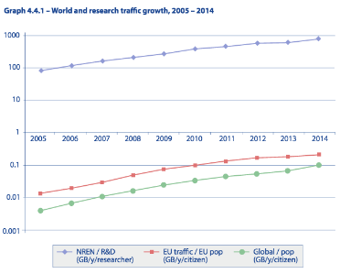
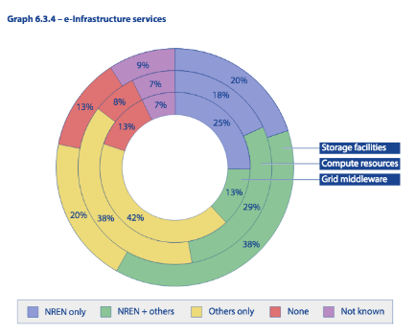
Compendium
Richness of data and expert intelligence adding value for the NRENs
Collect data
Data Analysis
Expert Intelligence
Key findings 2015
NRENs moving beyond only providing network services towards greater e-Infrastructure integration
  78% of NRENs actively deliver cloud services
NREN Traffic per researcher is now 10 000 times the traffic per EU citizen
GÉANT NRENs provide services to approximately 86% of all university level students; up from 82% in 2014
First mention of intensive research into Software Defined Networking (SDN) capabilities
Notes:
Process – it starts with collecting the data
Technical enhancements
We continued to make small technical improvements to the data collection. For instance pre-fllling questions with answers we already know, users now only had to check if that’s still the case,making the survey more user friendly.
Clensing, analysing
After collecting the data, the datasets were clenched and then analysed and visualised with graphs, charts and tables.
Data analist
Since we did not had a data analist this time. So we used existing resources to secure the integrity of data. and This put some more pressure on budgets we saw in earlier slide.
New approach
In GN4-1 we took a new approach to advance the Compendium into a more community-led publication.
While the Compendium has always been a community publication through the cooperation of NRENs and the oversight of a community Panel, we took it one step further and invited technical experts from the community to do the data interpretation from their field of expertise and write their findings.
Finally key findings coming out of this process were:
NRENs moving beyond providing just network services towards greater e-Infrastructure integration. 78% of NRENs actively deliver cloud services
NREN Traffic per researcher is now 10 000 times the traffic per EU citizen person
GÉANT NRENs provide services to approximately 86% of all university level students; up from 82% in 2014
First time we see intensive research into Software Defined Networking (SDN) capabilities
And yesterday we already heard about the exponential growth in services such as Edugain and eduroam in Ann’s presentation

Slide 13
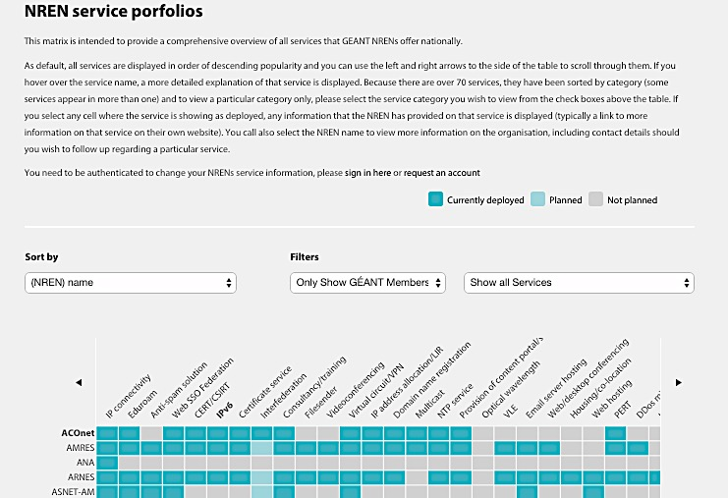
Compendium
Other uses of Compendium data
Compendium data feeds into NREN Service Portfolio
Service matrix framework adopted in other activities:
  SA7 Cloud catalogue
Notes:
The Compendium data is finding new and other uses.
Compendium data was used to feed the NREN service portfolio (known as the service matrix in GN3plus), Matthew presented on this earlier.
The developing work for the service matrix that was done in the NA3T1 has now also evolved in other activities such as the Cloud catalogue in SA7, Andres talked about yesterday.

Slide 14
Compendium A valuable reference tool for NRENs
“
“ ..Whenever you want to compare your NREN to the others or just get inspiration to what new services you could wish for, the service matrix is the place to consult.”
“..to see what strategies/services other NRENs are pursuing, to identify areas where we can collaborate or offer help.”
“..to see the positioning of our NREN in the European landscape and to find the way other NRENs solved some issues.”
“.. the funding, connectivity and service sections are great for reference in decision making and responding to our funding agencies.”
”
Notes:
Whether to see what strategies/services other NRENs are pursuing or whether is used as a reference to respond to funding bodies, the Compendium remains a valuable reference tool for NRENs.

Slide 15
Compendium
Task 1: GN4-1 Objectives and Results
Objectives
from
Technical
Annex
To be pursued in Compendium 2016:
Continue working with content owners and area experts
Work with data scientist for data and trend analysis
Keep focus on identifying and drawing out trends
Enrich factual data with qualitative interview data
Improve automated data collection functions
Production of the NREN Compendium
Best practice from leading networks for benefit of whole ecosystem
GN4-1
Results
2015 Compendium successfully published
Analysed and authored by community area experts
✓
✓
✓
Notes:
2015 compendium was successfully published
The Compendium continues to be an important benchmark and best practice from leading networks, for the community and by the community.
Lessons learned and looking ahead we will:
Continue working with content owners and area experts
Work with data scientist for data and trend analysis
Keep focus on identifying and drawing out trends
Enrich factual data with qualitative interview data
Improve automated data collection functions

Slide 16
WORKING AND LEARNING TOGETHER TO BUILD STRONG COMMUNITIES
Agenda
TASK 2: CAMPUS BEST PRACTICE

Slide 17


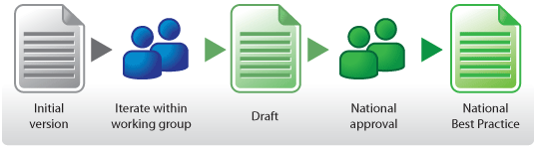
Campus Best Practice
Success Story: Campus Best Practice on digital assessment in Norway
Local Practice
Use case: Built compatible systems / framework for all universities in Norway, using the campus best practice method
Results: 6 Campus Best Practice documents
Global Interest
NRENs: UK, Ireland, Netherlands, Portugal, Brazil, Sweden, Denmark, Iceland
Individual Universities in Europe, Asia and the US
11 different vendors (from India, USA, Spain, Netherlands, UK, Island, Sweden, Denmark, Norway
6
Notes:
Background: develop a common understanding howto a build digital assessment service.
Collaboration between UNINETT and Norwegian universities resulted in six BPD document, which cover the topic from the viewpoint of technical considerations to legal issues.
All the BPD documents have been finalized and available from the GÉANT CBP website.
UNINETT, The Norwegian NREN in collaboration with higher Norwegian education has run a project on digital assessment

Slide 18

Campus Best Practice
New documents, outreach, workshops
 | 2010 GN3 | 2011 GN3 | 2012 GN3 | 2013 GN3 | 2014 GN3plus | 2015 GN3plus | 2016 GN4-1
NRENs | 4 | 4 | 4 | 5 | 10 | 10 | 16
Teams | 17 | 17 | 14 | 18 | 34 | 31 | 48
Workshops | 1 | 2 | 2 | 4 | 2 | 5 | 2
BPDs | 15 | 8 | 17 | 16 | 9 | 10 | 26

Slide 19
Campus Best Practice
Task 2: GN4-1 Objectives and Results
Objectives
from
Technical
Annex
10 BPDs with
extended range of topics
Intensify content dissemination
Interaction and engagement with campus/NREN staff
GN4-1
Results
Worked on 30 new BPDs
26 completed
Micro site (web stats)
NRENs actively utilising knowledge base to disseminate
Additional NREN partners
Workshops
Presentations
Training
✓
✓
✓
Notes:
Micro site:
Add the BPD area topic table on the right side of the slide
Add the number of participants to the trainings in Macedonia and Armenia!

Slide 20
WORKING AND LEARNING TOGETHER TO BUILD STRONG COMMUNITIES
Agenda
TASK 3: GREEN ICT

Slide 21
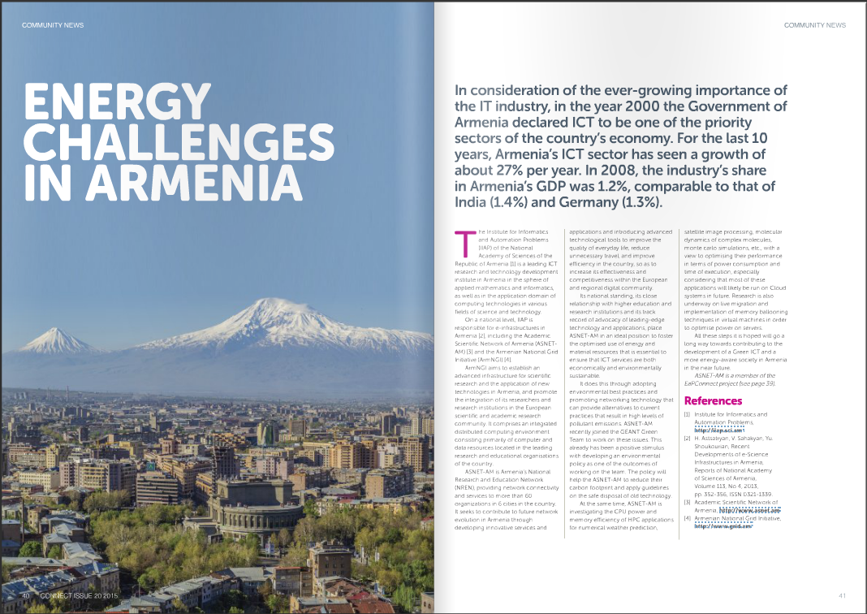
Green ICT
Success Story: Case Study Armenia
Armenia use case: Developing ICT sector
Green Team Training in Armenia
National impact, community activated
Established collaboration (Dutch, French)
Local IMPACT
“All these steps will act as a big step towards Green ICT and energy aware society in Armenia in the near future.”
– H. Astsatryan, National Academy of Sciences, Armenia
CONNECT, OCT 2015 ISSUE
Green topics initiated by team members regularly featured in CONNECT Magazine
Notes:
ICT industry has been a special focus of the Armenian government for the last decade.
The growth rate has been some 27% per year.
The Armenian NREN joined the Green Team and a special training was arranged.
The training matched the needs very well the local needs and led into community activation
After adopting the best practices the Armenians started to build up on top of it and
established collaboration ties with advanced NRENs.
For the first time, the GƒANT Green Team has chosen to present its approach to GHG emissions auditing in a forum based on industry and academic researchers working with the energy challenges and roles of mechanics as a means for seeking solutions, involving multiple disciplines in technology, science and management [ISECM]. Next, the output of one of these GHG Emissions report iseCO2meter has now been expanded to produce a series of graphical reports to allow NRENS compare performance in each of the four categories .

Slide 22

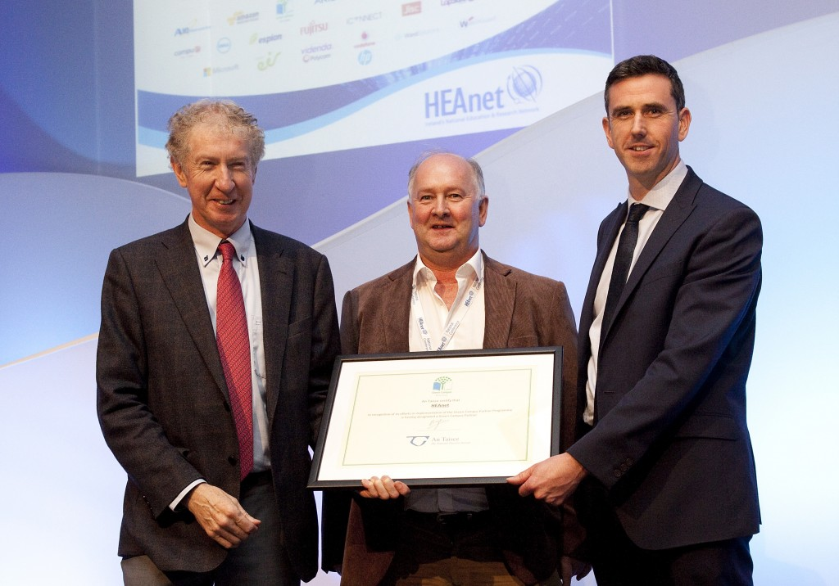
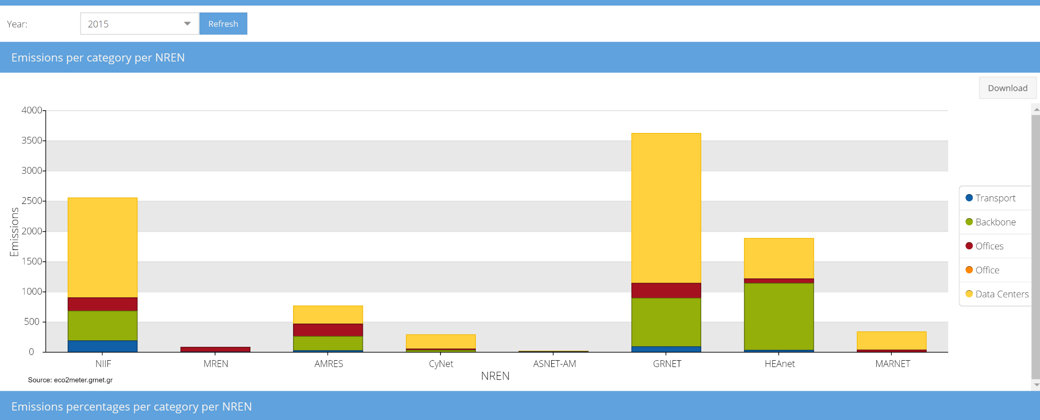
Green ICT
There were many highlights…
14 new test cases written on energy saving studies
HEAnet awarded Green Campus partner certification in Eco-University programme
GÉANT adopted an environmental policy and implementation strategy
eCO2meter enhanced to compare NREN energy consumption performance
2 x successful training workshops held in Armenia and in Macedonia
GN4-1 Test Case Studies
“As a result of the covered training topics, we extended our energy efficiency coverage with additional information on evaluating IT energy efficiency, in particular, estimating the PUE coefficient for data centres and using the eCO2meter” comment from the training host at Green ICT training held at the Faculty of Computer Science and Engineering [FINKI], Macedonia
Digital Assessment in Norway
Investigate the Use of Renewable Energy Sources (RES)
Eco Friendly Office Design
Recycling / Website
GRNET Videoconferencing Services
PowMon POE Device Power Cycling Software Enhancements
Nagios Monitoring an in SMS based alerts
Using Rasperry Pi as a Classroom Client Terminal
How a Network Technology Refresh can make an NRENs network greener
How to achieve energy savings by functional aggregation of CPE
Using ITC Design Guidelines to Improve classroom energy efficiency
Moving libraries to the Cloud in Serbia
Designing and building an environmental-aware datacentre
Power Cycling CPE at small clients to save energy
John Boland, HEAnet Chief Executive and Andrew Mackarel, HEAnet Project Manager accepting the Green Campus Certification award from Anthony Purcell, Development Manager, Environmental Education Unit, An Taisce, at HEAnet’s National Conference, November 2015
CONNECT magazine article, Oct 2015
Notes:
An Taisce has now awarded Green Campus Partner certification and the award was presented at the HEAnet national conference in November 2015. This certification is reviewed every two years, and HEAnet must furnish a brief report summarising its Environmental Sustainability activity during each year. Both parties are trying to setup joint workshops to share their expertise with their mutual client sets.

Slide 23
Green ICT
There were many highlights…
14 new test cases written on energy saving studies
HEAnet awarded Green Campus partner certification in Eco-University programme
GÉANT adopted an environmental policy and implementation strategy
eCO2meter enhanced to compare NREN energy consumption performance
2 x successful training workshops held in Armenia and in Macedonia
GN4-1 Test Case Studies
“As a result of the covered training topics, we extended our energy efficiency coverage with additional information on evaluating IT energy efficiency, in particular, estimating the PUE coefficient for data centres and using the eCO2meter” comment from the training host at Green ICT training held at the Faculty of Computer Science and Engineering [FINKI], Macedonia
Digital Assessment in Norway
Investigate the Use of Renewable Energy Sources (RES)
Eco Friendly Office Design
Recycling / Website
GRNET Videoconferencing Services
PowMon POE Device Power Cycling Software Enhancements
Nagios Monitoring an in SMS based alerts
Using Rasperry Pi as a Classroom Client Terminal
How a Network Technology Refresh can make an NRENs network greener
How to achieve energy savings by functional aggregation of CPE
Using ITC Design Guidelines to Improve classroom energy efficiency
Moving libraries to the Cloud in Serbia
Designing and building an environmental-aware datacentre
Power Cycling CPE at small clients to save energy
Figure 4.4: Graphical report generated by eCO2meter showing NRENs GHG emission by category Source: eCO2meter.grnet.gr
John Boland, HEAnet Chief Executive and Andrew Mackarel, HEAnet Project Manager accepting the Green Campus Certification award from Anthony Purcell, Development Manager, Environmental Education Unit, An Taisce, at HEAnet’s National Conference, November 2015
CONNECT magazine article, Oct 2015
Notes:
An Taisce has now awarded Green Campus Partner certification and the award was presented at the HEAnet national conference in November 2015. This certification is reviewed every two years, and HEAnet must furnish a brief report summarising its Environmental Sustainability activity during each year. Both parties are trying to setup joint workshops to share their expertise with their mutual client sets.

Slide 24
Green ICT
Objectives and Results
Encourage environmental improvement of GEANT delivery chain
Link with others in and outside the project to create Green ICT and energy-aware society
Be a centre of excellence and knowledge on environmental performance
Promote widespread use of energy efficiency supporting tools
Objectives
from
Technical
Annex
GN4-1
Results
Built competencies of new NRENs and their constituencies
All 13 partners, including GEANT association adopted environmental policy
Grown GREEN ICT library with new materials
All 13 NREN partners made GHG audits using the eCO2meter tool
✓
✓
✓
✓
Notes:
Established a Green Special Interest Group to entrust future resources

Slide 25
WORKING AND LEARNING TOGETHER TO BUILD STRONG COMMUNITIES
Agenda
TASK 4: TASK FORCES AND SPECIAL INTEREST GROUPS

Slide 26

Task Forces and SIGs
Success story: Cross Community Collaboration
Joint DDoS mitigation workshop
In Q3, several TFs and SIGs (TF-CSIRT, TF-MSP, SIG-ISM and SIG-NOC) successfully brought their communities together for a joint workshop on DDoS mitigation
The workshop was aimed at providing a general overview of current DDoS mitigation solutions for the NREN environment
The findings of the workshop were summarised in the final report
https://wiki.geant.org/download/attachments/49120034/DDoSMitigationintheNRENEnvironmentReportv1.pdf
Notes:
TF-NOC shared knowledge around designing inventory systems addressing the principles of a modular operations support system / business support system (OSS/BSS) compliant inventory.
The final report is available: https://wiki.geant.org/download/attachments/49120034/DDoSMitigationintheNRENEnvironmentReportv1.pdf
See page: https://wiki.geant.org/display/SIGISM/DDoS+Mitigation+in+the+NREN+Environment+Workshop

Slide 27

Task Forces and SIGs
New Initiatives in challenging fields
Network Operations
NOC Tool Survey and outcomes published in report
Storage
Total Cost of Ownership (TCO) Calculator
Sync-and-share technical discussions with ownCloud Inc. and a new European company, Zettabox
Online forum for deployers of OpenStack within the community
Security
White paper on security management
Introduction of response test by Trusted Introducer team
Notes:
Mention industry participation

Slide 28
Task Forces and SIGs
Objectives
Objectives
from
Technical
Annex
Provide a mechanism for community to test ideas
Bring members of knowledge community together to develop world-leading platform for R&E tasks
Contribute to secure, trustworthy networks of services and verifiable identities
Provide fora in which world experts can continue to work together to solve problems
GN4-1
Results
7 Task Forces
3 SIGs, 10 Topic areas met 2-3 times a year to discuss new ideas
24 meetings and workshops
1000+ participants from various countries
Innovations in security, NOC and storage
Productive engagement
community & industry
✓
✓
✓
✓

Slide 29
Agenda
NA3: Status and Trends
Organisation & Structure
  Organisation (Team & Tasks)
  Resources (Manpower and Partners)
  NA3 Activity Objectives
  and Accomplishments
Results of the Tasks
  Achievements
  Task Objectives and Results
Activity Challenges
Conclusions
Notes:
My name is Nadia Sluer and I took over the activity leader duties from John Dyer who had been leading
until March this year.
Until then I have been involved in the work of the this activity as a deputy activity leader and as such kept close to the project. I have been working closely with all the task leaders in the final months and in particular with Jari Miettinen to bring this activity to its completion
Jari, will talk you through the second part of this
presentation and he will share some interesting
success stories and results from the tasks with you, about the challenges that were overcome and
I will
Close with the final conclusions.
But before that , I will introduce you the team and the wider team, talk a little about the budget and I will also cover the first task 1 Compendium and talk about the use and value of the Compendium

Slide 30
NA3 Activity Challenges
Encountered unexpected challenges in the project
Challenges/opportunities
Mitigation
Impact
Changes in personnel
Changes in duties
Focus on main tasks
Finalisation of tasks
Budget re-allocation
On-time delivery
Challenge of success
Change of process
More documents published
New approaches
Activities’ migration plan
Task priorisation
Notes:
Challenges quite similar or comparable to typical project work.

Slide 31
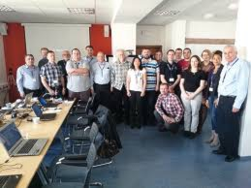
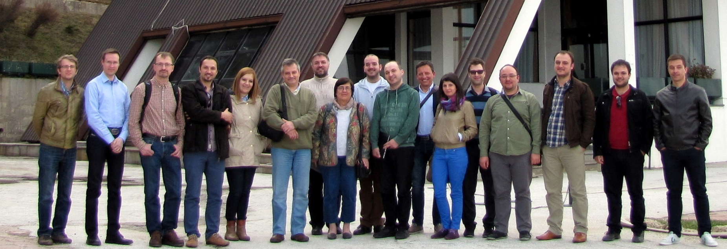
Challenge = Opportunity
Tasks 2 and 3: Continuation of the work in the SIG
Safeguard legacy
The work of Task 2 and 3 will continue as a GÉANT Special Interest Group
A migration plan was made and it was executed during the last months of the project
A SIG was established at the end of GN4-1
GN4-1 kick-off meeting at Czech Technical University
T2 Campus Best Practice MARnet, Macedonia
SIG-Marcomms

Slide 32
Conclusions
NA3 delivered many benefits to the community
SIG-MARCOMS
Skills
Contacts
Guidelines
Intelligence
Ideas & Innovations
  Competencies
  Collaborations and Partnerships
  Best Practice,
  Green Team Test Cases
  Compendium
  New Initiatives in
  Task Forces & Working Groups
Notes:
Competency in good work practices for sustainability
New collaborations and partnerships involving NRENs and institutions
New best practice guidelines to aid business implementations on top of the normal networking considerations for the NREN community.

Slide 33
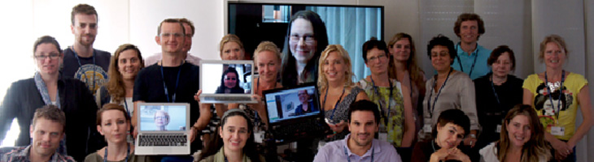
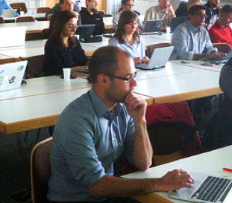
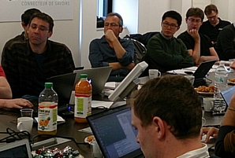
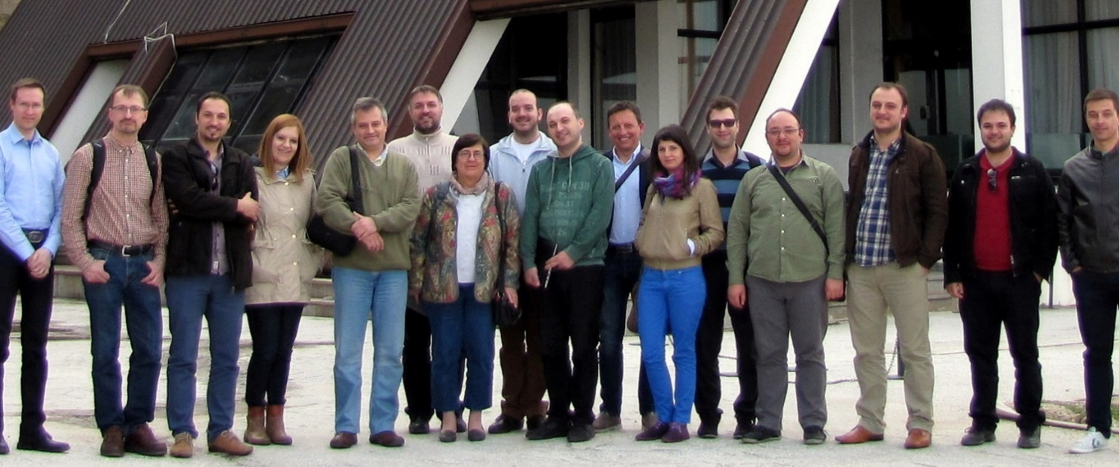
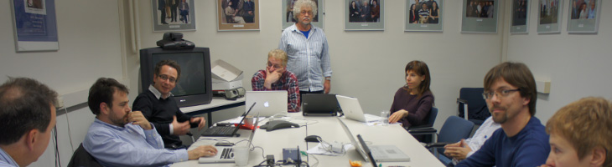
Conclusions
SIG-MARCOMS
Working and Learning Together to Build Strong Communities
GN4-1 kick-off meeting at Czech Technical University
Campus Best Practice team at
Marnet, Macedonia
SIG-MSP Management of Service Portfolios

Slide 34
Thank you and
any questions?

