Slide 1
Sprint Objectives
Gather feedback from current pilot users on the existing discovery pilot service
Handover/transition the eduTEAM Discovery Service to the WP5 T1 eduGAIN service.
Continue work on RA21. In particular:
  Review and provide inputs on the RA21 work from GÉANT's point of view.
  Figure out if and how to best operate a Discovery Service for eduGAIN community

Slide 2
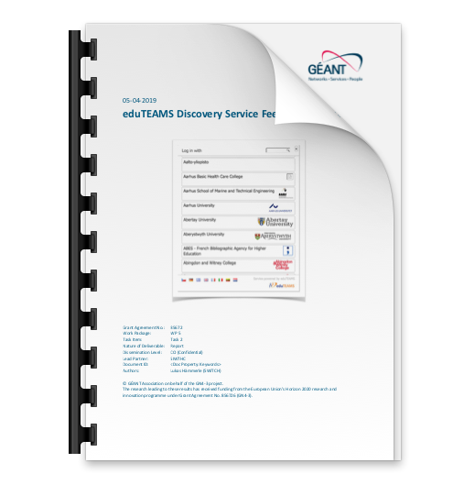
1. Feedback Report
7 of 9 SP operators have answered
Draft report written
(minus potentially 2 answers)
Small sample but neutral or positive
feedback from SP operators
Link: https://wiki.geant.org/download/attachments/120500433/eduTEAMS%20Discovery%20Service%20Feedback%20Report.pdf

Slide 3
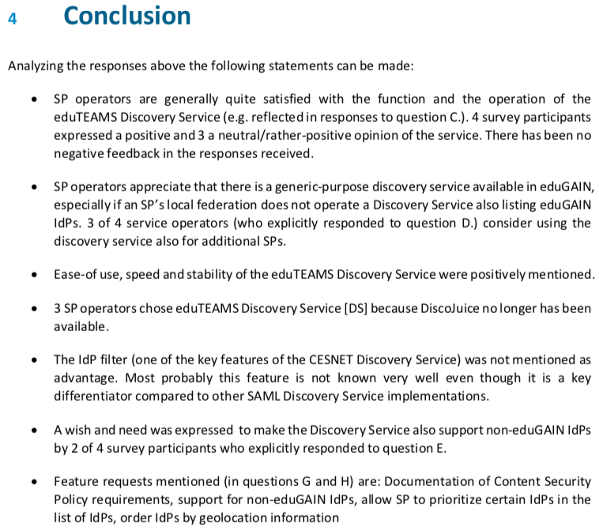
Conclusions

Slide 4
2. Handover/Transitioning eduTEAMS Discovery Service
Discussion with Davide on how DS will be migrated to eduGAIN
Plan was created to migrate service
Service was renamed to DSX
  discovery.eduteams.org -> dsx.edugain.org
Documentation and privacy statement were moved and adapted
Current service can be migrated without any changes on their side (thanks to HTTP redirect)
  Still, we will inform them yet about the change

Slide 5
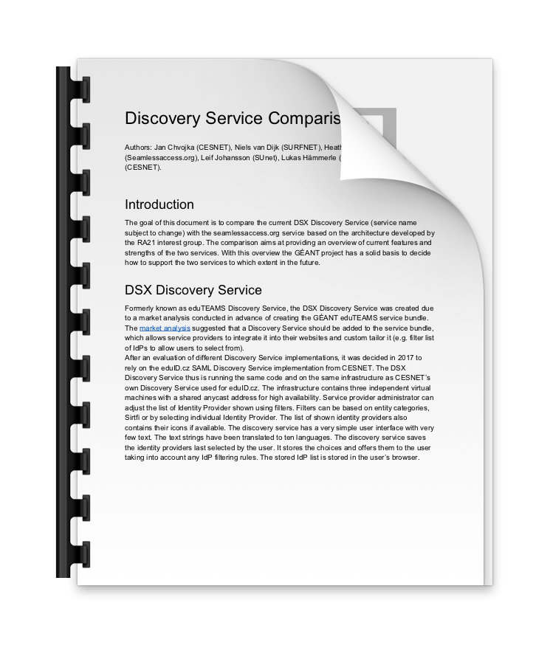
3. RA21/Seamless Access
Reviewed and compared DSX and SeamlessAcesss service (becoming available in October)
Tested 2 of 3 Seamless Access
integration options
Recommendation on how GÉANT should
proceed with the two DS services is yet
pending
Link: https://docs.google.com/document/d/1_RkbM032coe07Xa3LfDBWbSQezA4L_z3CyO9lsnvJiI/edit?usp=sharing

Slide 6
What’s missing yet
UI changes to make DSX similar to SeamlessAccess UI
Information to SP operators regarding name/URL change of service
Actual redirect from old to new service URL

