Slide 1
Securing Your Network & Application Availability
Radware’s Security Solutions

Slide 2
About Radware

Slide 3
























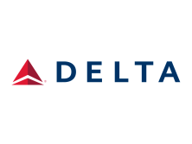
























Market Leading Attack Mitigation Solution
7 of Top 14 World’s Stock Exchanges
12 of Top 22 World’s Commercial Banks
Leading Online Businesses
6 of Top 20 World’s Retailers
6 of Top 10 World’s Telcos
2 of Top 5 Cloud Service Providers
Top organizations using Radware’s Security Services
3
Notes:
Trusted by organizations worldwide
Solution adopted by organizations around the world, across verticals
Services adopted and used by top organizations including UPS, Harvard, etc.

Slide 4
Current Trends

Slide 5
Attacker Motivation is Shifting
Increase in Ransom as a Motive
More than 50% increase in ransom as a motivator for attackers
Motivation behind cyber-attacks is still largely unknown
One-third cited political/hacktivism
About a quarter referenced competition, ransom, or angry users
Q: Which of the following motives are behind any cyber-attacks your organization experienced?
5
Notes:
As in previous years, the majority of respondents (50% in 2015) claim to not know the motivation behind cyber-attacks. Thus, the data again suggests that most organizations are essentially in the dark when it comes to “why” of any attacks they have experienced. When motivations are unknown, it hinders an organization’s ability to optimize preparation for future attacks
This year’s survey results underscore a significant growth in ransom as motivation for attackers, which increased from 16% in 2014 to 25% in 2015.
Consider the highly publicized attacks on Swiss-based encrypted email provider, ProtonMail. In November
2015, the company experienced consecutive attacks initiated with a ransom request by a new hacker
group, The Armada Collective. Hoping to stop the attacks, ProtonMail paid a ransom, only to see the
attacks continue with volumetric and burst attacks combining application and network vectors.

Slide 6

No One Is Immune
Increased Attacks on Education and Hosting
Most verticals stayed the same
Education and Hosting – increased likelihood
Growing number of “help me DDoS my school” requests
Motivations varies for Hosting
  Some target end customers
  Some target the hosting companies
2015
Change from 2014
6
Notes:
The Cyber-Attack Ring of Fire maps vertical markets based on the likelihood that organizations in these sectors would experience attacks. In 2015, several verticals faced consistent levels of threat, while both Education and Hosting moved from “Medium” to “High” risk. This means that organizations in these verticals are more likely to experience DoS/DDoS and other cyber-attacks and to experience such attacks at a higher frequency than in the previous year.
Hosting:
This year brought an increase in attacks against large hosting companies, some targeting end customers (website owners) and some targeting the hosting companies themselves. Motivations for these attacks vary. As with ISPs, some
companies are threatened with a DDoS attack unless a ransom is paid through Bitcoin. Some are attacked due to the impression of offensive nature of the site they are hosting. In other cases, it seems that the attackers’ objective is
simply to cause damage to services that impact more than the company itself. For example, a DNS services attack on DNS hosting
Education
Cyber-attacks on school and other educational websites increased, as those who execute attacks on educational sites can gain notoriety and fame.
Common attacks include hitting the mail server and targeting sites and services for submitting work and managing the admission process. Both are “business” critical to any school—with downtime leading to day-to-day chaos and potential damage to an institution’s reputation
A growing number of “Help me DDoS my school” requests are popping up in dark corners of the Internet, making it easy for non-hackers to attack and inflict damage on school resources

Slide 7
More Automated, Persistent DoS Attacks
Burst Attacks on the Rise
More than half of the three biggest attacks experienced lasted 1 hour or less
Significant increase from the 27% in 2014
Another indication of increased automated attacks
Q: What are the three biggest cyber-attacks you have suffered: Duration?
7
Notes:
This report outlines the rise of advanced persistent denial-of-service (APDoS) attacks. These attacks represent a clear and emerging threat demanding more advanced detection and mitigation and, more often than not, true partnership with DDoS mitigation service providers.
APDoS attacks involve massive network-layer DDoS attacks and focused application layer (HTTP) floods, followed by repeated SQLI and XSS attacks occurring at varying intervals.
Typically, perpetrators simultaneously use five to eight attack vectors involving up to tens of millions requests per second, often accompanied by large SYN floods that can not only attack the victim but also the service provider implementing any sort of managed DDoS mitigation capability
More than half of the three biggest attacks experienced lasted one hour or less, a significant increase from the 27% that said the same in 2014.
It also indicates greater use of automated, bot-based attacks that generate large volumes of attack traffic in a short period of time, and maintain that as an attack campaign over a long period of time; essentially creating an APDoS.

Slide 8
Similar Frequency for Network and Application Attacks
Network Attacks
Application Attacks
38-42%
experienced Network attacks
daily, weekly or monthly
38-52%
experienced Application attacks
daily, weekly or monthly
8

Slide 9



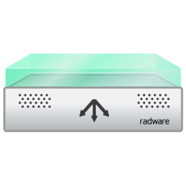
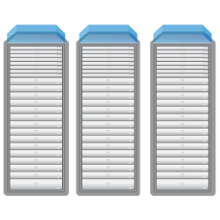


Internet Pipe – #1 Failure Point
Internet pipe is the bottleneck of DDoS attacks
36%
21%
10%
3%
28%
2%
INTERNET PIPE
(S
a
tu
r
a
tion)
FIRE
W
ALL
IPS/IDS
L
O
AD
B
ALANCER
THE SERVER
SQL
(ADC)
UNDER
ATTACK
SE
RVER
Internet Pipe
Firewall
IPS/IDS
Load Balancer/ADC
Server Under Attack
SQL Server
9
Notes:
Now looking at the point of failures in DDoS attacks. Every year, the results have been largely consistent: Points of failure are divided among three main entities – the server that is under direct attack, the Internet pipe itself when it gets saturated, and the firewall which often fails even sooner than the server.
In 2014 the Internet pipe has increased as a point of failure. In fact, it has the dubious honor of being the number-one failure point—most likely because of the increase in User Datagram Protocol (UDP) reflected amplification attacks.

Slide 10











Complexity of Attacks Continues to Grow
Multi-vector attacks target all layers of the infrastructure
“Low & Slow” DoS attacks (e.g.Slowloris)
SQL Injections
XSS, CSRF
HTTP Floods
Brute Force
Large volume network flood attacks
SSL Floods
App Misuse
Network Scan
Syn Floods
Internet Pipe
Firewall
IPS/IDS
Load Balancer/ADC
Server Under Attack
SQL Server
On-Demand Cloud DDoS
DoS protection
Behavioral analysis
IPS
SSL protection
WAF
10
Notes:
Attackers are deploying multi-vulnerability attack campaigns by increasing the number of attack VECTORS they launch in parallel. To target your blind spot, different attack vectors target different layers of the network and data center, for example Net DDoS, App DDoS, Low & slow, SSL attacks and Web attacks. Even If only one vector will go undetected then the attack is successful and the result is highly destructive
To effectively mitigate all type of DoS/DDoS attacks you need to use multiple protection tools, such as:
• DoS protection to detect and mitigate all type of network DDoS attacks
• Behavioral Analysis to protect against application DDoS and misuse attacks. Behavioral-based real-time signatures and challenge-response mechanism can block the attack traffic accurately without blocking legitimate user traffic.
• IPS to block known attack tools and the low and slow attacks
• SSL protection to protect against encrypted flood attacks
• WAF, web application firewall, to prevent web application vulnerability exploitations
All these protection tools are needed ON PREMISE to detect attacks in real-time and mitigate them immediately. But on premise protections tools are not enough. About 15% of all DDoS attacks are volumetric attacks that threaten to saturate the internet pipe. In these cases, you need to move mitigation to the CLOUD DDoS scrubbing.

Slide 11
A Hybrid Solution is Needed
DDoS in-the-cloud alone provides insufficient protection
On-Demand
Always-On
In-the-Cloud
On-Premise
Radware provides complete hybrid protection
Always-On DDoS on-premise with
DDoS in-the-cloud activated on-demand
On-Demand Cloud DDoS
DoS protection
Behavioral analysis
IPS
SSL protection
WAF
11
Notes:
You need cloud DDoS protection to mitigation volumetric DDoS attacks.
But that alone is not enough. You also need these other tools & technologies to provide full protection from today’s complex, multi-vector threats – and you need them on premise. To provide real-time detection and mitigation.
Radware offers a complete, hybrid solution integrating
on-premises detection & mitigation that is always-on
cloud-based volumetric attack scrubbing on-demand when needed
Its a single-vendor, real time solution that includes all the protection tools needed

Slide 12
Radware’s Attack Mitigation Solution

Slide 13






Synchronized Operation
Defense Messaging
On-Premise
In-the-Cloud
Defense Messaging
All security elements exchange Defense Messaging
for more accurate detection and protection and minimal impact on service-level
13
Notes:
At the core of Radware's single-vendor, hybrid attack mitigation solution is Defense Messaging - a unique messaging capability that synchronizes attack information and baselines across the various elements of the solution to create a truly integrated system.
This capability allows Radware's solution to "detect where you can, and mitigate where you should" - applying the optimal detection deployment while maintaining the ability to mitigate attacks at high performance at the network perimeter

Slide 14

Multi-Tiered Protection
In-the-Cloud
On-Premise
On-Demand Cloud DDoS
DoS protection
Behavioral analysis
IPS
SSL protection
WAF
Only a multi-tiered solution can provide full protection from multi-vector threats
to prevent outage and minimize service-level degradation
14
Notes:
Radware is the only vendor to offer the full set of technologies you need to get maximum protection from multi vector attacks. Other solutions are lacking in one area or another. And as we’ve seen in the previous slide, you need to have a multi-tiered solution to get full protection.

Slide 15

Behavior-Based vs. Rate-Based Detection
Non-Radware
Radware
Rate-Based Detection
Behavior-Based Detection
To prevent service-level impact of legit traffic
Notes:
This is another unique capability in Radware’s solution. We are able to detect attacks more accurately, with lower false positives, by using patent protected behavioral analysis algorithm. Using this, we can accurately differentiate between a spike of traffic that is legitimate (for example – a marketing campaign or promotion) and a spike of traffic that is illegitimate – an attack.
Compare to a rate-based technology that simply blocks traffic above a certain rate and, in this way, blocks legitimate traffic as well, we will not block your legitimate traffic and allow users to access your applications during peak traffic times as they should.

Slide 16
Radware’s Unique Technologies
Web
Application
Server
Network
Behavioral HTTP Flood Protection
Behavioral DNS Protection
Behavioral DoS
WAF – DDoS Signaling
Available Information Services
DNS Challenge Response
Real Time Signature
Hybrid WAF
HTTP Polymorphic Challenge Response
SSL Session and Network Protection
Network Challenge Response
Behavioral Server Cracking
Encrypted Challenge Response
Advanced Fingerprinting
Behavioral Anti-Scan
16

Slide 17

Radware Intellectual Property
Rich Security Patents Portfolio Secures Radware’s Attack Mitigation Solution
Dynamic Network Protection (7,681,235)
SSL DDoS Protection
(13/ 425,978)
SIP Behavioral Protection
(11/ 835,503)
Application Path Security (7,882,555)
HTTP Behavioral Flood
(7,617,170)
Low & Slow Behavioral Protection
(7,607,170)
Signature Propagation Network
(11/ 869,067)
Counter Attack Protection
(13/ 306,360)
Application
RTS
(7,624,084)
Network Real-time Signature (7,836,496)
Secured
SDN
(61/ 658,134)
17

Slide 18






Emergency Response Team (ERT)
Protecting against top attack campaigns
Emergency Response Team (ERT) - 24x7 dedicated team of security experts for fast mitigation under attack
“We've been fortunate to be able to work with the ERT to help us deploy custom signatures that are very specific, reactive approaches to a customized attack, which has been a fantastic thing.”
Ron Winward, Director of Network Engineering, ServerCentral
18

Slide 19
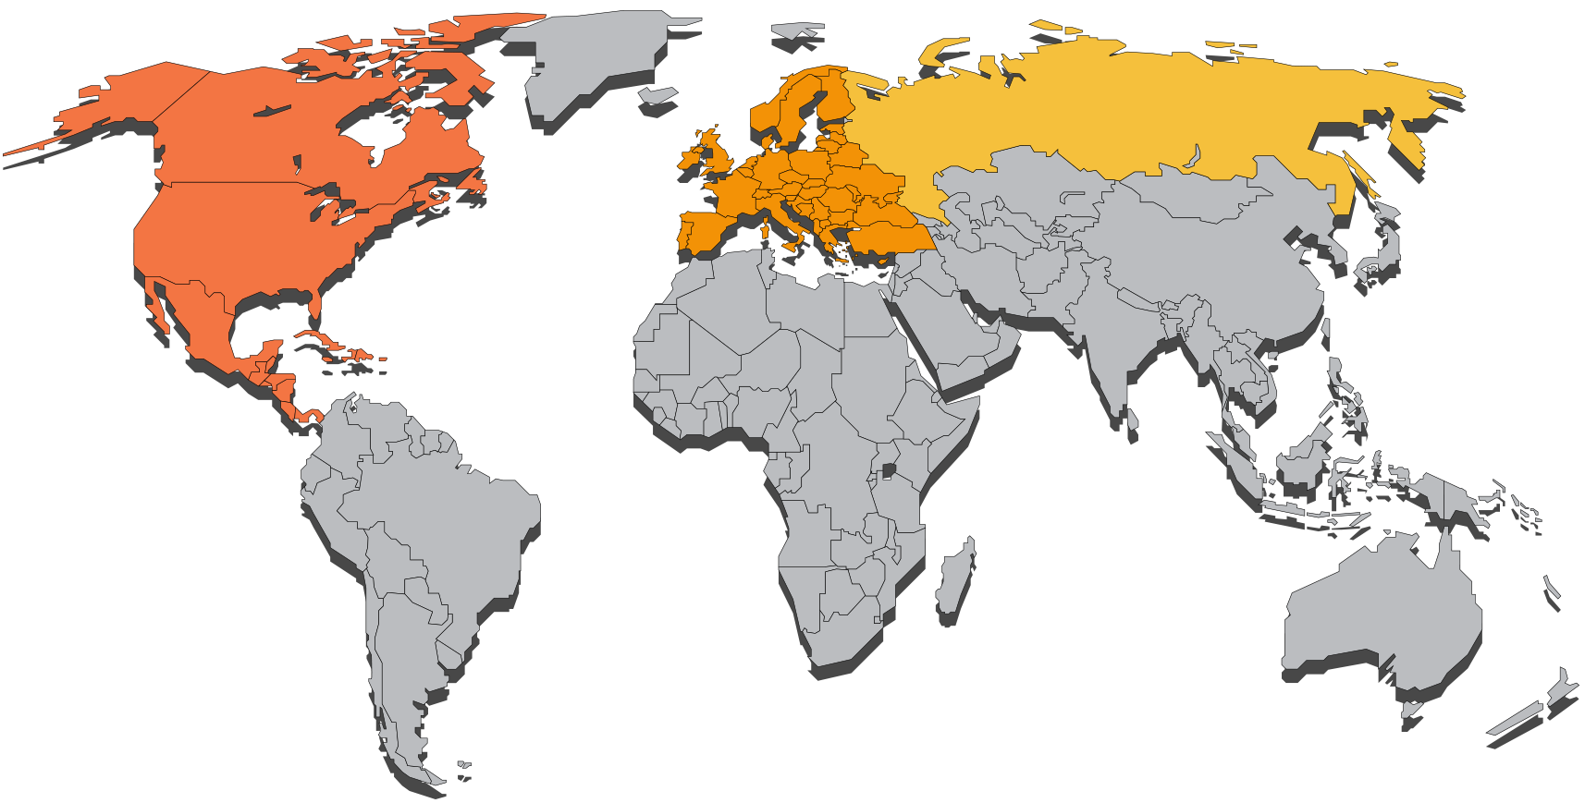



Global Infrastructure
Radware Cloud WAF POPs
Radware Scrubbing Centers
Coming soon
19
Notes:
Supporting the world’s only single vendor Hybrid Solution in the industry, Radware’s global network of mitigation devices totals over 1Tbps of mitigation capacity. This capability is spread strategically across scrubbing centers around the world for when volumetric attacks threaten to saturate customers’ link capacity. Radware scrubbing centers are designed to serve major markets with minimal latency, and are constantly being expanded and upgraded based on the growth of the customer base and changes in DDoS attack trends.
In addition, for its always-on security cloud services (Hybrid Cloud WAF), Radware has security cloud POPs already available in the US (Chicago and Virginia areas) and UK. In addition, we have a new partnership with IBM Softlayer where we can quickly build new PoPs in any of IBM Softlayer's data centers (www.softlayer.com/data-centers).

Slide 20
Radware’s Attack Mitigation Device (DefensePro)

Slide 21
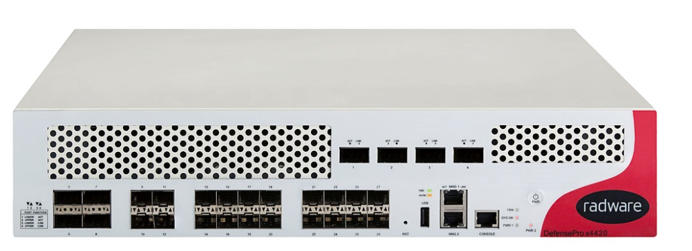


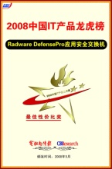



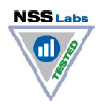






Real-Time Attack Mitigation with DefensePro
DefensePro is a real-time attack prevention device that protects your application infrastructure against network and application downtime, application vulnerability exploitation and network anomalies
21

Slide 22
Real-Time Attack Mitigation with DefensePro
Integrated Anti-DoS, IPS, SSL protection and Behavioral Analysis protection
Patent-protected behavioral analysis to limit false positives
Automatic real-time signature creation for zero-day attack prevention
Advanced challenge-response mechanism for accurate detection with minimal impact on legitimate traffic
Unique messaging between solution elements to maximize protection
22
Notes:
The Network Behavioral Analysis (NBA) module employs patented behavioral-based real-time signature technology. It creates baselines of normal network, application and user behavior. When anomalous behavior is detected as an attack the NBA module creates a real-time signature on- the-fly that uses the attack characteristics and starts blocking the attack immediately. In the case of DDoS attacks it injects the real-time signature into the DME hardware offloading the main CPUs from the excessive unwanted traffic.
Automatic Real-Time Signature Generation Module
In cases where the attack is unknown (zero-minute threat), it is a challenge to block the attack without simultaneously blocking legitimate traffic.
Radware utilizes probability analysis and closed-feedback loop technology in order to create an attack signature that characterizes the ongoing anomaly without the need for a human research vulnerability group.
Advanced Action Escalation Technology
The main idea behind this escalation approach is to first detect suspicious users (through the real time signature generation module) and second, to start and activate a set of actions beginning with the most “gentle” one that will have negligible, if any, impact on the legitimate user. Based on a closed-feedback loop, the system will decide if escalating to a more aggressive action is required.
The approach aims to minimize the impact on the human user experience while presenting a more accurate and adaptive response to the artificial users (for example, a bot).
A Truly Integrated System – Defense Messaging
Defense Messaging is a communications method developed by Radware which enables the different elements in Radware's attack mitigation solution to operate as a single system. This capability allows Radware's solution to apply the optimal detection technology deployment and maintain the ability to mitigate attackers at high performance and push them to the perimeter of the network.

Slide 23

DefensePro Protection Layers
  Behavioral protections
  Challenge response
  Access control
  Known vulnerabilities/tools
Application
Server
Network
DNS Protection
Behavioral HTTP Flood Protection
DNS Protection
Behavioral DoS
Behavioral HTTP Flood Protection
Behavioral DoS
SYN Protection
Anti-Scan
SYN Protection
Anti-Scan
Available Service
Server Cracking
Server Cracking
Connection Limit
Connection Limit
Out-Of-State
Out-Of-State
Signature Protection
Signature Protection
Connection PPS Limit
Connection PPS Limit
BL/WL
BL/WL
23

Slide 24


Dedicated Hardware to Fight Attacks
Non-Radware
Radware
10 Million
PPS
Attack
Traffic
Attack traffic does not impact legitimate traffic
10Gbps
Capacity
Legitimate
Traffic
+ Attack
10Gbps
Capacity
Legitimate
Traffic
1MPPS
2MPPS
5MPPS
Device handles attack traffic on the expense of legitimate traffic!
DefensePro
Other IPS Solutions
24
Notes:
Radware’s solution is supported on dedicated hardware designed to fight multiple attack vectors in parallel and limit impact on legitimate traffic

Slide 25

Beyond Primitive Source IP Blocking
Non-Radware
Radware
Source IP
Address Only
X.X.X.X
Signature with multiple parameters
Smart traffic blocking based on Real-Time Signature incorporating multiple parameters comparing to primitive source IP address blocking
25
Notes:
Traditional systems look at source IPs and create access lists to block.
Radware’s attack mitigation solution elements can look beyond source IP and block the attack based on attack characteristics. This is important when you have attacks with changing source Ips (dynamic IP attacks) or when the source IP does not identify the attacker itself (for example, attacks from behind the CDN).

Slide 26
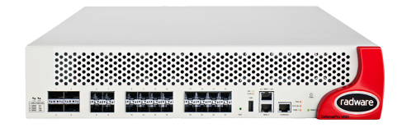

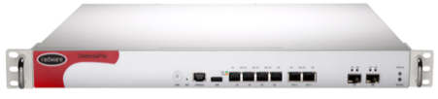
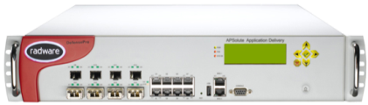
DefensePro Platforms Range
x06 Series
Branch / Small Enterprise Platform
x412 Series
Enterprise Platform
x420 Series Managed Service Platform
x4420 Series
Cloud & Carrier Platform
Coming Soon
Inspection Ports:
4x Copper, 2x1G
BW: 200M-2G
Mitigation BW:
3G
Size: 1U
Inspection Ports:
8x Copper, 4x1G, 4x10G
BW: 2G-12G
Mitigation BW:
14G
Size: 2U
Inspection Ports:
20x10G, 4x40G
BW: 10G-40G
Mitigation BW:
60G
Size: 2U
Inspection Ports:
20x10G, 4x40G, 4x100G
BW: 50G-160G
Mitigation BW:
300G
Size: 2U

Slide 27
DefensePro Behavioral Flow
Detection
Am I under attack?
Characterization
Who is attacking me?
Termination
Is the attack over?
Mitigation
What action do I take?
27

Slide 28
DefensePro Behavioral Flow
Detection: Am I under attack?
28

Slide 29
Rate & Rate-Invariant Behavioral Analysis
Rate Analysis
Flash Crowd
Rate Analysis
RST Flood Attack
29
Notes:
Systems will learn a certain rate and during an attack, block traffic beyond that rate.
Rates are not consistent.

Slide 30
DefensePro Behavioral Flow
Characterization: Who is attacking me?
30

Slide 31



Real-Time Signature Generation vs. Manual
Non-Radware
Radware
Manual Signature Generation
Real-Time Signature Generation
30 MINUTES
18 SECONDS
Manual signature creation can take up to 30 minutes.
Radware Real-Time Signature is generated in up to 18 seconds.
31

Slide 32

Network Behavior Analysis & RT Signature Technology
Public Network
Degree of Attack = High
Traffic characteristics
Learning
Inbound Traffic
Blocking Rules
Statistics
Detection Engine
Signature parameters
Source/Destination IP
Source/Destination Port
Packet size
TTL (Time To Live)
DNS Query
Packet ID
TCP sequence number
More … (up to 20)
Narrowest filters
Packet ID
Source IP Address
Packet size
TTL (Time To Live)
Outbound Traffic
RT Signatures
Protected Network
32

Slide 33
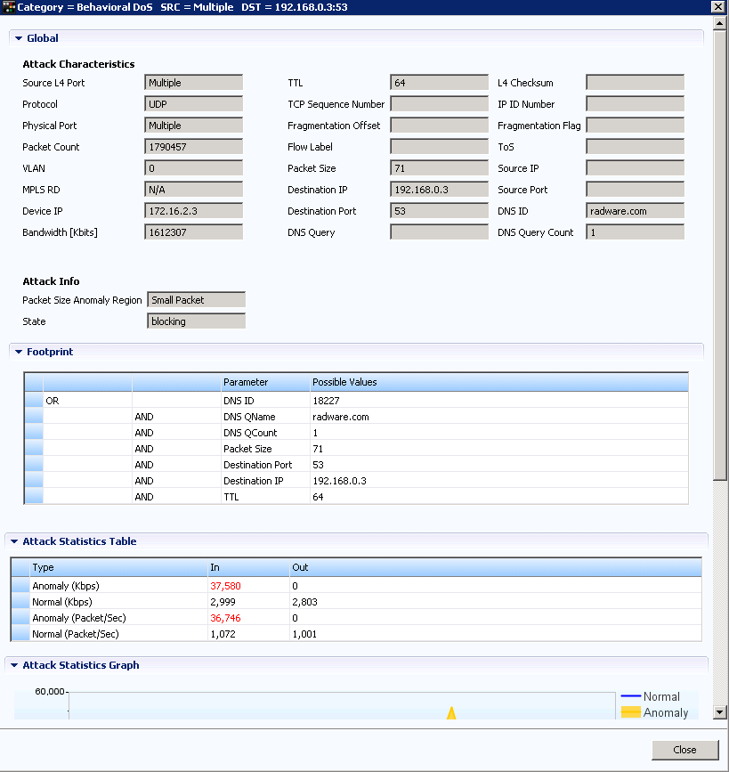
Network Behavior Analysis & RT Signature Technology
Mitigation optimization process
Closed feedback
Degree of Attack = Low
Initial Filter
Public Network
Degree of Attack = High
Learning
Start
mitigation
Final Filter
0
Up to 10 sec
10+X sec
Blocking Rules
Statistics
Detection Engine
Initial filter is generated: Packet ID
Filtered Traffic
Narrowest filters
Packet ID
Source IP Address
Packet size
TTL (Time To Live)
Degree of Attack = High
(Negative Feedback)
Filter Optimization:
    Packet ID AND Source IP
Degree of Attack = Low
(Positive Feedback)
    Packet ID AND Source IP AND Packet size
    Packet ID AND Source IP AND Packet size AND TTL
Real-Time Signature
Protected Network
33

Slide 34
DefensePro Behavioral Flow
Mitigation: What Action do I take?
34

Slide 35






Challenge/Response & Action Escalation System
Botnet is identified (suspicious traffic is detected per query type)
Attack
Detection
Real-Time signature created
DNS query challenge
Query rate limit
Collective query challenge
Collective query rate limit
Behavioral RT signature technology
RT signature scope protection per query type
Collective scope protection per query Type
Closed Feedback & Action Escalation
35

Slide 36
Radware’s Cloud Scrubbing Service (DefensePipe)

Slide 37






Protecting The Internet Link
Protected Organization
On Premises Mitigation
  Fastest time to protection
  No disruption of traffic
  Detailed forensics and visibility
Even the best on-premises solution cannot handle pipe saturation
On-premises AMS mitigates the attack
DefensePro
AppWall
Protected Online
Services
Internet
37

Slide 38




Protect The Internet Pipe with DefensePipe
Cloud Based Protection
Against Pipe Saturation
Industry First
Hybrid Solution
Activated Only
on Pipe Saturation Risk
Information sharing between cloud and on-premise
Global coverage through multiple scrubbing centers
38
Notes:
About 15% of DDoS attacks handled by Radware’s ERT in 2014 were saturating the Internet pipe
Radware’s Cloud Scrubbing Service – DefensePipe -
A Cloud based service protecting against Internet pipe saturation
Complementing the on-premise attack mitigation capabilities
Traffic is diverted only when attack threatens to saturate the pipe
Global coverage using multiple scrubbing centers in the cloud
Single point of contact for emergency response
Post attack full report and analysis

Slide 39


Hybrid DDoS Mitigation Solution
Radware On-Demand Cloud DDoS
Protected Organization
ERT and the customer decide to divert the traffic
DefensePros
Sharing essential information for attack mitigation
Volumetric DDoS attack that blocks the Internet pipe
On-premises AMS mitigates the attack
Defense
Messaging
DefensePro
AppWall
Protected Online
Services
Internet
39
Notes:
When an Attack Starts
On-premise attack mitigation device (DefensePro) mitigates attacks in real-time without ERT involvement
Defense Messaging
DefensePro sends ‘pipe utilization’ messages to DefensePipe
Defense Messages include also baselines and attack footprint so once diverted, the attack is immediately mitigated accurately – no learning curve
Single Point of Contact
Once a pre-defined threshold is reached, the ERT asks for the customer approval to divert the traffic to the cloud
Attack is handled with the customer from inception at the customer’s premise

Slide 40
Hybrid DDoS Mitigation Solution
Radware On-Demand Cloud DDoS
Protected Organization
ERT and the customer decide to divert the traffic
DefensePros
Sharing essential information for attack mitigation
Clean traffic
Defense
Messaging
DefensePro
AppWall
Protected Online
Services
Internet
40
Notes:
When an Attack Starts
On-premise attack mitigation device (DefensePro) mitigates attacks in real-time without ERT involvement
Defense Messaging
DefensePro sends ‘pipe utilization’ messages to DefensePipe
Defense Messages include also baselines and attack footprint so once diverted, the attack is immediately mitigated accurately – no learning curve
Single Point of Contact
Once a pre-defined threshold is reached, the ERT asks for the customer approval to divert the traffic to the cloud
Attack is handled with the customer from inception at the customer’s premise

Slide 41
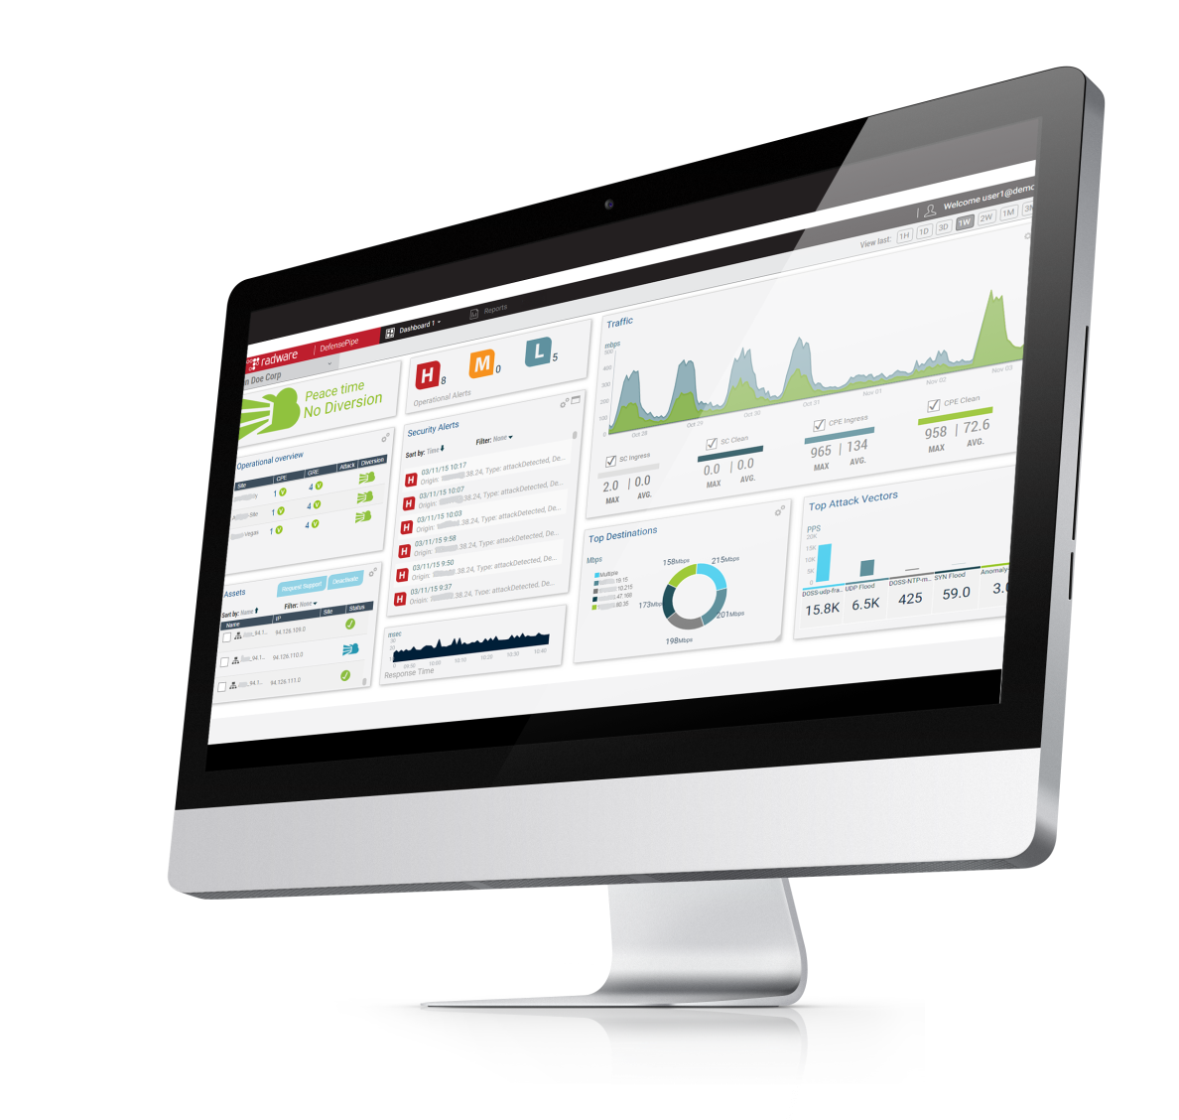
Customer Web Portal: Monitoring
Complete control of DDoS protection layers
  Real-time monitoring
  Traffic
  Attack information
  Alerts
  Overall view of elements assets status
  Top sources, top destination and top attack vectors
  Traffic diversion activation/deactivation
  Collection of attack data from on-premises and cloud equipment
  Customized view by time periods
  Comprehensive reporting features

Slide 42
Radware’s Security Command and Control (DefenseFlow)

Slide 43

Centralized Command and Control - DefenseFlow
DefenseFlow is a software product
Key features
  Behavioral-based attack detection
  Attack life cycle management
    Collects & analyzes security telemetries
    Provides intelligent security actions
Supported use cases:
  NetFlow-based attack detection
  3rd party NetFlow-based attack detection
  OpenFlow-based attack detection (SDN)
43

Slide 44

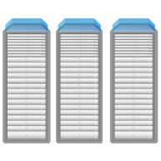







Use Case 1: NetFlow-based Attack Detection
Internet
Service Provider Network
Protected Objects
NetFlow Stats Collector
Scrubbing Center
DefensePro
DefenseFlow detects the attack (behavioral analysis)
DefenseFlow exports to DefensePro traffic baselines and diversion information
DefenseFlow diverts traffic for attack cleansing
44

Slide 45

Use Case 2: 3rd party NetFlow-based Attack Detection
Internet
Service Provider Network
Protected Objects
NetFlow Stats Collector
Scrubbing Center
DefensePro
Attack detection by the NetFlow Attack Detector
DefenseFlow configures DefensePro with Traffic baselines and diversion information
DefenseFlow Diverts traffic for attack cleansing
45

Slide 46

Use Case 3: OpenFlow-based Attack Detection (SDN)
Internet
Service Provider Network
Protected Objects
SDN Controller
Scrubbing Center
DefensePro
DefenseFlow Diverts suspicious traffic for attack cleansing
DefenseFlow detects the attack (behavioral analysis)
DefenseFlow configures DefensePro for attack information and traffic diversion
46

Slide 47




Summary of Use Cases
Case
Attack Detection
Traffic Redirection
Attack Mitigation
NetFlow Attack Detector
BGP Redirection
NetFlow Telemetry
BGP Redirection
DefensePro
OpenFlow (SDN) Telemetry
SDN Redirection
47

Slide 48
Service Provider Solution

Slide 49





Carrier/ISP: Network Diagram
Peering
Carriers/ISPs Local/International
Internet Service Provider
Corporate Internet Connection
Peering Edge
Transit Edge
Backbone
49

Slide 50



Carrier/ISP: Network Diagram
Tier 1: Infrastructure and Volumetric Protection (with 3rd party telemetry device)
Cloud
Carrier Scrubbing Center
Corporate LAN
Telemetry
Alert
Flow based telemetry used to detect network layer attacks from peering edges while high capacity Mitigation Center is used to protect infrastructure
50

Slide 51
Carrier/ISP: Network Diagram
Tier 1: Infrastructure and Volumetric Protection (with DefenseFlow as detector)
Cloud
Carrier Scrubbing Center
Corporate LAN
Telemetry
Flow based telemetry used to detect network layer attacks from peering edges while high capacity Mitigation Center is used to protect infrastructure
Unique Value:
Radware TM Behavioral Technology delivers the fastest time to mitigation and mitigation accuracy in Out-Of-Path Infrastructure Protection
51

Slide 52



Carrier/ISP: Network Diagram
Tier 2: Customer Applications Inline Protection – Small Enterprises
Cloud
Carrier Scrubbing Center
Corporate LAN
Signaling Traffic
Signaling Traffic
Unprotected Customer
DefensePro
AppWall
Unprotected Customer
Alteon SSL Accelerator
(optional)
Protected Customer
Unprotected Client Traffic
Unique Value:
  Immediate mitigation of application and network attacks
  Widest security coverage
  Signaling to Tier 1 for volumetric attacks
DC Applications protected by advanced inline detection with signaling to activate higher tier mitigation when necessary
Web applications protected by advanced web tier protection
52

Slide 53
Carrier/ISP: Network Diagram
Tier 2: Customer Applications Inline Protection – Small Enterprises
Cloud
Carrier Scrubbing Center
Corporate LAN
Signaling Traffic
Signaling Traffic
Unprotected Customer
Unprotected Customer
DefensePro
AppWall
Protected Customer
Unprotected Client Traffic
Alteon SSL Accelerator
(optional)
Unique Value:
  Dedicated hardware and resources per customer with full integration to Tier 1 mitigation
DC Applications protected by advanced inline detection with signaling to activate higher tier mitigation when necessary
Web applications protected by advanced web tier protection
53

Slide 54


Carrier/ISP: Network Diagram
Tier 2: Customer Applications Inline Protection – Peak Protection
Cloud
Carrier Scrubbing Center
Corporate LAN
Signaling Traffic
Signaling Traffic
Unprotected Customer
Unprotected Customer
DefensePro
AppWall
Protected Customer
Unprotected Client Traffic
Alteon SSL Accelerator
(optional)
Unique Value:
  Never run out of capacity when backed up by DefensePipe
  Full integration between DefensePipe mitigation to lower capacity tiers mitigation
54

Slide 55
Emergency Response Team

Slide 56
Emergency Response Team (ERT)
Protecting against top attack campaigns
Emergency Response Team (ERT) - 24x7 dedicated team of security experts for fast mitigation under attack
“We've been fortunate to be able to work with the ERT to help us deploy custom signatures that are very specific, reactive approaches to a customized attack, which has been a fantastic thing.”
Ron Winward, Director of Network Engineering, ServerCentral
56

Slide 57




ERT Premium Service
24/7 DDoS Protection
On-Premise Device Management
Online Portal & Reporting
Periodic Security
Consulting
Fully outsource the monitoring and management to Radware’s security experts
57
Notes:
24/7 Monitoring & Blocking of DDoS Attacks - Direct “Hot-Line” access - ‘Time to Security Expert’ SLA = 10 mins
On-Premise Device Management - Configuration of on-premise attack mitigation device
Online Portal & Reporting - network statistics, attacks’ situational awareness, historical reports, post-attack forensic analysis
Periodic Security Consulting - Periodic network security design & security configuration review

Slide 58






Radware's Security Services Organization
Monitoring customer equipment
Validate if false positive/negative
First line of mitigation
Reporting
Customer focal point
Project management
Consultancy
TAM
ERT Analyst
Cloud Operation
Automation & provisioning
Mitigate complex attacks
Forensics and analysis
Customer onboarding
Cloud OPS
ERT Expert
Scrubbing center management
Monitoring
Full research on malware and bots
Deep analysis on potential attackers
ERT NOC
Research
58

Slide 60



Service Catalogue and Consumption Models
Service Level | Threat Coverage | infrastructure
Silver | Tenant detection - L4 DDoS Tenant mitigation – L4-L7 DDoS Time to mitigation SLA - Minutes | Scrubbing Center
Gold | Tenant detection and mitigation – L4-L7 DDoS SSL Encrypted DDoS Time to mitigation SLA – Seconds | ‘Always-On’ + Scrubbing Center
Platinum | Tenant detection and mitigation – L4-L7 DDoS SSL Encrypted DDoS WAF - Directed Web, DLP Time to mitigation SLA – Seconds | ‘Always-On’ + WAF + Scrubbing Center
Diamond | Detection and Mitigation – L4-L7 DDoS SSL Encrypted DDoS Directed Web, DLP Time to mitigation SLA – Seconds | Hybrid – On-premise -WAF + CPE + Off-premise - Scrubbing Center
60

Slide 61
Radware’s SSL Mitigation Solution

Slide 62





SSL and Encrypted DDoS Attack Vectors
Single vendor, comprehensive SSL attack protection
HTTP Floods
Encoding and Evasion
Single Packet DDoS
Brute Force
Large volume TCP flood attacks
Syn Floods
SSL Session State Attacks
SSL Vulnerability exploitation and compliance attacks
App Misuse
Internet Pipe
Firewall
IPS/IDS
Load Balancer/ADC
Server Under Attack
SQL Server
Cloud DDoS protection
DoS protection
Behavioral analysis
IPS
WAF
SSL protection
62
Notes:
Single Vendor Comprehensive Protection Integrated solution with all security technologies

Slide 63


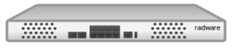


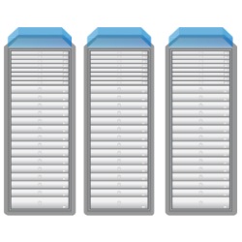


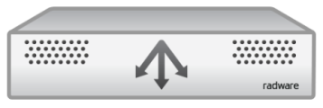
SSL Mitigation Solution Building Blocks
Cloud
Enterprise Data Center
HTTPS protection:
Layer 4 and HTTP
authentication
Alteon
Encrypted Traffic
Clear traffic
R1
R2
DefensePro
Protected Server
DefensePro – Deployed inline as a perimeter security device. Connected to both data-path and Alteon.
Alteon – Deployed in parallel to DefensePro without direct access to the network. Connected to DefensePro with two physical ports.
AppWall – Deployed within Alteon physical appliance in OOP mode, with a copy of the traffic for deep analysis.
63

Slide 64

SSL Mitigation and Signaling
Cloud
Enterprise Data Center
Defense
Messaging
Alteon
Defense
Messaging
DefensePro
  Main advantages:
Covers all SSL threats
Includes Encoding, Evasion, Single packet attacks
Includes SQLi over SSL – common attack which accompanies DDoS.
64

Slide 65

Radware SSL Solution Flow – Encrypted Traffic
Attacker
  Once an attack
  is detected
  L4 Challenge
  HTTPS Decryption
  Filters – signatures
  HTTPS with Web Cookie
  Authenticated
  Authenticated traffic
  directly to server
  HTTPS Attack Traffic
  SYN Attack Protection
  HTTP Filters
  Web Cookie Challenge
  Clean Traffic
  Main advantages:
Covers all SSL threats
Passive – Authenticated sources experience no added latency
Ingress-Only – Works in an ingress-only deployment scheme
65
Notes:
When a suspected attack is identified by DefensePro, a Network Challenge Response is activated to protect the environment from network floods. And the user is authenticated for Layer 4.
At this point an SSL Session is created by Alteon and SSL filters are applied to SSL traffic by DefensePro to protect from SSL layer threats.
The first HTTP request is decrypted and sent to DefensePro, which runs HTTP filter and sends an HTTP application Challenge to the user. If passed, the user is authenticated for Layer 7.
DefensePro then sends a redirect command which causes the user to generate a new session. The new session, of an authenticated user, is allowed to reach the origin server directly.
This unique deployment model enables a solution which introduces zero latency in peace time and minimal latency under attack – only on the first session per each client.

Slide 66
Radware SSL Solution Advantages
  Full coverage - detects all types of SSL encrypted attacks
    SSL Negotiation Floods
    HTTPS Floods
    Encrypted Web Attacks
Security Coverage
Deployment Flexibility
  Symmetric / Ingress only deployment
  Stateless solution - non-vulnerable mitigation architecture
Minimum Latency
  No attack - No added latency
  Under attack – 1st session per client only
Certificate Control
  On-premise – No requirement to export certificates
Notes:
Radware’s SSL mitigation solution in unique in the industry.
It mitigates SSL encrypted flood attacks at the network perimeter. In addition to Radware’s WAF (Web Application Firewall) which mitigates encrypted web application attacks carried over HTTPS.
Radware’s SSL solution features unique capabilities, as it mitigates SSL based attacks by authenticating suspicious sources prior to establishing a direct connection with the designated Web server. The result is lowest latency solution in the industry, it is non-vulnerable to attacks that target the SSL decryption layer, FIPS compliant & Common Criteria certified solution and provide by a single vendor with an integrated management
Offering the widest security coverage for availability threats over HTTPS
Full coverage - Detects all types of SSL encrypted attacks
SSL Negotiation Floods
HTTPS Floods
Encrypted Web Attacks
Stateless solution - Non-vulnerable mitigation architecture
Lowest latency approach - Legitimate transactions go through without decryption
FIPS compliant & common criteria certified solution
Single vendor, integrated management

Slide 67
Radware’s Application and Security Management System (APSolute Vision)

Slide 68

Centralized Management & Reporting with Vision
Key modules and capabilities:
  Multi-device configuration and monitoring
  Security monitoring – real time and historical
  Device level monitoring
  Service level monitoring
  Advanced productivity capabilities for streamlining day-to-day operations
  ReST API for automation and integration with 3rd party tools
Available in multiple form factors – physical or virtual appliance
68

Slide 69








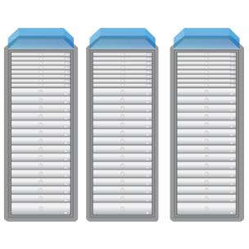

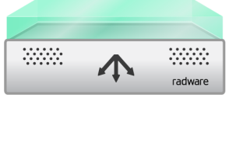
Attack traffic
Management Solution Architecture
Clean traffic
Config / event feed
Defense Messaging
ז
Perimeter
WAN
LAN
REST
DefensePipe
HTTP
FVaaS
WAFaaS
Email/syslog
WAF
Defense
Messaging
Defense Messaging
69

Slide 70
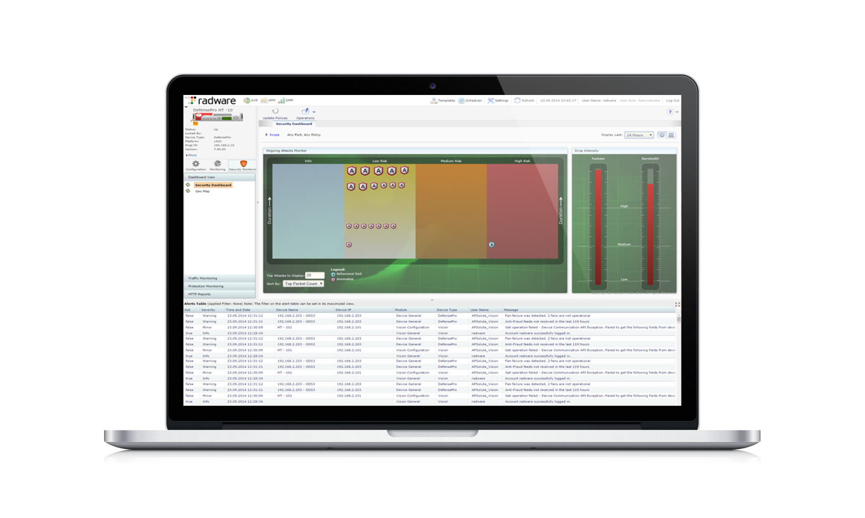
Built in Security Information and Events Management (SIEM)
Real Time Monitoring
Historical Reporting Engine
Customizable Dashboards
Event Correlation Engine
Advanced Forensics Reports
Compliance Reports
Ticket Work Flow Management
3rd Party Event Notifications
Role/User Based Access Control
Works with all Radware’s Security Modules
70

Slide 71
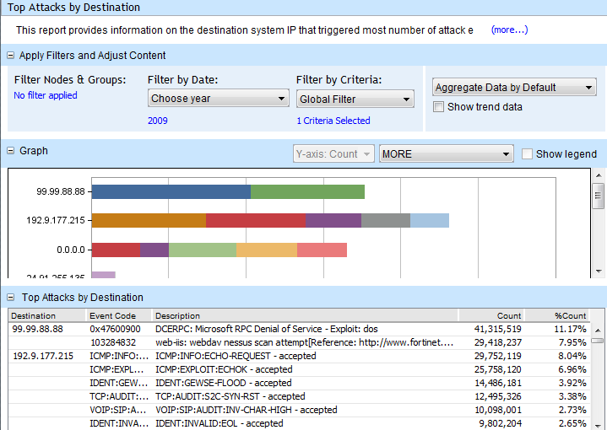
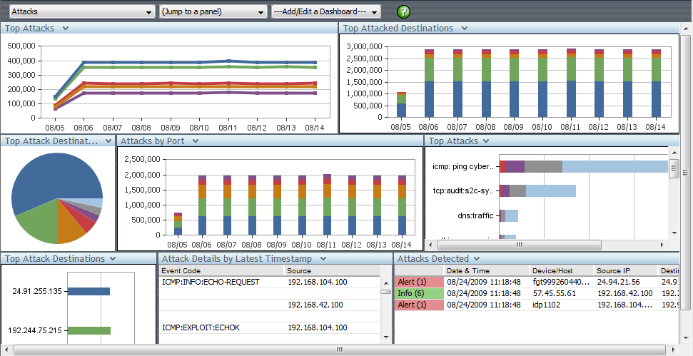
Multi Tenancy Support
  Separate processing capabilities per tenant
  Role based access control for management permissions per policy
  Each tenant can view and monitor only the resources that are relevant for them
  Personalized, per tenant, historical reporting, dashboards and event management
71

Slide 72

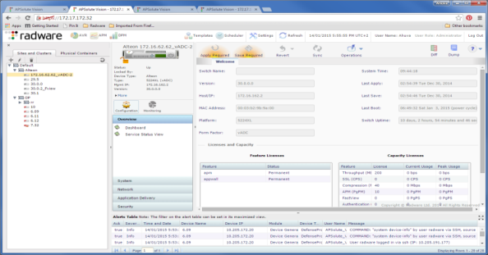


REST API Communication
SNMP, HTTPS
DefensePro Devices
APSolute Vision ReST API over HTTPS
APSolute Vision Server
Alteon ReST API
over HTTPS
Alteon Devices
72

Slide 73
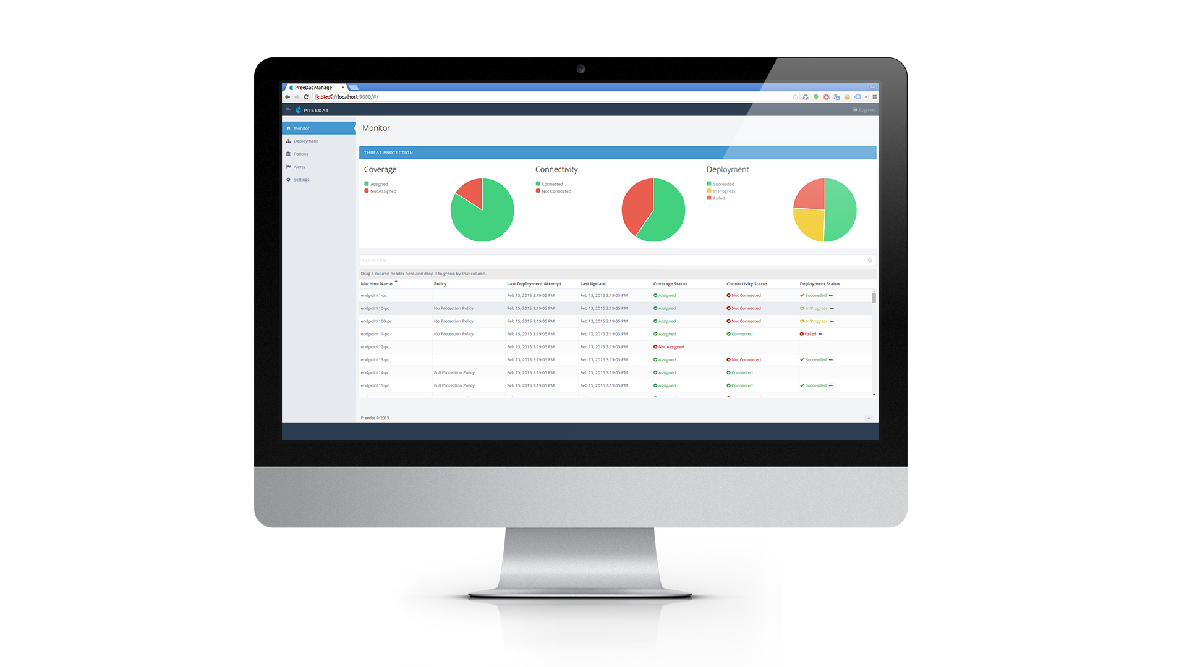
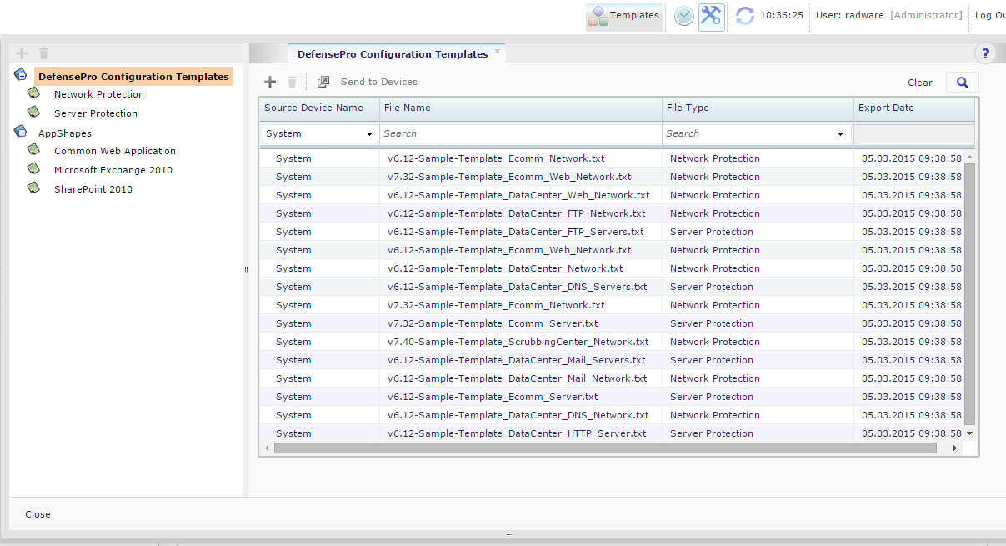
Predefined DefensePro Configuration Templates
A list of predefined DefensePro Configuration Templates is bundled with Vision Installation
73

Slide 74
Security Management System Capacity
Topic | Physical Appliance, Full-Scale VA, and Vision with APM Server VA Capacity | Demo-Scale VA Capacity
User Accounts | Unlimited | Unlimited
Concurrent Users | 50 | 1
Maximum managed Alteon devices (Standalone, VA, ADC-VX, and vADC) | 1000 | 10
Maximum managed DefensePro devices | 40 | 2
Total managed devices | 1000 | 2
Attacks stored in APSolute Vision Reporter | 100M
74

