Slide 1
GÉANT Data Protection Code of Conduct (CoCo)
Mikael Linden, CSC - the Finnish IT Center for Science
Attribute release training
15 June 2015

Slide 2
GEANT Data Protection Code of Conduct
Work started 2011
Community consultations and a pilot with CLARIN 2012-2013
Ver 1.0 published 6/2013
Legal document (4 pages)
  17 clauses for SPs
Supporting framework
  Technical documents (EC)
  Good practices, templates, cookbooks
  Tools
  https://wiki.refeds.org/display/CODE

Slide 3
Data Protection Code of Conduct approach
Learn SP’s commitment
GEANT Data protection Code of Conduct
Commit to
HO
SP
Learn SP’s commitment
Commit to
HO
SP
HO
Learn SP’s commitment
Commit to
SP
Currently: 38
Currently: 51
Service Providers (SP) commits to the CoCo
Federations (and eduGAIN) relies SPs’ commitment to Home Organisations (HO)
  Using SAML2 metadata (Entity Category)
HO decides if it feels confident to release attributes to the SP

Slide 4
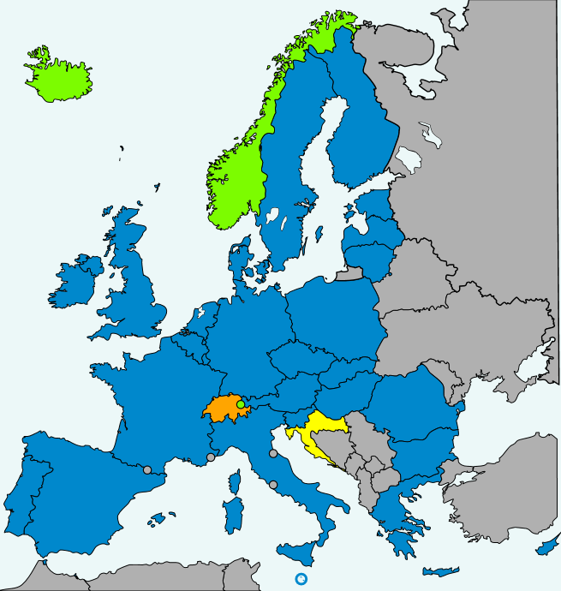

Code of Conduct and the Data Protection directive
CoCo based on the EU Data protection directive (95/46/EC)
An SP can commit to the CoCo if it is established in an EEA country (*)
EU is currently revising its data protection law
  We are following the development
 | Service Provider in EEA (*) | Service Provider outside EEA(*)
Home Organisation in EEA | Primary focus | Not supported by the current CoCo alone
Home Organisation outside EEA | Not the primary focus, but EU’s data protection laws may convince some HOs | Vague or not supported
(*) or the EC whitelist of countries:
http://ec.europa.eu/justice/data-protection/document/international-transfers/adequacy/index_en.htm
Notes:
"European Economic Area Agreement" by IgnisFatuus * derivative work : Blue-Haired Lawyer, Danlaycock - CC BY-SA 3.0

Slide 5
Federations are different
Some federation policies cover data protection issues already
Some federation policies are silent on data protection
  Or just say ”IdPs and SPs must comply with the law”
CoCo tries to introduce a data protection overlay for the (fragmented) federations
  For cross-federation/jurisdiction interoperability
Federations can incorporate the CoCo to their national policies, if they wish
  CC BY-SA 3.0
CoCo
Federation policy coverage
Federation B
Federation C
Federation A

Slide 6
Data protection directive and the Code of Conduct
Legal foundations.
Obligations for an SP that commits to the CoCo.

Slide 7
EU Data protection directive
Definitions
Definitions (Art 2a):
Personal data: ”any information relating to an identified or identifiable natural person”
CoCo approach:
To be in the safe side, CoCo assumes all attributes released by the HO qualify as personal data (even SAML2 persistent ID or eduPersonAffiliation alone).

Slide 8
EU Data protection directive
Definitions
Definitions (Art 2 d,e):
Data Controller: organisation ”which alone or jointly with others determines the purposes and means of the processing of personal data”
Data Processor: organisation “which processes personal data on behalf of the controller”
CoCo approach:
HO is a data controller
which may have outsourced IdP operations to a subcontractor or the federation operator (possibly a data processor)
SP is a data controller
However, HO and SP can override this and agree else
Federation (and interfederation) may be a joint data controller

Slide 9
EU Data protection directive
Purpose of processing personal data
Purpose of personal data processing (Art 6.1b)
Must be defined beforehand
You must stick to that purpose.
CoCo approach:
The SP commits to process personal data for enabling access to the service.
The SP can deviate from that purpose, if the user gives his/her (freely given) consent (to the SP).

Slide 10
EU Data protection directive
Data minimisation
Relevance of personal data (Art 6.1c)
Personal data processed must be adequate, relevant and not excessive
CoCo approach:
The SP minimizes the attributes requested from a Home Organisation to those that are adequate, relevant and not excessive for enabling access to the service.
Where a number of Attributes could be used, the SP will request the least intrusive Attributes possible
Technical implementation: <md:RequestedAttributes>

Slide 11
EU Data protection directive
Data retention
Data retention (Art 6.1e)
Personal data must be kept in a form which permits identification of data subjects for no longer than is necessary for the purposes for which the data were collected
CoCo approach:
The SP commits to delete or anonymise all Attributes as soon as they are no longer necessary for the purposes of providing the service.

Slide 12
EU Data protection directive
Security of processing (Art 17)
The controller must implement appropriate technical and organizational measures to protect personal data against accidental or unlawful destruction or accidental loss, alteration, unauthorized disclosure or access, in particular where the processing involves the transmission of data over a network, and against all other unlawful forms of processing.
Having regard to the state of the art and the cost of their implementation, such measures shall ensure a level of security appropriate to the risks represented by the processing and the nature of the data to be protected.
CoCo approach:
The SP commits to the protect personal data (CoCo text 1:1 from the directive)

Slide 13
EU Data protection directive
Informing the data subject (Art 11)
The controller must when the data are first disclosed provide the data subject with at least the following information:
a) the identity of the controller;
b) the purposes of the processing;
c) any further information such as…
CoCo approach:
The SP commits to provide to the End User, at least at first contact, in an easily, directly and permanently accessible way a Privacy Policy, containing at least the following information: …
Technical implementation – SP’s SAML2 metadata:
SP’s name and identity <mdui:Displayname>
SP’s purpose <mdui:Description>
Privacy policy <mdui:PrivacyStatementURL>

Slide 14
EU Data protection directive
Legal grounds (Art 7)
Personal data may be processed only if
User consents, or
Processing is necessary for performance of a contract to which the user is a subject, or
The controller has a legal obligation to process personal data, or
Necessary for vital interests of the user, or
Necessary for a task carried out in public interest, or
Necessary for the legitimate interests of the data controller
CoCo approach:
The SP commits to ”only process attributes that are necessary for enabling access to the service” -- refers to (f).
No requirements for HOs (because HOs don’t commit to CoCo). Supporting documentation suggests (f) for HOs, too.

Slide 15
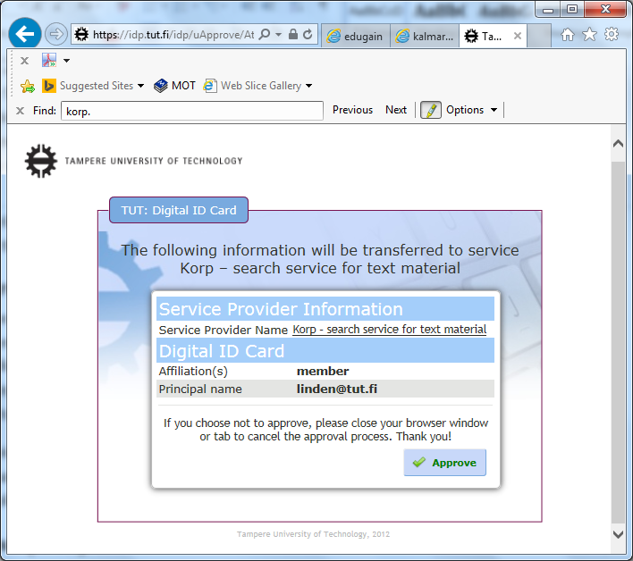
CoCo Supporting documentation:
Informing the end user in the IdP side
The SP’s name (mdui:DisplayName)
A resolvable link to the SP’s privacy policy (mdui:PrivacyStatementURL)
No word ”consent” used
Suggests Attribute release based on ”legitimate interests legal grounds”, not on ”user consent”
The user is just informed (e.g. uApprove, a Shibboleth Identity provider extension module, above)

Slide 16
Other obligations for the SP in the CoCo
CoCo approach:
SP transferring Attributes to a third party
The SP commits not to transfer Attributes to a third party except
The third party is the SP’s data processor,
The third party is committed to the CoCo or similar, or
The user has given his/her (freely given) consent (to the SP)
SP transferring attributes outside EEA (and the EC whitelist)
The SP commits to ensure appropriate measures depending on the HO’s laws, such as user consent or EC model contracts.

Slide 17
Finally…
CoCo approach:
Governing law
The country in which the Service Provider is established.
- The country where the SP has the core of its economical functions
- The SP indicates its jurisdiction in its privacy policy
CoCo approach:
Eligibility to execute
The SP warrants that the commitment to the CoCo is done by an authorised representative of the SP.
- Not necessarily the technical admin of the SP

Slide 18
Code of Conduct technically

Slide 19
SP’s Commitment to the CoCo is represented as an Entity Category
http://www.geant.net/uri/dataprotection-code-of-conduct/v1
  Entity category attribute (for SPs)
  Entity category support attribute (for IdPs)
An SP asserting the EC attribute claims that
  It is in EEA or the EC whitelist of countries
  It has committed to the Code of Conduct
  It conforms to the SAML2 metadata profile of the Coco
The registrar (SP’s home federation)
  Registers SP’s assertion
  Performs the technical steps described in the Operator guidelines documents

Slide 20
SAML2 metadata profile for the CoCo
Service Providers
The Entity Category attribute (MUST)
mdui:PrivacyStatementURL (MUST)
mdui:DisplayName (RECOMMENDED)
mdui:Description (RECOMMENDED)
Md:RequestedAttribute with isRequired=”true” for necessary attributes
  saml:AttributeValue element, if the SP requires only a particular value (e.g. eduPersonAffiliation= ”member”)
Identity Providers
The Entity Category support attribute (MUST)
MUST at least in English (xml:lang="en")

Slide 21
Examples on mdui:DisplayName and mdui:Description
Displayname and Description SHOULD be meaningful both to the users of the service and to readers not affiliated with the service
DisplayName
Helsinki University's Moodle learning management system
University of Tübingen's Weblicht tool for linguistics research
Description
SAS-download gives access to SAS®-software for qualified users.
bibliotek.dk gives access to all public Danish libraries, and allows users to search for and order materials.
WebLicht is a chaining tool for linguistics research. It provides an execution environment for automatic annotation of text corpora.
The intention is that the IdP can display them to the user in the attribute release GUI (e.g. uApprove)

Slide 22

Code of Conduct document suite
Normative documents:
Data Protection Code of Conduct for SPs in EU/EEA
SAML2 profile for the DP CoCo
Entity category attribute definition for the DP CoCo
Cookbooks:
For Service Providers
For Identity Providers
For Federation operators
Non-normative, informational documents:
Introduction
Introduction to the DP directive
Risk management
Privacy policy guidelines
What attributes SP can request
Good practice for Home Organisations
Federation operator guideines
Handling non-compliance
IdP GUI guidelines
  https://wiki.refeds.org/display/CODE/

Slide 23
CoCo doesn’t have a fixed attribute set
However, the Cookbook refers to eduGAIN’s RECOMMENDED attribute set for IdPs to populate
displayName
cn
mail
eduPersonAffiliation, eduPersonScopedAffiliation,
eduPersonPrincipalName,
SAML2 Persistent NameID (eduPersonTargetedID),
schacHomeOrganization
schacHomeOrganizationType

Slide 24
Other CoCo resources

Slide 25
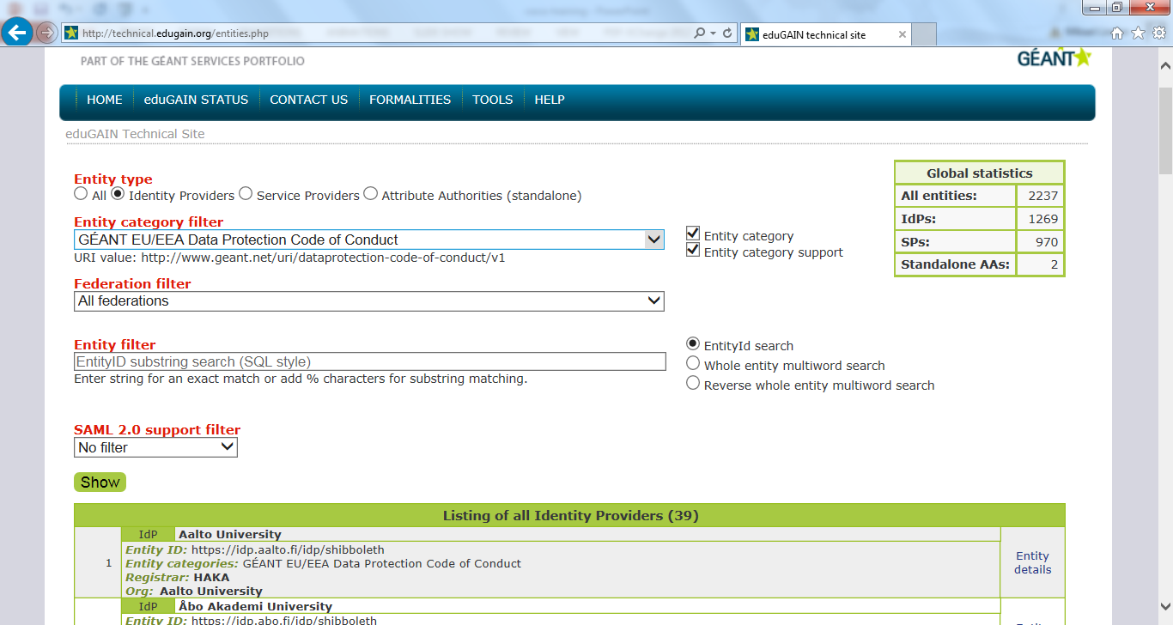
eduGAIN Entity listing http://technical.edugain.org/entities.php

Slide 26
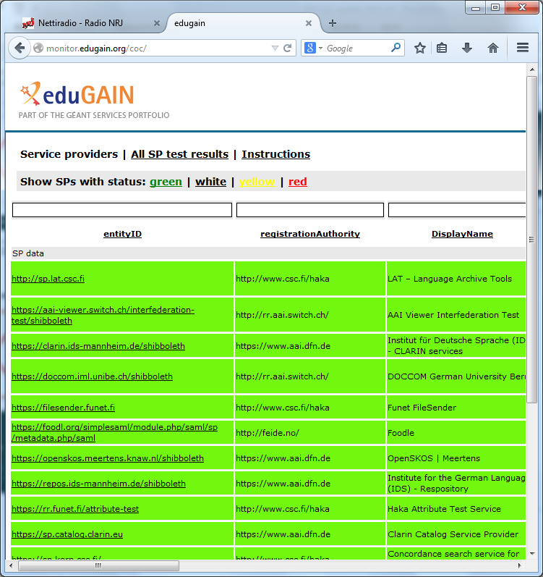
GÉANT CoCo monitoring tool http://monitor.edugain.org/coco/
Monitors the technical compliance of the CoCo-SP in eduGAIN metadata
Green: the SP is OK
Yellow: recommended parts missing
  SP’s name and description in English
Red: the SP fails to comply to the CoCo
  No privacy policy
  Privacy policy does not refer to the CoCo
  No requested attributes
New: custom metadata file check:
http://monitor.edugain.org/coco/?show=cod

Slide 27
Research communities endorsing the Code of Conduct
CLARIN, DARIAH, DASISH, ELIXIR, WLCG
”Adopting the Code of Conduct makes the work of researchers easier, reduces uncertainty and overheads for Identity Provider administrators, and could potentially increase your organisation’s scientific output.”
https://wiki.edugain.org/
CoCoEndorsement

Slide 28
Future plans for the Code of Conduct
CoCo submitted to EU’s data protection authorities for evaluation
Following the reform of the EU’s data protection law
  General data protection regulation
Preparing an ”international” Code of Conduct for attribute release out of EEA

Slide 29
Work in progress:
International Code of Conduct
GEANT Data protection Code of Conduct
HO
Commit to
Commit to
SP
HO
Commit to
Commit to
SP
Commit to
+
Commit to
HO
SP
EC Contractual Clauses
In EU/EEA
Outside EU/EEA
Draft memo: https://wiki.refeds.org/x/5YEY

Slide 30
Questions?

Slide 31
Thank you!

Slide 32
Some frequently asked questions
Q: Why GÉANT, not eduGAIN?
A: Wanted to leave the door open for use outside WebSSO?
Q: Can I use it also locally in my fed?
A: Yes, federations can incorporate the CoCo in their national policy. Everything is released under CC BY-SA
Q: Is it stable?
A: yes, although the WP29 consultation and General Data Protection Regulation probably results to some updates
Q: Will there be a CoCo with ”higher level of assurance”
A: Another CoCo with an obligation to audit for SPs is suggested…

