Slide 1
Code of Conduct and R&S in H&S
(Mostly SURFconext)
Femke Morsch
Arnout Terpstra

Slide 2
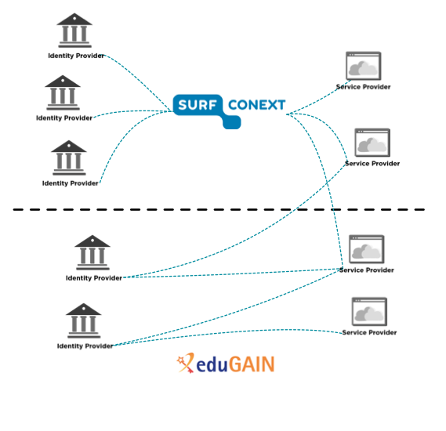
SURFconext and eduGAIN
Notes:
Our hub & spoke setup
Our IdPs are offered individually → “Dutch scoping”. Not 1 big fat proxy
Why include eduGAIN like this?
We don’t want to save information about users from foreign IdPs
Unknown increase in administrative burden (and support and load to our platform)

Slide 3
SURFconext and policies
SURFconext policy
SURFconext policy
SURFconext policy
SURFconext policy
Code of Conduct
SURFconext policy
Regular eduGAIN
Code of Coduct
Regular eduGAIN
Regular eduGAIN
Notes:
You might not expect it (some people see the Netherlands as sodom & gomorra), but our SURFconext policy is very strong. Within federation, attribute release is a non-issue (trust levels are high).

Slide 4
SURFconext vs. Code of Conduct
Comparing Code of Conduct to SURFconext policy:
Based on the same European laws, but:
CoCo describes principles, whereas SURFconext policy describes an elaboration of those principles, leaving less up to interpretation
CoCo dictates contents of privacy policy
SURFconext requires regular audits (every 1 or 2 years)
SURFconext describes what to do when authorities request a user's personal data
Goal: include all CoCo principles in policies for SPs within SURFconext

Slide 5
SURFconext and Code of Conduct
Our advise to our members:
IdPs: CoCo SPs comply to (the same) European laws as SURFconext SPs. But mind the small differences (it's up to you)
SPs (SURFconext): if you already signed a (recent) SURFconext contract, you can easily sign the CoCo as well
SPs (eduGAIN) connected to our hub: support CoCo (requirement)
… some IdPs hesitate to connect to eduGAIN SPs; more fine-grained filtering is requested

Slide 6
CoCo Challenges
Who is responsible for what?
    Should we check whether a SP really complies to the CoCo?
    Do our institutions assume we are checking this?

Slide 7
SURFconext and R&S
Identity Providers:
Attribute release is managed centrally (and manually)
No opt-out for attributes in federation policy
Currently no capabilities for automatic attribute release, based on entity categories
Change to OpenConext is needed. Priority is not high.
  So far, 2 IdPs want to ‘consume’ all R&S SPs automatically
Service Providers:
For SPs, full support upon request
We assess SPs, attributes, and pass on metadata. That’s all.
Notes:
Within SURFconext, attribute release is less of an issue
As the central entity helps SPs negotiate with IdPs

Slide 8
R&S Challenges
R&S definition to broad? (Candidates should support … at least in part)
    Are Google and Box.net R&S compliant?
Definition of attribute bundle is ambiguous? (Minimal subset vs. strongly encouraged attribute bundle)
    What is the maximum set that can be requested? If there is no maximum set, how can the risk be assessed?
How about SPs that require no attributes? (Only NameID)
    Can they be part of R&S?
(Our) institutions are already struggling with eduGAIN. R&S is adding complexity, but lacking ‘marketing’
    We are helping with documentation and education.

