Slide 1
udpmon for Network Troubleshooting
A Hands-On Session
Richard-Hughes Jones
Senior Network Advisor, Office of the CTO
GÉANT Association - Cambridge
eduPERT Training Session, Porto
18/06/2015

Slide 2
What is udpmon?
Software package for investigating end host and network performance, using UDP/IP frames.
Programs work in client-server pairs to:
  Transmit streams of sequenced UDP packets at regular, carefully controlled intervals.
  Can vary frame size and frame transmit spacing.
  Receive and check the sequence & timing of the packets.
  Identify if packets lost in the end host or network.
Allows measurement of:
  Request-response latency.
  Achievable UDP bandwidth, packet loss, packet ordering, jitter.
  Packet dynamics & packet loss patterns.
  Quality of the connection path and its stability.

Slide 3
The client-server pairs
udpmon_bw_mon → udpmon_resp
  Achievable UDP bandwidth, packet loss, packet ordering, jitter
  Packet dynamics & packet loss patterns
udpmon_req → udpmon_resp
  Request-response latency
udpmon_send → udpmon_recv
  Quality of the connection path and its stability
  Time series of achievable UDP bandwidth, packet loss

Slide 4
Latency Measurements
Round trip times measured using Request-Response UDP frames
Latency as a function of frame size
  Slope is given by:
    Mem-mem copy(s) + pci + Gig Ethernet + pci + mem-mem copy(s)
  Intercept indicates: processing times + HW latencies
Histograms of ‘singleton’ latency measurements
Tells us about:
  Behavior of the IP stack
  The way the HW operates
  Interrupt coalescence
  Performance of the LAN / MAN / WAN
udpmon_req
udpmon_resp
Request
Latency
Respond
Response
●●●
Time

Slide 5
Achievable UDP Throughput Measurements
Send a controlled stream of UDP frames spaced at regular intervals with
64 bit sequence numbers & send time stamp. Record the packet receive time.
Sender
Receiver
Zero stats set concurrent lockout
OK done
Send data frames at regular intervals
●●●
Inter-packet time
(Histogram)
●●●
Time to send
Time to receive
Get remote statistics
Send statistics back:
No. received
No. lost + loss pattern
No. out-of-order
No. lost in network
CPU load
No. interrupts & SNMP
Tx, Rx times & 1-way delay
Signal end of test
OK done
Time
Number of packets
n bytes
•••
Wait time
time

Slide 6
What udpmon records
Packets
  Num received
  Num lost: in network, in total
    Also: loss pattern
  Num arrived out of order
Timestamps when packet sent & received
  Packet jitter inter-packet arrival times
  Relative 1-way delay
CPU load on end hosts
Bytes Received and Bytes/frame rate
Elapsed time (microseconds)
Receiver data rate and wire rate (Mbit/s)

Slide 7
udpmon in Burst Mode
Send a set of regularly spaced UDP frames
Wait for a specified period – the gap
Emulates TCP slow start
Useful to investigate
  Bandwidth impedance miss-matches
  Buffering issues
no. packets
n bytes
•••
•••
wait
time
gap time
time

Slide 8
Time-Series Measurements
Useful for stability tests and checking for intermittent faults.
  Send a steady stream of regularly spaced UDP frames for a given (long) period.
udpmon_bw_mon → udpmon_resp
  Packet Dynamics
    Record packet statistics & for each packet the send and receive time stamps. Plot:
      Lost packets as function of packet number / time
      Inter-packet transmit times as function of packet number / time
      Inter-packet arrival times as function of packet number / time
  Packet Loss Patterns
    Record the lost packets – info from last valid received packet for each “lost packet”
udpmon_send → udpmon_recv
  Network Stability
  Send a UDP flow for several days.
  At the receiver take a snapshot of the packet statistics every few sec (e.g. 10 s)
  record the incremental statistics for that period with the time of that period.
  Plot packet loss as a function of the elapsed time during the measurement.

Slide 9

Start the receiver
- and bind to a specific port
On the receiver side start udpmon_resp
  The –S option sets the receiver and sender buffer to 300000 Bytes
[sbin]$ ./udpmon_resp –S300000
[sbin]$
By default udpmon uses port 14233
It is possible to change the port with option –u
(Must use the same port for udpmon sending )
[sbin]$ ./udpmon_resp –S300000 –u5001
[sbin]$

Slide 10
Send a train of equally spaced packets
On the sender side, we can send a train of 100 packets with 50 µs spacing
<host> name or IP address
$ udpmon_bw_mon -d <host> -w50 -l100
pkt len; num_sent; inter-pkt_time us; send_user_data_rate Mbit; num_recv; num_lost; num_badorder; %lost; num_lost_innet; %lost_innet; recv_user_data_rate Mbit; recv_wire_rate Mbit;
64; 100; 50; 10.1587; 100; 0; 0; 0; 0; 0; 10.3002; 20.9222
udpmon sends these values back from udpmon_resp

Slide 11
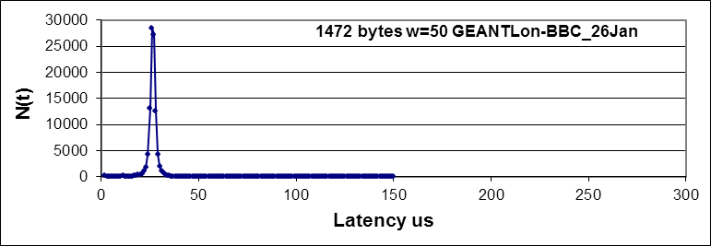
Histograms:
Packet jitter – inter-packet arrival times
Sending a train of 100 packets with 50 µs spacing and creating a histogram
$ udpmon_bw_mon -d <host> -w50 –H –B10
-l100
64; 100; 50; 10.1547; 100; 0; 0; 0; 0; 0; 10.297; 20.9159;
Hist 0 Time between frames us counts 99 mean 49.74 underflows 0 overflows 1
...
30 ; 4
40 ; 47
50 ; 43
60 ; 3
...
A simple signature of counts in 0-4 μs bin indicates interrupt coalescence in use at the receiving host.

Slide 12
Making sets of throughput measurements
Make a set of measurements with the wait time -w incremented by -i (increment) until -e (end)
$ udpmon_bw_mon -d <host> -w0 -i1 –e7 -l100
pkt len; num_sent; inter-pkt_time us; send_user_data_rate Mbit; num_recv; num_lost; num_badorder; %lost; num_lost_innet; %lost_innet; recv_user_data_rate Mbit; recv_wire_rate Mbit;
64; 100; 0; 14.3097; 100; 0; 0; 0; 0; 0; 14.5294; 29.5128;
64; 100; 1; 25.6513; 100; 0; 0; 0; 0; 0; 27.808; 56.4849;
64; 100; 2; 32.7157; 100; 0; 0; 0; 0; 0; 45.1977; 91.8079;
64; 100; 3; 36.9942; 100; 0; 0; 0; 0; 0; 41.9948; 85.3018;
64; 100; 4; 31.1246; 100; 0; 0; 0; 0; 0; 34.9822; 71.0577;
64; 100; 5; 27.9324; 100; 0; 0; 0; 0; 0; 29.1721; 59.2559;
64; 100; 6; 34.2017; 100; 0; 0; 0; 0; 0; 61.3027; 124.521;
64; 100; 7; 33.8848; 100; 0; 0; 0; 0; 0; 61.0614; 124.031;

Slide 13
Changing the packet size
Make a set of measurements with the wait time -w incremented by -i (increment) until -e (end)
The option –p allows to set the packet size.
-p is the size of the user data:
for 1500 Byte MTU max is 1472 Bytes.
for 9000 Byte MTU max is 8972 Bytes.
$ udpmon_bw_mon -d <host> -p 1472 -w0 -i1 –e7 -l100
pkt len; num_sent; inter-pkt_time us; send_user_data_rate Mbit; num_recv; num_lost; num_badorder; %lost; num_lost_innet; %lost_innet; recv_user_data_rate Mbit; recv_wire_rate Mbit;
1472; 100; 0; 424.82; 100; 0; 0; 0; 0; 0; 95.952; 100.254;
1472; 100; 1; 604.828; 100; 0; 0; 0; 0; 0; 95.4543; 99.7341;
1472; 100; 2; 600.204; 100; 0; 0; 0; 0; 0; 95.4318; 99.7107;
1472; 100; 3; 395.035; 100; 0; 0; 0; 0; 0; 95.0912; 99.3548;
1472; 100; 4; 436.633; 100; 0; 0; 0; 0; 0; 95.4519; 99.7317;
1472; 100; 5; 737.383; 100; 0; 0; 0; 0; 0; 95.4604; 99.7406;
1472; 100; 6; 357.498; 100; 0; 0; 0; 0; 0; 95.4589; 99.739;
1472; 100; 7; 619.463; 100; 0; 0; 0; 0; 0; 95.9231; 100.224;

Slide 14
Using the option –L for packet loss report
Using the option -L the program will print a detailed report for each of the first (10) LOST packets
$ udpmon_bw_mon -d <host> -w50 -l100 -L10
pkt len; num_sent; inter-pkt_time us; send_user_data_rate Mbit; num_recv; num_lost; num_badorder; %lost; num_lost_innet; %lost_innet; recv_user_data_rate Mbit; recv_wire_rate Mbit;
64; 100; 50; 9.24355; 82; 18; 0; 18; 18; 18; 7.56278; 15.3619;
lost event; recv_time 0.1us; send_time 0.1us; diff 0.1us; one_way time us; lost packet num; ;delta recv_time us; delta send_time us; num packets between losses;
1; 104150201; 104090779; 59422; -1.04091e+07; 3; ; 1.0415e+07; 1.04091e+07; 3
2; 104152807; 104092814; 59993; -1.04093e+07; 7; ; 260.6; 203.5; 4
3; 104152940; 104093815; 59125; -1.04094e+07; 9; ; 13.3; 100.1; 2
4; 104155534; 104096364; 59170; -1.04096e+07; 14; ; 259.4; 254.9; 5
5; 104155534; 104096364; 59170; -1.04096e+07; 15; ; 0; 0; 1
6; 104158213; 104097890; 60323; -1.04098e+07; 17; ; 267.9; 152.6; 2
7; 104166034; 104106711; 59323; -1.04107e+07; 34; ; 782.1; 882.1; 17
8; 104168430; 104108247; 60183; -1.04108e+07; 37; ; 239.6; 153.6; 3
9; 104173533; 104114060; 59473; -1.04114e+07; 48; ; 510.3; 581.3; 11
10; 104173756; 104115079; 58677; -1.04115e+07; 50; ; 22.3; 101.9; 2

Slide 15
General approach for testing (1)
ping <host>
traceroute <host> both directions to check the path
udpmon to check the connection:
Then run a udpmon bandwidth and packet loss test
Receiving host
$ udpmon_resp –S 200000
Sending host
$ udpmon_bw_mon -d <host> -p 1472 –w 123 -l1000
Receiving host
$ udpmon_resp –S 200000
Sending host
$ ./cmd_throughput_lite.pl -d <host> -o sto-man -l 10000

Slide 16
General approach for testing (2)
If it fails . . .
Try to identify which direction fails to pass UDP packets
Check the firewalls in the host – need an iptables term like
Call your NOC for help with router ACLs
Receiving host
$ udpmon_recv –S 200000
Sending host
$ udpmon_send -d <host> -p 1472 –w 123 -l1000
# udpmon
-A INPUT -p udp -m udp --dport 14233 -j ACCEPT

Slide 17
Some examples of
looking at udpmon data

Slide 18
UDP achievable throughput graph
Ideal shape
Flat portions
Limited by capacity of link
Available BW on a loaded link
Shape follows 1/t
Packet spacing most important.
Cannot send packets back-2-back
End host: NIC setup time on PCI / context switches

Slide 19
Packet jitter plots
Histograms of inter-packet arrival times for equally spaced packets
(1472 Bytes packets, with 50µs spacing in this case)
This is a really good jitter plot, really narrow and no side bands

Slide 20
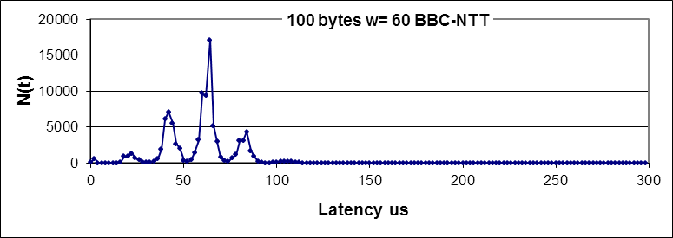
Using packet jitter to discover queuing
Histograms of inter-packet arrival times for equally spaced packets
Indicates how queuing along the path shows on a jitter plot:
  Side bands
  Multiple peaks
This is a typical shape of a busy link with cross traffic
May not be any packet loss

Slide 21
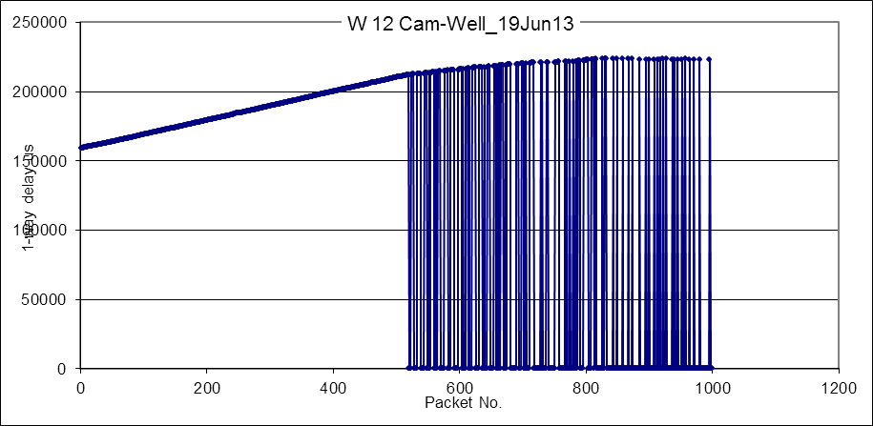
One-way delay on a link with queuing and losses
Queuing signature
Packet loss signature

Slide 22
Looking for Lost Packet Distributions
./udpmon_bw_mon -w20 -L500 -x –d <host> -p 1472 -l 1000000
Three trials at about 600 Mbit/s
Plot shows packets lost in long bursts at different times into the test.

Slide 23
Network Stability: Lost Packet Events
./udpmon_recv ./udpmon_recv -S 300000 -T10 > udp_tseries_HK-netmon.txt &
./udpmon_send –d <host> -d 62.40.120.154 -p1472 -w12304 -t 604800 &
1 Mbit/s flow for 24 Hr period
Plot shows packet loss events as function of time
Histogram of the number of loss events per 2 hour period .

Slide 24
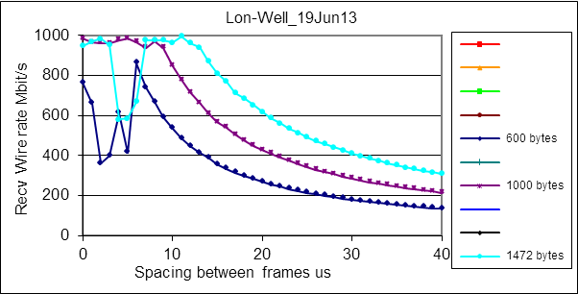
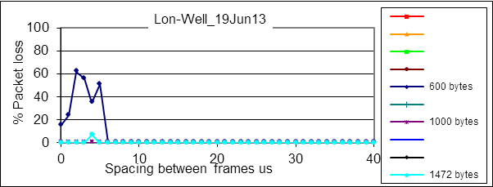
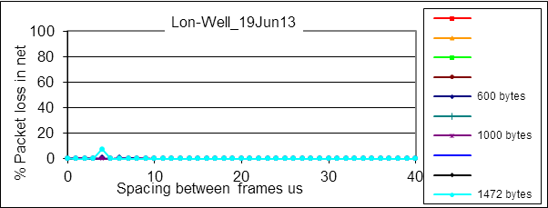
London-Wellington: Throughput
Most packets lost at receiver
Packets lost in the end-host
Total packet loss:
Network+Receiver
Some packets lost in the network

Slide 25
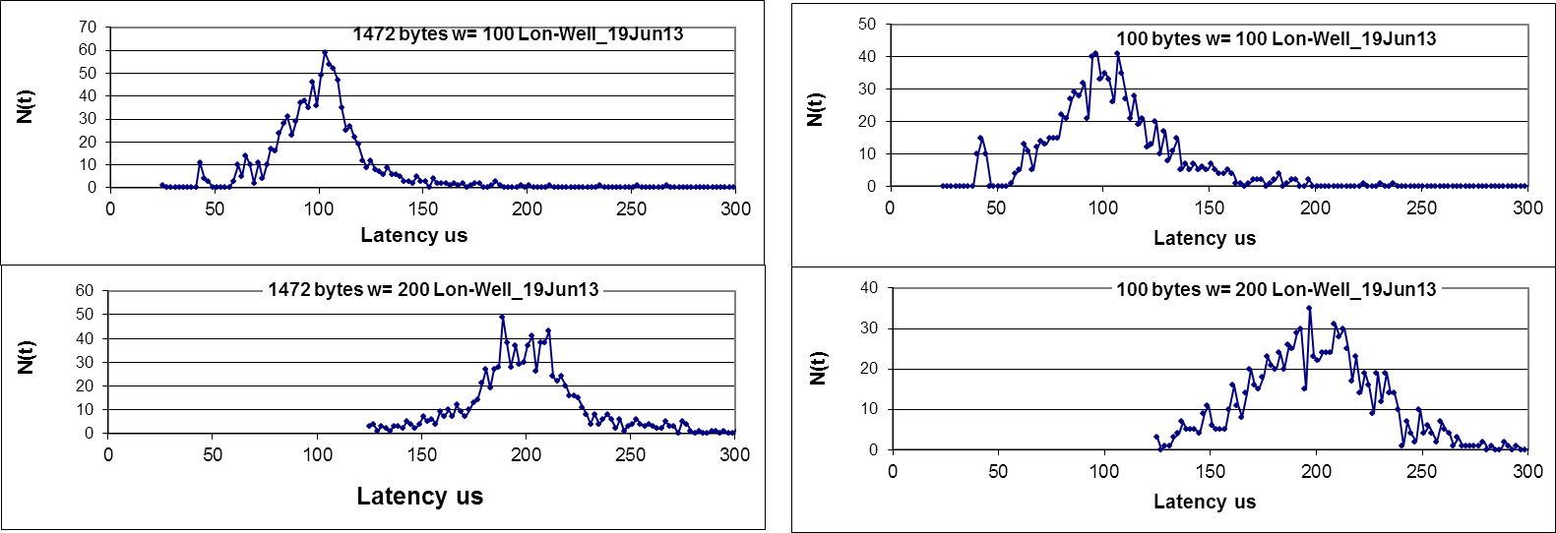
London-Wellington: Jitter
(1-way delay variation) distribution
Distribution of inter-packet arrival time for equally spaced packets
(Packets send at100 µs-top and 200 µs-bottom)
The narrower the peak, the smaller the queues from Source to Destination
FWHM ~50 µs for 1472 Bytes and up to ~70 µs for 100 Byte packets.

Slide 26
Network limits the bandwidth
EXPReS 4 Gigabit GÉANT Plus circuit
Stockholm to London PoP January 2008
Alcatel Metro Core Connect MCC Flow control OFF
rx-usecs=25 so Interrupt Coalescence ON
MTU 9000 bytes
Max throughput 4.05 Gbit/s
Packet loss
as expected
Falls to zero
at 4.05 Gbit/s
BBC to NTT

Slide 27

Network switch limits behaviour
End2end packets from udpmon
Only 700 Mbit/s throughput
Lots of packet loss
1-way delay & Packet loss
distribution shows
throughput limited

Slide 28
Richard-Hughes Jones
Richard.Hughes-Jones@geant.org

