Slide 1

Troubleshooting Network Performance Issues with Active Monitoring
TNC15 Edupert Workshop
Brian Tierney, ESnet, bltierney@es.net
June 18, 2015
This document is a result of work by the perfSONAR Project (http://www.perfsonar.net) and is licensed under CC BY-SA 4.0 (https://creativecommons.org/licenses/by-sa/4.0/).

Slide 2
What is perfSONAR?
perfSONAR is a tool to:
  Set (hopefully raise) network performance expectations
  Find network problems (“soft failures”)
  Help fix these problems
All in multi-domain environments
These problems are all harder when multiple networks are involved
perfSONAR is provides a standard way to publish active and passive monitoring data
  This data is interesting to network researchers as well as network operators

Slide 3
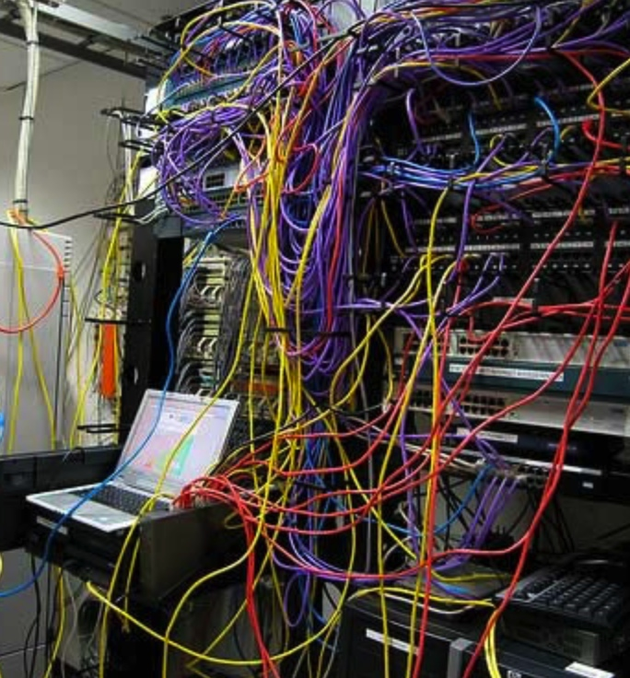
Problem Statement
In practice, performance issues are prevalent and distributed.
When a network is underperforming or errors occur, it is difficult to identify the source, as problems can happen anywhere, in any domain.
Local-area network testing is not sufficient, as errors can occur between networks.
Notes:
Issues are

Slide 4

Where Are The Problems?
Congested or faulty links between domains
Latency dependant problems inside domains with small RTT
Source
Campus
Backbone
Destination
Campus
S
D
NREN
Regional
Congested intra- campus links
Notes:
Isolating problems is challenging – consider the following sets of domains. If things are ‘slow’, it could be anything (or multiple things)
We need something that examines the entire path, and pulls out trouble

Slide 5
Local Testing Will Not Find Everything
Performance is poor when RTT exceeds ~10 ms
Performance is good when RTT is < ~10 ms
Source
Campus
R&E
Backbone
Destination
Campus
S
D
Switch with small buffers
Regional
Regional
Notes:
The magic buffer zone – if we are < 10ms, we often don’t see problems. Throughput still works well because TCP can perform well over short distances with lots of loss.
As we get further out, we notice the pain.
This leads to some false diagnostics at times – e.g. if we have a problem locally, but we only see it when we go far away, its tempting to say the problem is out there, far away. See the switch with small buffers locally as the example.

Slide 6
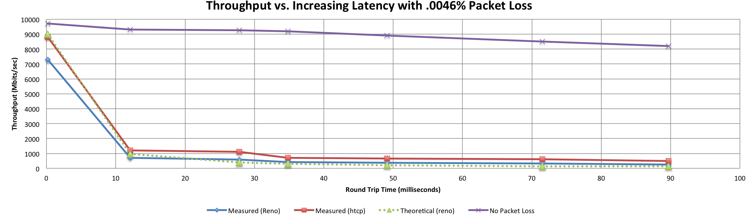
A small amount of packet loss makes a huge difference in TCP performance
Local
(LAN)
With loss, high performance beyond metro distances is essentially impossible
International
Metro Area
Regional
Continental
Measured (TCP Reno)
Measured (HTCP)
Theoretical (TCP Reno)
Measured (no loss)
Notes:
This is an annotated version of the plot from the Science DMZ paper
Beyond your metro area, zero loss is essentially required for high performance
Where are your collaborators? Where are your users?
When global collaboration is the norm, nobody can afford to be a local-only resource

Slide 7
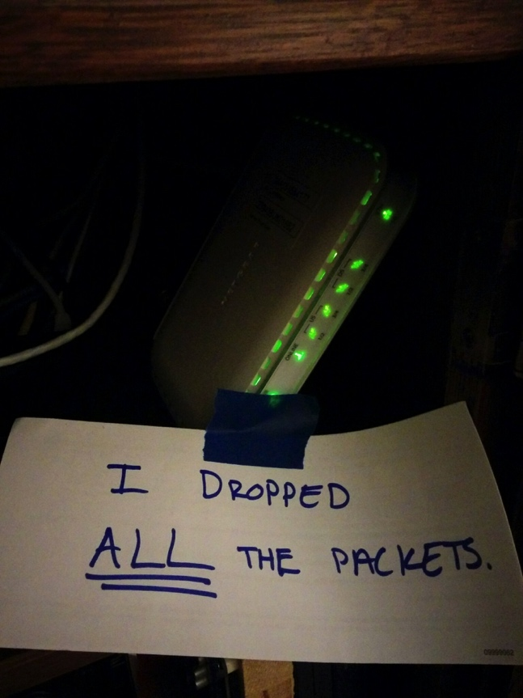
Soft Network Failures
Soft failures are where basic connectivity functions, but high performance is not possible.
TCP was intentionally designed to hide all transmission errors from the user:
  “As long as the TCPs continue to function properly and the internet system does not become completely partitioned, no transmission errors will affect the users.” (From IEN 129, RFC 716)
Some soft failures only affect high bandwidth long RTT flows.
Hard failures are easy to detect & fix
  soft failures can lie hidden for years!
One network problem can often mask others
Hardware counters can lie!
Notes:
Introduce the soft network failure – not a loss of connectivity. This is what perfSONAR is designed to find since they are challenging to see unless you are testing end to end over a large distance.

Slide 8
Hard vs. Soft Failures
“Hard failures” are the kind of problems every organization understands
  Fiber cut
  Power failure takes down routers
  Hardware ceases to function
Classic monitoring systems are good at alerting hard failures
  i.e., NOC sees something turn red on their screen
  Engineers paged by monitoring systems
“Soft failures” are different and often go undetected
  Basic connectivity (ping, traceroute, web pages, email) works
  Performance is just poor
How much should we care about soft failures?
Notes:
Answer: we need to care *a lot* about soft failures – see next

Slide 9



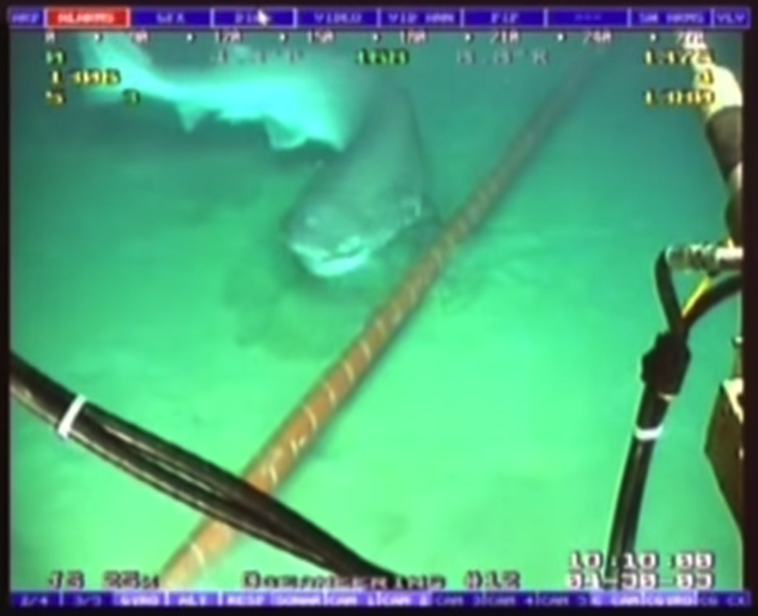
Notes:
Images from cable survey robot – came close to being a hard failure!

Slide 10
Causes of Packet Loss
Network Congestion
  Easy to confirm via SNMP, easy to fix with $$
  This is not a ‘soft failure’, but just a network capacity issue
  Often people assume congestion is the issue when it fact it is not.
Under-buffered switch dropping packets
    Hard to confirm
Under-powered firewall dropping packets
    Hard to confirm
Dirty fibers or connectors, failing optics/light levels
    Sometimes easy to confirm by looking at error counters in the routers
Overloaded or slow receive host dropping packets
    Easy to confirm by looking at CPU load on the host

Slide 11
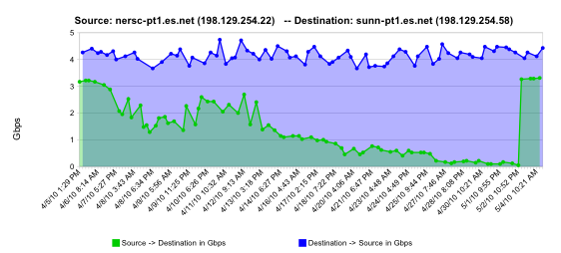
Sample Soft Failure: failing optics
normal performance
Gb/s
degrading performance
repair
one month
Notes:
This graph shows how perfsonar identified failing optics leading to a repair and improvement in performance

Slide 12
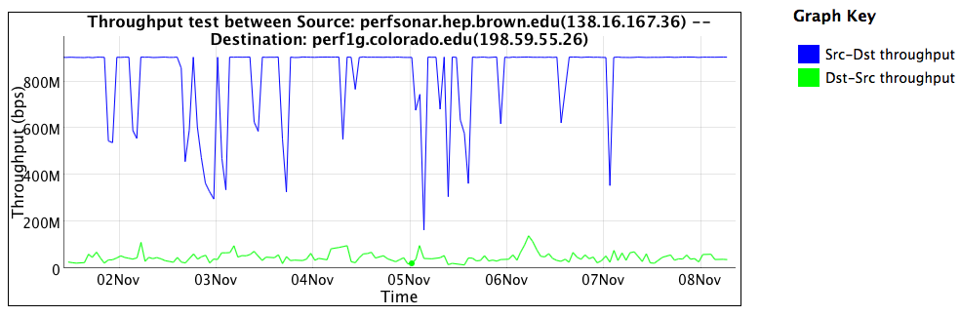
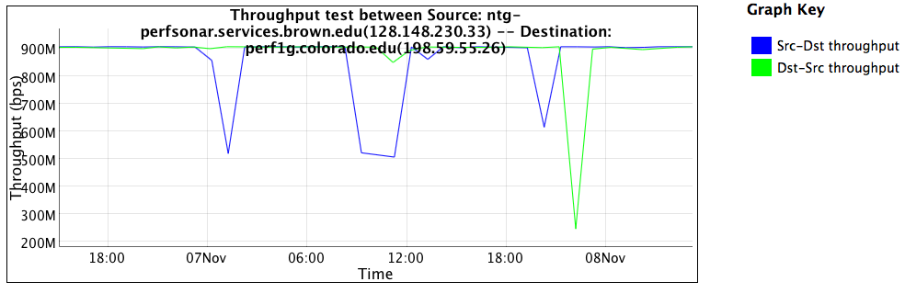
Sample Soft Failure: Under-powered Firewall
Inside the firewall
One direction severely impacted by firewall
Not useful for science data
Outside the firewall
Good performance in both directions

Slide 13
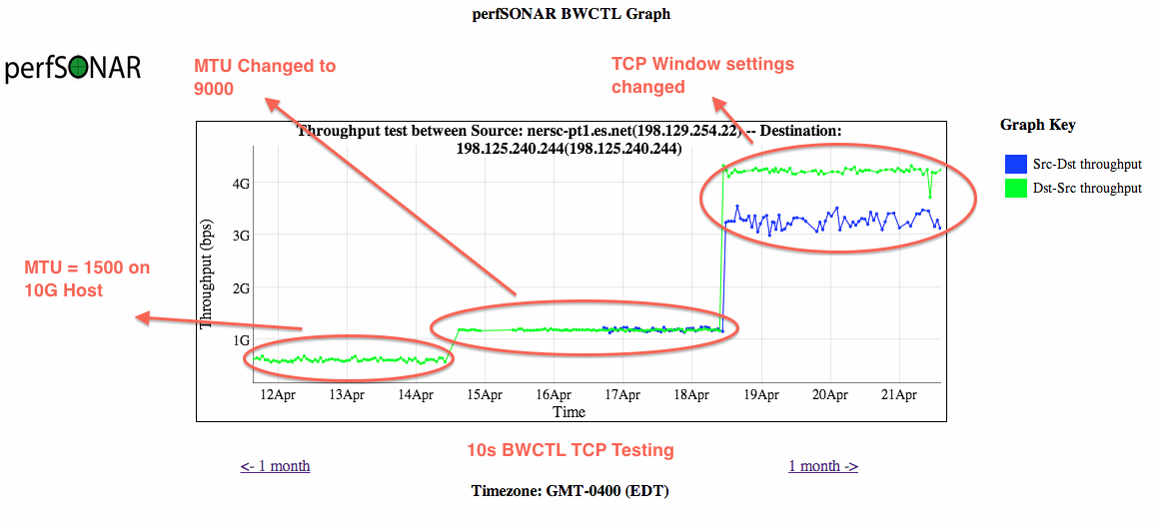
Sample Soft Failure: Host Tuning
Notes:
This graph shows how perfsonar identified host tuning leading to a repair and improvement in performance

Slide 14
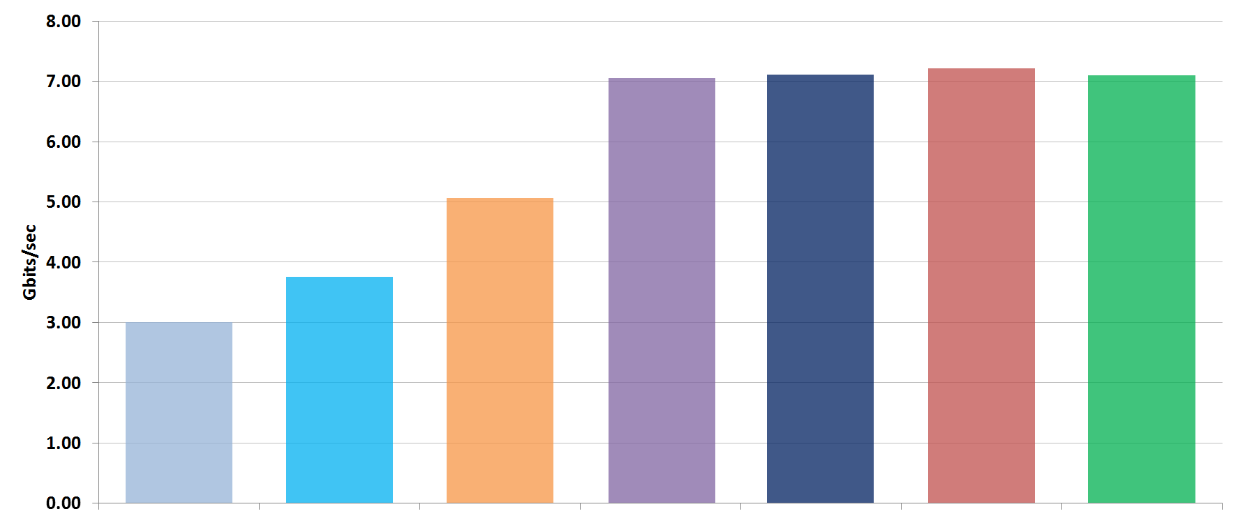
Average TCP results, various switches
Soft Failure: Under-buffered Switches
Buffers per 10G egress port, 2x parallel TCP streams,
50ms simulated RTT, 2Gbps UDP background traffic
1MB
Brocade
MLXe¹
9MB
Arista
7150
16MB
Cisco
6704
64MB
Brocade
MLXe¹
90MB
Cisco
6716²
200MB
Cisco
6716³
VOQ
Arista
7504

Slide 15
What is perfSONAR?
perfSONAR is a tool to:
  Set network performance expectations
  Find network problems (“soft failures”)
  Help fix these problems
  All in multi-domain environments
These problems are all harder when multiple networks are involved
perfSONAR is provides a standard way to publish active and passive monitoring data
perfSONAR = Measurement Middleware
  You can’t fix what you can’t find
  You can’t find what you can’t see
  perfSONAR lets you see
Notes:
Enables Federation
Service oriented
Designed with ‘multi-domain’ in mind
Brings together useful tools to address different needs
Several active and passive tools
Interface to configure regular testing
Diagnostic tools ready with ‘0 configuration’
Easy to install, easy to use
ISO image can be burned to CD/USB key
‘Wizard’ interface for configuration
Encouraging people to deploy ‘known good’ measurement points near domain boundaries
“known good” = hosts that are well configured, enough memory and CPU to drive the network, proper TCP tuning, clean path, etc.
Community Adoption
Over 1300 instances seen world wide
40+ countries
100s of domains

Slide 16
perfSONAR History
perfSONAR can trace its origin to the Internet2 “End 2 End performance Initiative” from the year 2000.
What has changed since 2000?
  The Good News:
    TCP is much less fragile; Cubic is the default CC alg, autotuning is and larger TCP buffers are everywhere
    Reliable parallel transfers via tools like Globus Online
    High-performance UDP-based commercial tools like Aspera
  The Bad News:
    The wizard gap is still large
    Jumbo frame use is still small
    Under-buffered and switches and routers are still common
    Under-powered/misconfigured firewalls are common
    Soft failures still go undetected for months
    User performance expectations are still too low
Notes:
Improvements in 15 years since the idea came about – but lots of room to grow

Slide 17
The perfSONAR collaboration
The perfSONAR collaboration is a Open Source project lead by ESnet, Internet2, Indiana University, and GEANT.
  Each organization has committed 1.5 FTE effort to the project
  Plus additional help from many others in the community (OSG, RNP, SLAC, and more)
The perfSONAR Roadmap is influence by
  requests on the project issue tracker
  annual user surveys sent to everyone on the user list
  regular meetings with VO using perfSONAR such as the WLCG and OSG
  discussions at various perfSONAR related workshops
Based on the above, every 6-12 months the perfSONAR governance group meets to prioritize features based on:
  impact to the community
  level of effort required to implement and support
  availability of someone with the right skill set for the task

Slide 18
perfSONAR Toolkit
The “perfSONAR Toolkit” is an open source implementation and packaging of the perfSONAR measurement infrastructure and protocols
  http://www.perfsonar.net
All components are available as RPMs, and bundled into a CentOS 6-based “netinstall” (Debian support in next release)
perfSONAR tools are much more accurate if run on a dedicated perfSONAR host, not on the data server
Very easy to install and configure
  Usually takes less than 30 minutes
Notes:
Install via the ISO – RPMs if you don’t want to do that

Slide 19

perfSONAR Toolkit Components
BWCTL for scheduling periodic throughout (iperf, iperf3), ping and traceroute tests
OWAMP for measuring one-way latency and packet loss (RFC4856)
“esmond” for storing measurements, summarizing results and making available via REST API
Lookup service for discovering other testers
On-demand test tools such as NDT (Network Diagnostic Test)
Configuration GUIs to assist with managing all of the above
Graphs to display measurement results
Notes:
Mention NDT used by MLAB

Slide 20
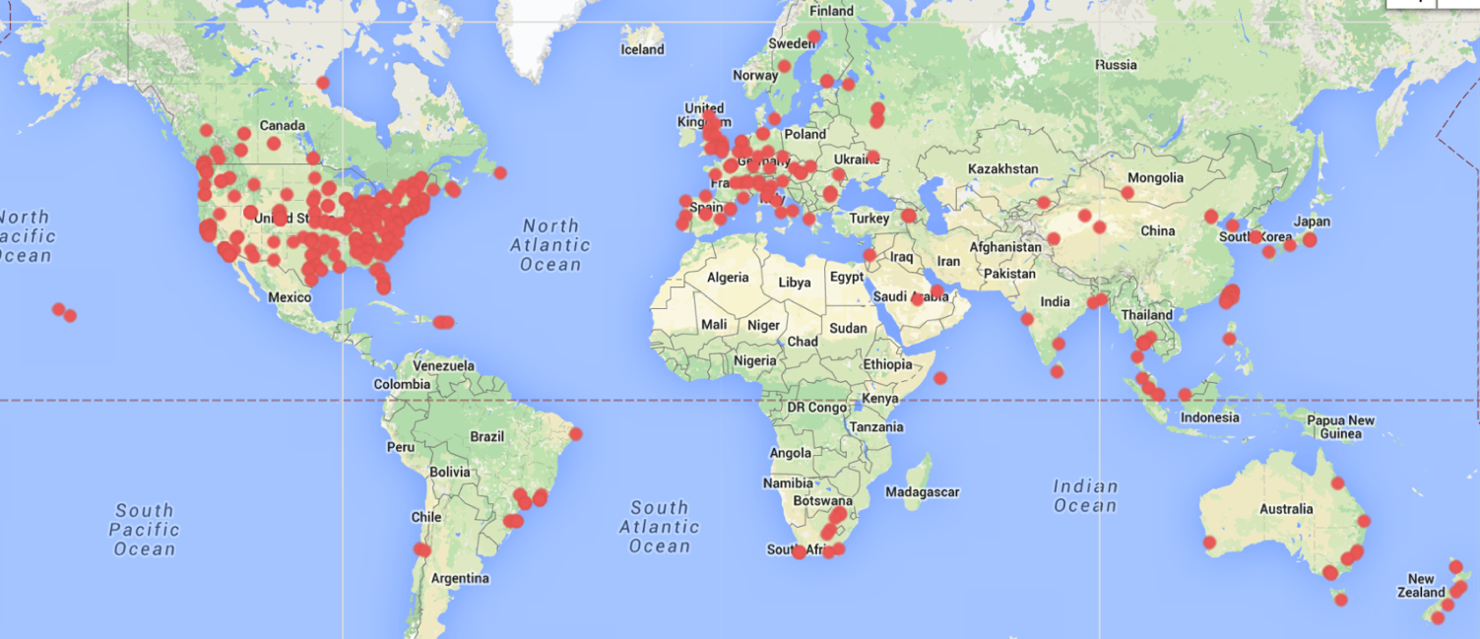
Who is running perfSONAR?
Currently over 1400 deployments world-wide
http://stats.es.net/ServicesDirectory/

Slide 21
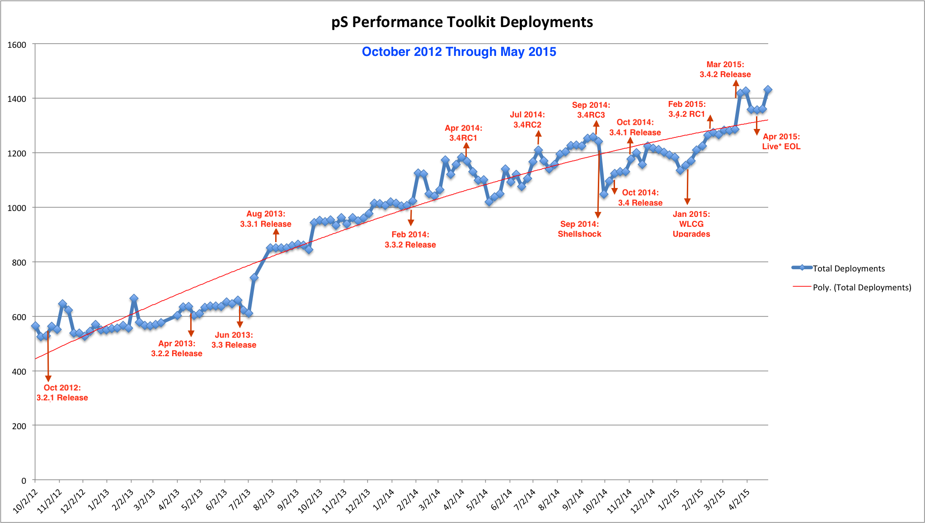
perfSONAR Deployment Growth
Notes:
Updated in 2/2015, steady growth curve with some dips.

Slide 22
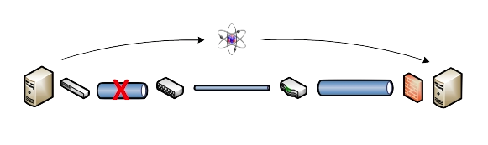
Active vs. Passive Monitoring
Passive monitoring systems have limitations
Performance problems are often only visible at the ends
Individual network components (e.g. routers) have no knowledge of end-to-end state
perfSONAR tests the network in ways that passive monitoring systems do not
More perfSONAR hosts = better network visibility
There are now enough perfSONAR hosts in the world to be quite useful
Notes:
Metcalf law argument – only useful because people are using it

Slide 23
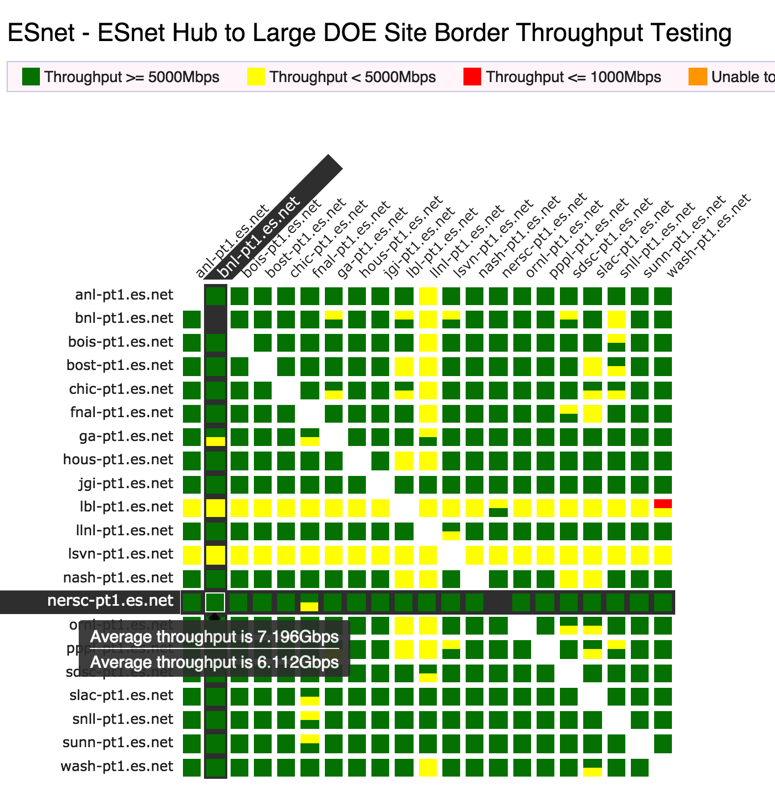
perfSONAR Dashboard: Raising Expectations and improving network visibility
Status at-a-glance
Packet loss
Throughput
Correctness
Current live instances at:
http://ps-dashboard.es.net/
And many more
Drill-down capabilities:
Test history between hosts
Ability to correlate with other events
Very valuable for fault localization and isolation
Notes:
Dashboards – requires coordination of testing

Slide 24
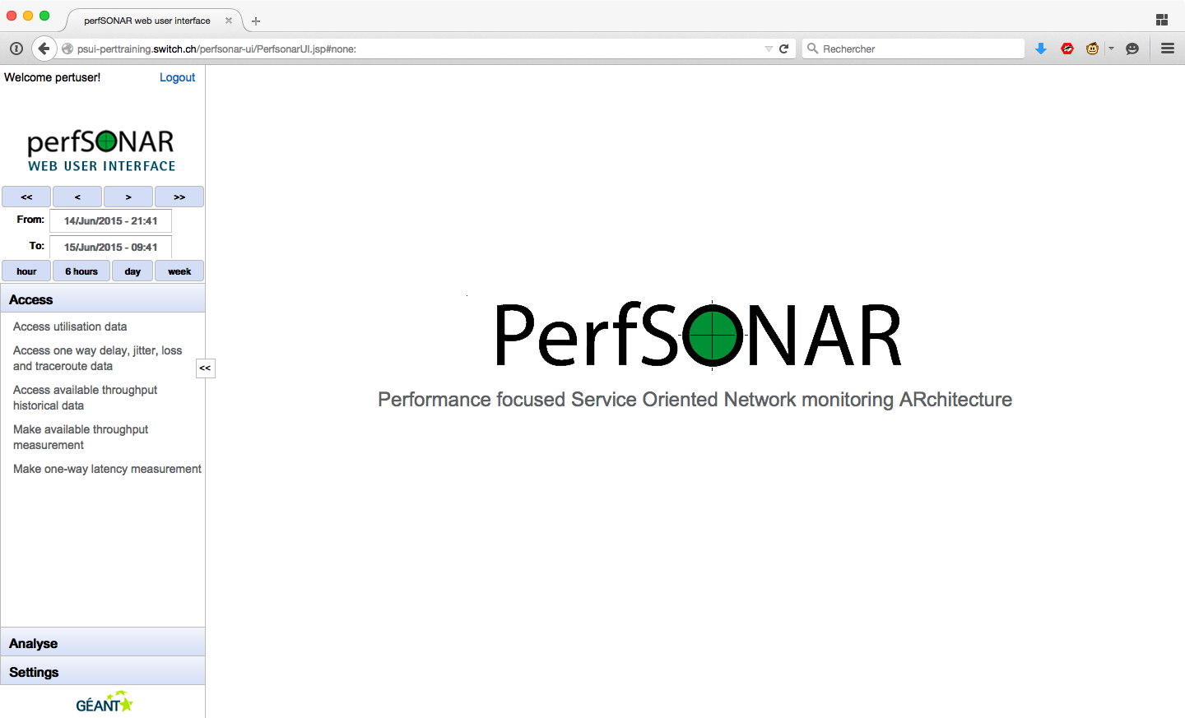
psUI

Slide 25
What is psUI for?
Visualising measurements
  On demand bandwidth and latency
  Archived measurements
  Traceroute analysis
From which MP/MA?
  Global list coming from Lookup Service
  You own managed local list
Federated login or local users DB

Slide 26
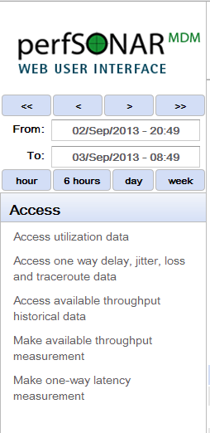

Slide 27
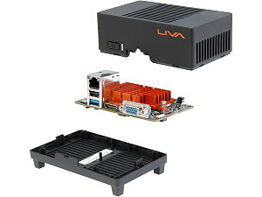
perfSONAR Hardware
These days you can get a good 1U host capable of pushing 10Gbps TCP for around $500 (+10G NIC cost).
  See perfSONAR user list
And you can get a host capable of 1G for around $100!
  Intel Celeron-based (ARM is not fast enough)
  e.g.: http://www.newegg.com/Product/Product.aspx?Item=N82E16856501007
VMs are not recommended
  Tools work better if can guarantee NIC isolation

Slide 28

Active and Growing perfSONAR Community
Active email lists and forums provide:
  Instant access to advice and expertise from the community.
  Ability to share metrics, experience and findings with others to help debug issues on a global scale.
Joining the community automatically increases the reach and power of perfSONAR
  The more endpoints means exponentially more ways to test and discover issues, compare metrics

Slide 29
perfSONAR Community
The perfSONAR collaboration is working to build a strong user community to support the use and development of the software.
perfSONAR Mailing Lists
  Announcement Lists:
    https://mail.internet2.edu/wws/subrequest/perfsonar-announce
  Users List:
    https://mail.internet2.edu/wws/subrequest/perfsonar-users

Slide 30
Part 2: perfSONAR Measurement Tools: Hands On exercises
Brian Tierney, ESnet, bltierney@es.net
June 18, 2015
This document is a result of work by the perfSONAR Project (http://www.perfsonar.net) and is licensed under CC BY-SA 4.0 (https://creativecommons.org/licenses/by-sa/4.0/).

Slide 31
perfSONAR Tools
The following tools are on the perfSONAR toolkit
  perfSONAR specific tools
    bwctl
    owamp
  Standard Unix tools
    ping, traceroute, tracepath
  Standard Unix add-on tools
    iperf, iperf3, nuttcp

Slide 32
Default perfSONAR Throughput Tool: iperf3
iperf3 (http://software.es.net/iperf/) is a new implementation if iperf from scratch, with the goal of a smaller, simpler code base, and a library version of the functionality that can be used in other programs.
Some new features in iperf3 include:
  reports the number of TCP packets that were retransmitted and CWND
  reports the average CPU utilization of the client and server (-V flag)
  support for zero copy TCP (-Z flag)
  JSON output format (-J flag)
  “omit” flag: ignore the first N seconds in the results
On RHEL-based hosts, just type ‘yum install iperf3’
More at: http://fasterdata.es.net/performance-testing/network-troubleshooting-tools/iperf-and-iperf3/
Notes:
Note: iperf3 and new bwctl were added in perfSONAR 3.3.2, but we have not had a Joint Techs since that came out.

Slide 33
Sample iperf3 output on lossy network
Performance is < 1Mbps due to heavy packet loss
  [ ID] Interval Transfer Bandwidth Retr Cwnd
  [ 15] 0.00-1.00 sec 139 MBytes 1.16 Gbits/sec 257 33.9 KBytes
  [ 15] 1.00-2.00 sec 106 MBytes 891 Mbits/sec 138 26.9 KBytes
  [ 15] 2.00-3.00 sec 105 MBytes 881 Mbits/sec 132 26.9 KBytes
  [ 15] 3.00-4.00 sec 71.2 MBytes 598 Mbits/sec 161 15.6 KBytes
  [ 15] 4.00-5.00 sec 110 MBytes 923 Mbits/sec 123 43.8 KBytes
  [ 15] 5.00-6.00 sec 136 MBytes 1.14 Gbits/sec 122 58.0 KBytes
  [ 15] 6.00-7.00 sec 88.8 MBytes 744 Mbits/sec 140 31.1 KBytes
  [ 15] 7.00-8.00 sec 112 MBytes 944 Mbits/sec 143 45.2 KBytes
  [ 15] 8.00-9.00 sec 119 MBytes 996 Mbits/sec 131 32.5 KBytes
  [ 15] 9.00-10.00 sec 110 MBytes 923 Mbits/sec 182 46.7 KBytes

Slide 34
mininet Exercises
What is mininet?
  “Mininet creates a realistic virtual network, running real kernel, switch and application code, on a single machine (VM, cloud or native), in seconds, with a single command”
  http://mininet.org/
  Used by many networking courses:
    https://github.com/mininet/mininet/wiki/Teaching-and-Learning-with-Mininet

Slide 35
Exercise: iperf3
sudo mn --custom ./mininet-topos/topo-ps-tutorial.py --topo mytopo
mininet> h2 iperf3 -s –D
mininet> h1 iperf3 -c h2
mininet> h1 iperf3 -c h2 –t20 –P4 # note impact of parallel streams
mininet> exit
Repeat with this topo:
sudo mn --custom ./mininet-topos/topo-ps-tutorial-loss.py --topo mytopo
Note the impact of 1% loss on TCP throughput.
Repeat with this topo:
sudo mn --custom ./mininet-topos/topo-ps-tutorial-loss-high-lat.py --topo mytopo
Note that at higher latency, impact is even bigger.

Slide 36
BWCTL
BWCTL is the wrapper around all the perfSONAR tools
Policy specification can do things like prevent tests to subnets, or allow longer tests to others. See the man pages for more details
Some general notes:
  Use ‘-c’ to specify a ‘catcher’ (receiver)
  Use ‘-s’ to specify a ‘sender’
  Will default to IPv6 if available (use -4 to force IPv4 as needed, or specify things in terms of an address if your host names are dual homed)

Slide 37
bwctl features
BWCTL lets you run any of the following between any 2 perfSONAR nodes:
  iperf3, nuttcp, ping, owping, traceroute, and tracepath
Sample Commands:
bwctl -c psmsu02.aglt2.org -s elpa-pt1.es.net -T iperf3
bwping -s atla-pt1.es.net -c ga-pt1.es.net
bwping -E -c www.google.com
bwtraceroute -T tracepath -c lbl-pt1.es.net -l 8192 -s atla-pt1.es.net
bwping -T owamp -s atla-pt1.es.net -c ga-pt1.es.net -N 1000 -i .01

Slide 38
Throughput Test Tools
Couple of varieties of tester that BWCTL (the control/policy wrapper) knows how to talk with:
  Iperf (v2)
    Default for the command line (e.g. bwctl –c HOST will invoke this)
    Some known behavioral problems (CPU hog, hard to get UDP testing to be correct)
  Iperf3
    Default for the perfSONAR regular testing framework, can invoke via command line switch (bwctl –T iperf3 –c HOST)
  Nuttcp
    Different code base, can invoke via command line switch (bwctl –T nuttcp –c HOST)
    More control over how the tool behaves on the host (bind to CPU/core, etc.)
    Similar feature set to iperf3

Slide 39
Exercise: bwctl
sudo mn --custom ./mininet-topos/topo-ps-tutorial.py --topo mytopo
mininet> h2 service bwctl-server restart
mininet> h1 bwctl -T nuttcp -fm -i1 -c h2 -a 1 –v
mininet> h1 bwctl -T iperf3 -c h2 -a 1 –v
mininet> exit
Edit topo-ps-tutorial.py, add loss, and rerun commands above

Slide 40
Throughput Expectations
Q: What iperf through should you expect to see on a uncongested 10Gbps network?
A: 3 - 9.9 Gbps, depending on
  RTT
  TCP tuning
  CPU core speed, and ratio of sender speed to receiver speed

Slide 41
OWAMP
OWAMP = One Way Active Measurement Protocol
  E.g. ‘one way ping’
Some differences from traditional ping:
  Measure each direction independently (recall that we often see things like congestion occur in one direction and not the other)
  Uses small evenly spaced groupings of UDP (not ICMP) packets
  Ability to ramp up the interval of the stream, size of the packets, number of packets
OWAMP is most useful for detecting packet train abnormalities on an end to end basis
  Loss
  Duplication
  Out of order packets
  Latency on the forward vs. reverse path
  Number of Layer 3 hops
Does require some accurate time via NTP – the perfSONAR toolkit does take care of this for you.
Notes:
This is more useful for local/MAN testing

Slide 42
What OWAMP Tells Us
OWAMP is very useful in regular testing
  Congestion or queuing often occurs in a single direction
  Packet loss information (and how often/how much occurs over time) is more valuable than throughput
    This gives you a ‘why’ to go with an observation.
  If your router is going to drop a 50B UDP packet, it is most certainly going to drop a 1500B/9000B TCP packet
Overlaying data
  Compare your throughput results against your OWAMP – do you see patterns?
  Alarm on each, if you are alarming (and we hope you are alarming …)

Slide 43
Exercise: owamp
sudo mn --custom ./mininet-topos/topo-ps-tutorial.py --topo mytopo
mininet> h2 service owamp-server restart
mininet> h1 owping h2
mininet> h1 owping -c 1000 -i .01 h2
mininet> h2 service bwctl-server restart
mininet> h1 bwping -T owamp –c h2 -4
mininet> exit
Edit topo-ps-tutorial.py, add loss, and rerun commands above

Slide 44
bwctl + tracepath
Using bwctl run tracepath very useful to see MTU and asymmetric routing issues

Slide 45
BWCTL (Tracepath with MTU mismatch)
> bwtraceroute -T tracepath -c nettest.lbl.gov -s anl-pt1.es.net
bwtraceroute: Using tool: tracepath
1?: [LOCALHOST] pmtu 9000
1: anlmr2-anlpt1.es.net (198.124.252.118) 0.249ms asymm 2
1: anlmr2-anlpt1.es.net (198.124.252.118) 0.197ms asymm 2
2: no reply
3: kanscr5-ip-a-chiccr5.es.net (134.55.43.82) 13.816ms
4: denvcr5-ip-a-kanscr5.es.net (134.55.49.57) 24.379ms
5: sacrcr5-ip-a-denvcr5.es.net (134.55.50.201) 45.298ms
6: sunncr5-ip-a-sacrcr5.es.net (134.55.40.6) 47.890ms
7: et-3-0-0-1411.er1-n1.lbl.gov (198.129.78.22) 50.093ms
8: t5-4.ir1-n1.lbl.gov (131.243.244.131) 50.772ms
9: t5-4.ir1-n1.lbl.gov (131.243.244.131) 52.669ms pmtu 1500
9: nettest.lbl.gov (131.243.24.11) 49.239ms reached
Resume: pmtu 1500 hops 9 back 56

Slide 46
Exercise: bwtraceroute
Note: don’t need mininet for these, can run directly on the VM:
> bwtraceroute -T tracepath -c amst-pt1.es.net \
-s psmp-gn-bw-02-fra-de.geant.net
Test reverse direction:
> bwtraceroute -T tracepath -s amst-pt1.es.net \
-c psmp-gn-bw-02-fra-de.geant.net

Slide 47
Part3 : perfSONAR Measurement Tools
Hands-On-Session between VMs
GEANT Advanced eduPERT Training @ TNC 2015
Antoine Delvaux, adelvaux@man.poznan.pl
Robert Stoy, stoy@dfn.de
18.06.2015

Slide 48

Overview: CLI tests between VMs
VM
pertX
10.0.0.x
10.0.0.y
VM
pertX+1
Link with emulated metrics (bandwidht, one-way-delay, packet loss)
Measurements, using bwctl/iperf3 , owamp
Get in contact with your neighbor
you will do further tests with him

Slide 49
Check your environment
Note private ipv4 address of your pert(X) VM
  ptraining@pertX:~$ ifconfig
and your neighbor's pert(X+1)VM
  ptraining@pertX+1:~$ ifconfig

Slide 50
iperf3 test natively (I)
Start receiver (iperf daemon or server) on VM pertX
  ptraining@pertX:~$ iperf3 -s
  -----------------------------------------------------------
  Server listening on 5201
  -----------------------------------------------------------

Slide 51
iperf3 TCP test natively (II)
Start sender (iperf client) on VM pertX+1
ptraining@pertX+1:~$ iperf3 -c 10.0.0.X
Connecting to host 10.0.0.41, port 5201
[ 4] local 10.0.0.254 port 39114 connected to 10.0.0.41 port 5201
[ ID] Interval Transfer Bandwidth Retr Cwnd
[ 4] 0.00-1.00 sec 103 MBytes 860 Mbits/sec 34 1.10 MBytes
[ 4] 1.00-2.00 sec 116 MBytes 975 Mbits/sec 385 1.03 MBytes
[ 4] 2.00-3.00 sec 91.2 MBytes 765 Mbits/sec 52 841 KBytes
[ 4] 3.00-4.00 sec 120 MBytes 1.01 Gbits/sec 16 642 KBytes
[ 4] 4.00-5.00 sec 111 MBytes 933 Mbits/sec 0 706 KBytes
[ 4] 5.00-6.00 sec 115 MBytes 965 Mbits/sec 0 765 KBytes
[ 4] 6.00-7.00 sec 121 MBytes 1.02 Gbits/sec 0 824 KBytes
[ 4] 7.00-8.00 sec 122 MBytes 1.03 Gbits/sec 0 880 KBytes
[ 4] 8.00-9.00 sec 112 MBytes 944 Mbits/sec 10 701 KBytes
[ 4] 9.00-10.00 sec 122 MBytes 1.03 Gbits/sec 0 769 KBytes
- - - - - - - - - - - - - - - - - - - - - - - - -
[ ID] Interval Transfer Bandwidth Retr
[ 4] 0.00-10.00 sec 1.11 GBytes 952 Mbits/sec 497 sender
[ 4] 0.00-10.00 sec 1.11 GBytes 949 Mbits/sec receiver
iperf Done.

Slide 52
iperf3 UDP test natively (I)
Start UDP sender (iperf client) on VM pertX+1
ptraining@pertX+1:~$ iperf3 –u -c 10.0.0.X –t 5 –b 100M
ptraining@pert2:~$ iperf3 -u -c 10.0.0.118 -b 100M -t 5
Connecting to host 10.0.0.118, port 5201
[ 4] local 10.0.0.254 port 38593 connected to 10.0.0.118 port 5201
[ ID] Interval Transfer Bandwidth Total Datagrams
[ 4] 0.00-1.00 sec 10.8 MBytes 90.2 Mbits/sec 1377
[ 4] 1.00-2.00 sec 11.9 MBytes 100 Mbits/sec 1526
[ 4] 2.00-3.00 sec 11.9 MBytes 100 Mbits/sec 1526
[ 4] 3.00-4.00 sec 12.0 MBytes 101 Mbits/sec 1534
[ 4] 4.00-5.00 sec 11.9 MBytes 99.4 Mbits/sec 1517
- - - - - - - - - - - - - - - - - - - - - - - - -
[ ID] Interval Transfer Bandwidth Jitter Lost/Total Datagrams
[ 4] 0.00-5.00 sec 58.4 MBytes 98.0 Mbits/sec 0.031 ms 30/7480 (0.4%)
[ 4] Sent 7480 datagrams

Slide 53
iperf3 UDP test natively (II)
Check receiver output on VM pertX
-----------------------------------------------------------
Server listening on 5201
-----------------------------------------------------------
Accepted connection from 10.0.0.254, port 57293
[ 5] local 10.0.0.118 port 5201 connected to 10.0.0.254 port 38593
[ ID] Interval Transfer Bandwidth Jitter Lost/Total Datagrams
[ 5] 0.00-1.00 sec 10.8 MBytes 90.2 Mbits/sec 0.028 ms 0/1377 (0%)
[ 5] 1.00-2.00 sec 11.9 MBytes 100 Mbits/sec 0.029 ms 0/1526 (0%)
[ 5] 2.00-3.00 sec 11.9 MBytes 100 Mbits/sec 0.020 ms 0/1526 (0%)
[ 5] 3.00-4.00 sec 11.8 MBytes 98.6 Mbits/sec 0.016 ms 30/1534 (2%)
[ 5] 4.00-5.00 sec 11.9 MBytes 99.4 Mbits/sec 0.031 ms 0/1517 (0%)
[ 5] 5.00-5.04 sec 0.00 Bytes 0.00 bits/sec 0.031 ms 0/0 (-nan%)
- - - - - - - - - - - - - - - - - - - - - - - - -
[ ID] Interval Transfer Bandwidth Jitter Lost/Total Datagrams
[ 5] 0.00-5.04 sec 58.4 MBytes 97.3 Mbits/sec 0.031 ms 30/7480 (0.4%)

Slide 54
bwctl/iperf3 tests (I) check environment
Check if bwctld is running on receiver and sender VM
ptraining@pertX:~$ ps -e | grep bwctl
Check two configuration files on sender and receiver VM
ptraining@pertX:~$ less /etc/bwctl/bwctld.limits
[..]
bandwidth=900m, \
duration=60, \
allow_udp=on, \
allow_tcp=on, \
[..]
ptraining@pertX:~$ less /etc/bwctl/bwctld.conf
[..]
peer_port 6001-6200
test_port 5001-5900
[..]

Slide 55
bwctl/iperf3 (II): TCP test
Do a iperf3 TCP measurement from PertX to PertX+1
ptraining@pertX:~$ bwctl -T iperf3 -s 10.0.0.(X) -c 10.0.0.(x+1) -t 5 -i 1
bwctl: Using tool: iperf3
bwctl: 12 seconds until test results available
SENDER START
Connecting to host 10.0.0.122, port 5795
[ 15] local 10.0.0.118 port 38774 connected to 10.0.0.122 port 5795
[ ID] Interval Transfer Bandwidth Retr Cwnd
[ 15] 0.00-1.00 sec 66.1 MBytes 555 Mbits/sec 337 776 KBytes
[ 15] 1.00-2.00 sec 80.0 MBytes 671 Mbits/sec 0 837 KBytes
[ 15] 2.00-3.00 sec 78.8 MBytes 661 Mbits/sec 477 635 KBytes
[ 15] 3.00-4.00 sec 75.0 MBytes 629 Mbits/sec 0 675 KBytes
[ 15] 4.00-5.00 sec 81.2 MBytes 682 Mbits/sec 0 721 KBytes
- - - - - - - - - - - - - - - - - - - - - - - - -
[ ID] Interval Transfer Bandwidth Retr
[ 15] 0.00-5.00 sec 381 MBytes 639 Mbits/sec 814 sender
[ 15] 0.00-5.00 sec 378 MBytes 635 Mbits/sec receiver
iperf Done.

Slide 56
bwctl/iperf3 (III) UDP test
Do a iperf3 UDP measurement from PertX to PertX+1 with data rate 10 Mbit/s, Duration 5 seconds, default report interval 1s
ptraining@pert19:~$ bwctl -T iperf3 -u -s 10.0.0.(X) -c 10.0.0.(X+1) -t 5 -b 10M
bwctl: Using tool: iperf3
bwctl: 10 seconds until test results available
SENDER START
Connecting to host 10.0.0.28, port 5629
[ 15] local 10.0.0.27 port 54634 connected to 10.0.0.28 port 5629
[ ID] Interval Transfer Bandwidth Total Datagrams
[ 15] 0.00-1.00 sec 1.08 MBytes 9.04 Mbits/sec 138
[ 15] 1.00-2.00 sec 1.19 MBytes 9.96 Mbits/sec 152
[ 15] 2.00-3.00 sec 1.20 MBytes 10.0 Mbits/sec 153
[ 15] 3.00-4.00 sec 1.20 MBytes 10.0 Mbits/sec 153
[ 15] 4.00-5.00 sec 1.19 MBytes 9.96 Mbits/sec 152
- - - - - - - - - - - - - - - - - - - - - - - - -
[ ID] Interval Transfer Bandwidth Jitter Lost/Total Datagrams
[ 15] 0.00-5.00 sec 5.84 MBytes 9.80 Mbits/sec 0.049 ms 0/748 (0%)
[ 15] Sent 748 datagrams
iperf Done.
SENDER END

Slide 57
OWAMP Test (I)
Check environment
ptraining@perX:~$ less /etc/owampd/owampd.limits
ptraining@perX:~$ less /etc/owampd/owampd.conf

Slide 58
OWAMP Test (II)
Do one-way delay and ‘percent-accuracy' packet loss test
ptraining@perX:~$ owping 10.0.0.(X+1)
Approximately 13.1 seconds until results available
--- owping statistics from [pert5]:8816 to [10.0.0.30]:9358 ---
SID: 0a00001ed92ac2d7a0b2f97cf6309eb5
first: 2015-06-16T15:44:24.749
last: 2015-06-16T15:44:38.313
100 sent, 0 lost (0.000%), 0 duplicates
one-way delay min/median/max = 0.403/0.6/0.766 ms, (err=0.898 ms)
one-way jitter = 0.1 ms (P95-P50)
TTL not reported
no reordering
--- owping statistics from [10.0.0.30]:9401 to [pert5]:8953 ---
SID: 0a000003d92ac2d7a29568a96ae7a995
first: 2015-06-16T15:44:24.718
last: 2015-06-16T15:44:33.457
100 sent, 0 lost (0.000%), 0 duplicates
one-way delay min/median/max = -0.152/0.1/0.2 ms, (err=0.898 ms)
one-way jitter = 0.1 ms (P95-P50)
TTL not reported
no reordering

Slide 59
OWAMP Test (III)
tweak test parameters:
-v : ping like output, allows for analysis of packet loss
and delay patterns
-i : packet interdeparture times, default is 100ms.
-c : number of packets run at a test (default is 100)
ptraining@perX:~$ owping 10.0.0.(X+1) –v –c 10 –i 0.01

Slide 60
Changing link metrics between VMs
Between the VMs we are using netem for changing link metrics on VM’s egress direction
Wrapper scripts have been prepared
Show current link limits
ptraining@perX:~$ netem-show
Set high packet loss (5%), high OWD (100ms)
ptraining@perX:~$ netem-loss5-delay100
Clear link limits
ptraining@perX:~$ netem-clear

Slide 61
Dashboard and Plots Demo
Go to: http://ps-dashboard.es.net/

Slide 62
Extra Exercise for those with a Mac
Install Homebrew
ruby -e "$(curl -fsSL https://raw.githubusercontent.com/Homebrew/install/master/install)"
brew install iperf iperf3 nuttcp bwctl owamp
Try some of the commands in the ‘extra slides’ below from your laptop.

Slide 63
Extra Exercise for those with a Linux VM
Install Tools
RHEL-based systems:
rpm -hUv http://software.internet2.edu/rpms/el6/x86_64/main/RPMS/Internet2-repo-0.5-7.noarch.rpm
yum -y install iperf iperf3 nuttcp bwctl owamp
Debian "wheezy" -based systems (this works on Ubuntu as well):
cd /etc/apt/sources.list.d/
wget http://downloads.perfsonar.net/debian/perfsonar-wheezy-release.list
wget -qO - http://downloads.perfsonar.net/debian/perfsonar-wheezy-release.gpg.key | apt-key add
apt-get update
apt-get install perfsonar-tools
Try some of the commands in the ‘extra slides’ below from your laptop.

Slide 64
Part 4: psUI: the perfSONAR web UI
TNC 2015
Antoine Delvaux — adelvaux@man.poznan.pl
Software Engineer
18 June 2015

Slide 65
psUI architecture
Java application running in tomcat
  Java 7 and Tomcat 7
To be deployed on separate host
List of MP and MA
  Global Lookup Service (~ 9.000 services)
  Locally maintained list
Calls bwctl through OPPD

Slide 66
psUI usage
Bandwidth measurements
  Beware of naming!
    Source = bwctl sender (-s) = iperf client (-c)
    Destination = bwctl receiver (-c) = iperf server (-s)
  iperf2 is used, or iperf3 if iperf2 not available (this will change with perfSONAR 3.5)
One Way Delay measurements
  Not reliable in virtualised environments
Measurement Archives

Slide 67
Bandwidth (iperf)
Between VM in the testbed
To the outside Internet
  Measurement from VM to outside only
  NAT not supported by bwctl
Between global MP
  Scheduling takes place when many testers, psUI may timeout waiting for bwctl
  Usage issues happens (ACL, firewall, misconf., …)

Slide 68
Overview: using psUI
VM
pertX
10.0.0.x
10.0.0.y
VM
pertX
VM
psUI
NAT
Internet
web- browser
@Laptop
control connection
measurement data

Slide 69
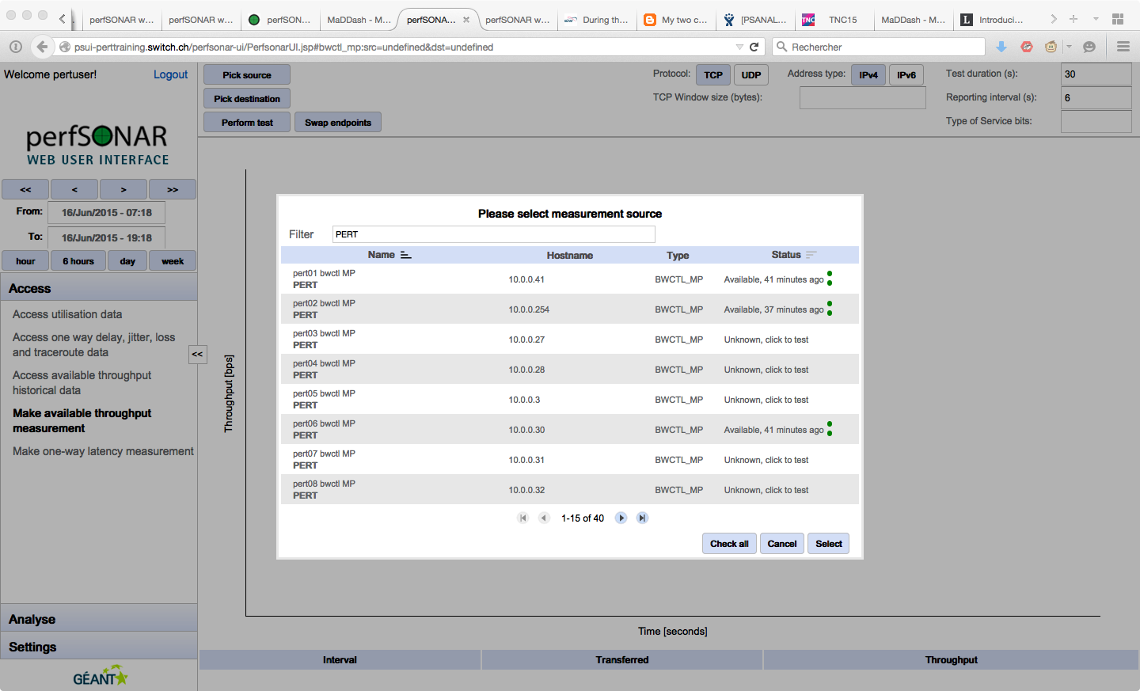
2
3
1

Slide 70
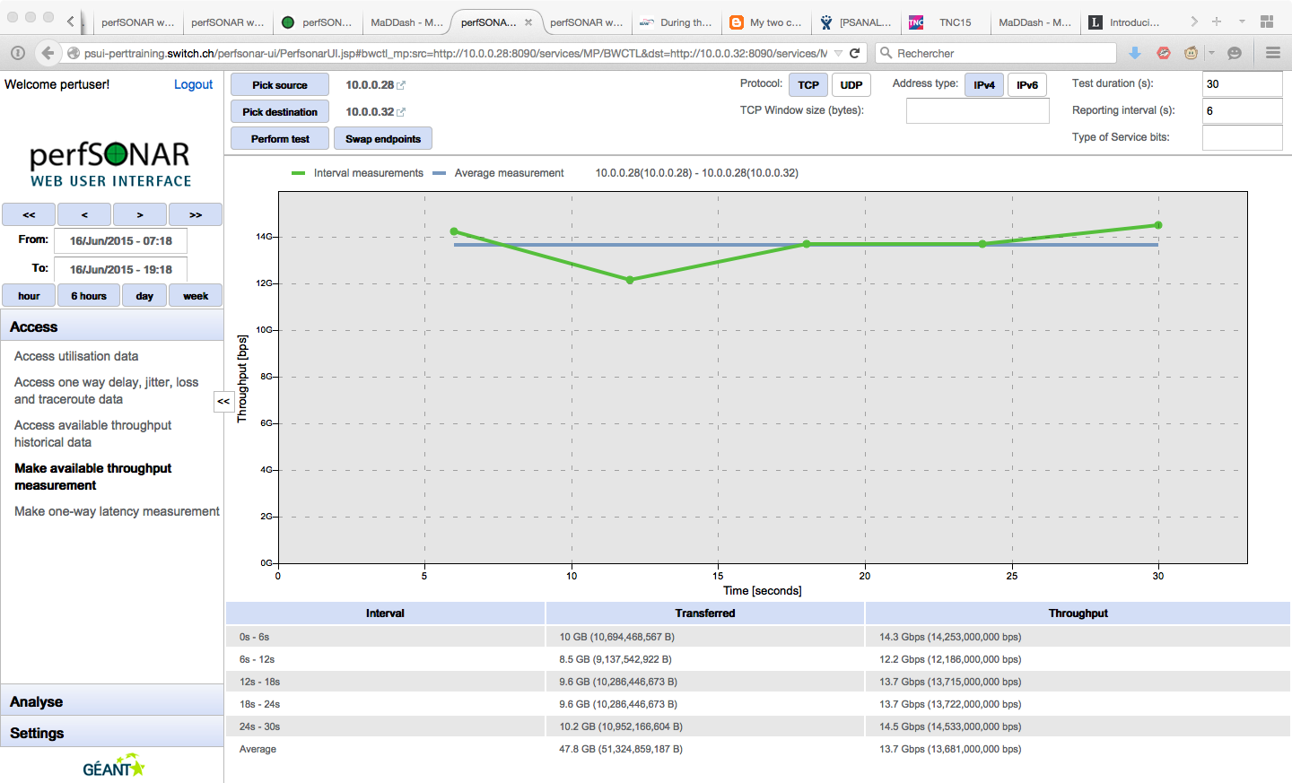
1
2
3

Slide 71
One way delay (owamp)
Between VM in the testbed
  Unreliable measurements because of the virtualised environment
To the outside Internetx@
Between global MP
  Need reliable time source
  Use different MP for bandwidth and one way delay measurements

Slide 72
Measurement Archives
GEANT RRD MA (development discontinued)
perfSONAR toolkit deployments (esmond)

Slide 73
Other resources
Install your own psUI for your NOC
  Installation instructions: http://docs.perfsonar.net/install_psui
  Usage instructions: http://docs.perfsonar.net/using_psui
Public demo psUI instance: http://psui.geant.net

Slide 74
Part 5: Use Cases & Success Stories
Brian Tierney, ESnet, bltierney@es.net
June 18, 2015
This document is a result of work by the perfSONAR Project (http://www.perfsonar.net) and is licensed under CC BY-SA 4.0 (https://creativecommons.org/licenses/by-sa/4.0/).

Slide 75
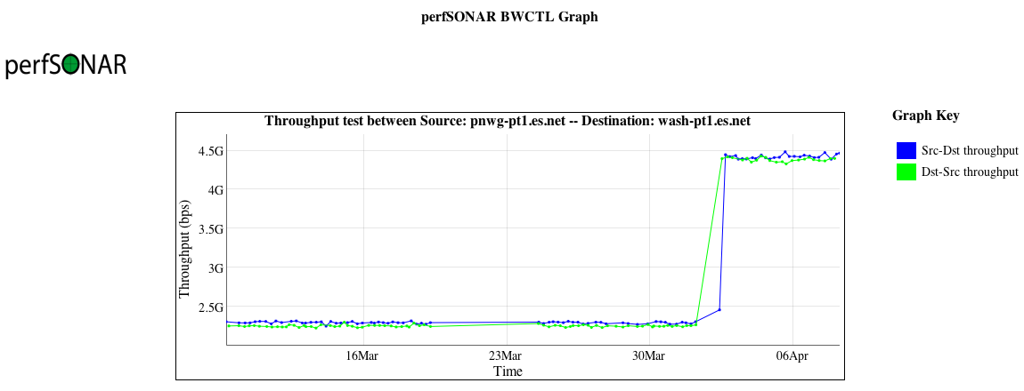
Success Stories - Host Tuning
long path (~70ms), single stream TCP, 10G cards, tuned hosts
Why the nearly 2x uptick? Adjusted net.ipv4.tcp_rmem/wmem maximums (used in auto tuning) to 64M instead of 16M.
Notes:
Better view of increasing the max window size

Slide 76
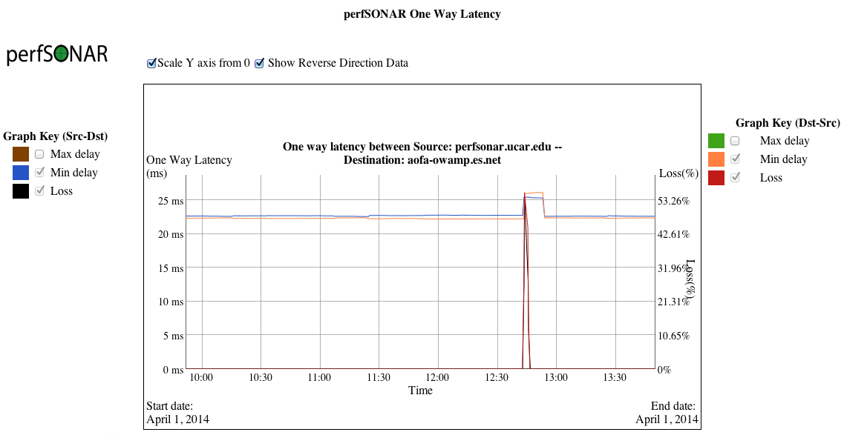
Success Stories - Fiber Cut
perfSONAR can't fix fiber cuts, but you can see the loss event and the latency change due to traffic re-routing
Notes:
Very clear signature of a fiber cut – loss spike, re-route, and then another re-route

Slide 77
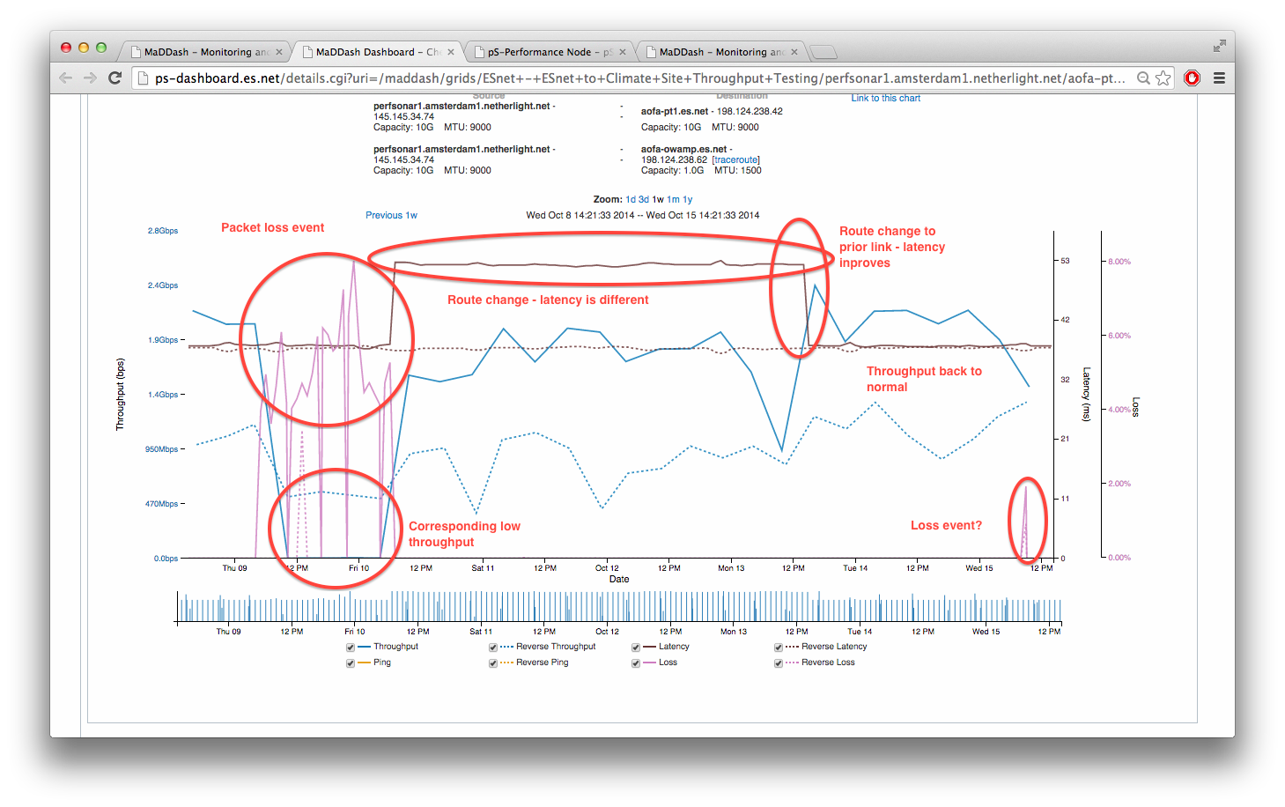
Success Stories - Monitoring TA Links
Notes:
Watching loss, route changes, and repair on a TA link (100G)

Slide 78
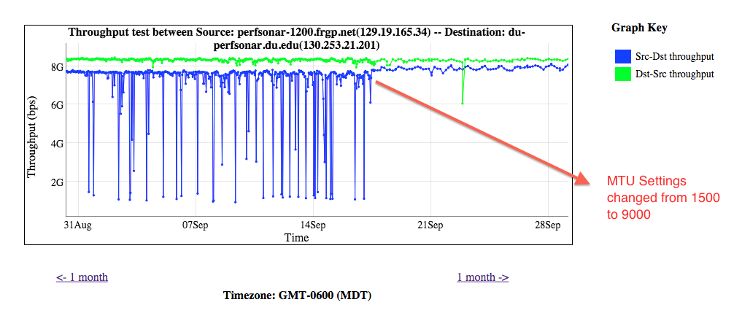
Success Stories - MTU Changes
Notes:
MTU things matter – and in this case even though things were close there was a deep variation in performance

Slide 79
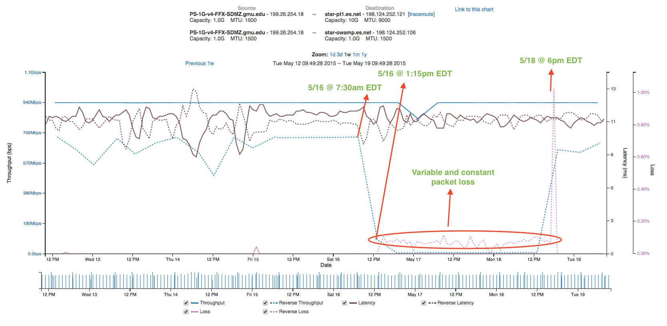
Another Failing Line Card Example
Notes:
Example from May 2015: Internet2 Brocade line card failure in Wash DC.

Slide 80
Success Stories Summary
Key Message(s):
This type of active monitoring find problems in the network and on the end hosts.
Ability to view long term trends in latency, loss, and throughput is very useful
  Ability to show someone a plot, and say “what did you do on Day X? It broke something.”
  Ability to show impact of an upgrade (or lack thereof).

Slide 81

Resources
perfSONAR website
  http://www.perfsonar.net/
perfSONAR Toolkit Manual
  http://docs.perfsonar.net/
perfSONAR mailing lists
  http://www.perfsonar.net/about/getting-help/
perfSONAR directory
  http://stats.es.net/ServicesDirectory/
FasterData Knowledgebase
  http://fasterdata.es.net/

Slide 82
Extra Slides

Slide 83
BWCTL Example (iperf)
[zurawski@wash-pt1 ~]$ bwctl -T iperf -f m -t 10 -i 2 -c sunn-pt1.es.net
bwctl: 83 seconds until test results available
bwctl: exec_line: /usr/bin/iperf -B 198.129.254.58 -s -f m -m -p 5136 -t 10 -i 2.000000
bwctl: run_tool: tester: iperf
bwctl: run_tool: receiver: 198.129.254.58
bwctl: run_tool: sender: 198.124.238.34
bwctl: start_tool: 3598657357.738868
------------------------------------------------------------
Server listening on TCP port 5136
Binding to local address 198.129.254.58
TCP window size: 0.08 MByte (default)
------------------------------------------------------------
[ 16] local 198.129.254.58 port 5136 connected with 198.124.238.34 port 5136
[ ID] Interval Transfer Bandwidth
[ 16] 0.0- 2.0 sec 90.4 MBytes 379 Mbits/sec
[ 16] 2.0- 4.0 sec 689 MBytes 2891 Mbits/sec
[ 16] 4.0- 6.0 sec 684 MBytes 2867 Mbits/sec
[ 16] 6.0- 8.0 sec 691 MBytes 2897 Mbits/sec
[ 16] 8.0-10.0 sec 691 MBytes 2898 Mbits/sec
[ 16] 0.0-10.0 sec 2853 MBytes 2386 Mbits/sec
[ 16] MSS size 8948 bytes (MTU 8988 bytes, unknown interface)
This is what perfSONAR Graphs – the average of the complete test

Slide 84
BWCTL Example (iperf3)
[zurawski@wash-pt1 ~]$ bwctl -T iperf3 -t 10 -i 2 -c sunn-pt1.es.net
bwctl: run_tool: tester: iperf3
bwctl: run_tool: receiver: 198.129.254.58
bwctl: run_tool: sender: 198.124.238.34
bwctl: start_tool: 3598657653.219168
Test initialized
Running client
Connecting to host 198.129.254.58, port 5001
[ 17] local 198.124.238.34 port 34277 connected to 198.129.254.58 port 5001
[ ID] Interval Transfer Bandwidth Retransmits
[ 17] 0.00-2.00 sec 430 MBytes 1.80 Gbits/sec 2
[ 17] 2.00-4.00 sec 680 MBytes 2.85 Gbits/sec 0
[ 17] 4.00-6.00 sec 669 MBytes 2.80 Gbits/sec 0
[ 17] 6.00-8.00 sec 670 MBytes 2.81 Gbits/sec 0
[ 17] 8.00-10.00 sec 680 MBytes 2.85 Gbits/sec 0
[ ID] Interval Transfer Bandwidth Retransmits
Sent
[ 17] 0.00-10.00 sec 3.06 GBytes 2.62 Gbits/sec 2
Received
[ 17] 0.00-10.00 sec 3.06 GBytes 2.63 Gbits/sec
iperf Done.
bwctl: stop_tool: 3598657664.995604
This is what perfSONAR Graphs – the average of the complete test

Slide 85
BWCTL Example (nuttcp)
> bwctl -T nuttcp -f m -t 10 -i 2 -c sunn-pt1.es.net
nuttcp-t: buflen=65536, nstream=1, port=5001 tcp -> 198.129.254.58
nuttcp-t: connect to 198.129.254.58 with mss=8948, RTT=62.418 ms
nuttcp-t: send window size = 98720, receive window size = 87380
nuttcp-t: available send window = 74040, available receive window = 65535
nuttcp-r: buflen=65536, nstream=1, port=5001 tcp
nuttcp-r: send window size = 98720, receive window size = 87380
nuttcp-r: available send window = 74040, available receive window = 65535
131.0625 MB / 2.00 sec = 549.7033 Mbps 1 retrans
725.6250 MB / 2.00 sec = 3043.4964 Mbps 0 retrans
715.0000 MB / 2.00 sec = 2998.8284 Mbps 0 retrans
714.3750 MB / 2.00 sec = 2996.4168 Mbps 0 retrans
707.1250 MB / 2.00 sec = 2965.8349 Mbps 0 retrans
nuttcp-t: 2998.1379 MB in 10.00 real seconds = 307005.08 KB/sec = 2514.9856 Mbps
nuttcp-t: 2998.1379 MB in 2.32 CPU seconds = 1325802.48 KB/cpu sec
nuttcp-t: retrans = 1
nuttcp-t: 47971 I/O calls, msec/call = 0.21, calls/sec = 4797.03
nuttcp-t: 0.0user 2.3sys 0:10real 23% 0i+0d 768maxrss 0+2pf 156+28csw
nuttcp-r: 2998.1379 MB in 10.07 real seconds = 304959.96 KB/sec = 2498.2320 Mbps
nuttcp-r: 2998.1379 MB in 2.36 CPU seconds = 1301084.31 KB/cpu sec
nuttcp-r: 57808 I/O calls, msec/call = 0.18, calls/sec = 5742.21
nuttcp-r: 0.0user 2.3sys 0:10real 23% 0i+0d 770maxrss 0+4pf 9146+24csw

Slide 86
BWCTL Example (nuttcp, [1%] loss)
> bwctl -T nuttcp -f m -t 10 -i 2 -c sunn-pt1.es.net
bwctl: exec_line: /usr/bin/nuttcp -vv -p 5004 -i 2.000000 -T 10 -t 198.129.254.58
nuttcp-t: buflen=65536, nstream=1, port=5004 tcp -> 198.129.254.58
nuttcp-t: connect to 198.129.254.58 with mss=8948, RTT=62.440 ms
nuttcp-t: send window size = 98720, receive window size = 87380
nuttcp-t: available send window = 74040, available receive window = 65535
nuttcp-r: send window size = 98720, receive window size = 87380
nuttcp-r: available send window = 74040, available receive window = 65535
6.3125 MB / 2.00 sec = 26.4759 Mbps 27 retrans
3.5625 MB / 2.00 sec = 14.9423 Mbps 4 retrans
3.8125 MB / 2.00 sec = 15.9906 Mbps 7 retrans
4.8125 MB / 2.00 sec = 20.1853 Mbps 13 retrans
6.0000 MB / 2.00 sec = 25.1659 Mbps 7 retrans
nuttcp-t: 25.5066 MB in 10.00 real seconds = 2611.85 KB/sec = 21.3963 Mbps
nuttcp-t: 25.5066 MB in 0.01 CPU seconds = 1741480.37 KB/cpu sec
nuttcp-t: retrans = 58
nuttcp-t: 409 I/O calls, msec/call = 25.04, calls/sec = 40.90
nuttcp-t: 0.0user 0.0sys 0:10real 0% 0i+0d 768maxrss 0+2pf 51+3csw
nuttcp-r: 25.5066 MB in 10.30 real seconds = 2537.03 KB/sec = 20.7833 Mbps
nuttcp-r: 25.5066 MB in 0.02 CPU seconds = 1044874.29 KB/cpu sec
nuttcp-r: 787 I/O calls, msec/call = 13.40, calls/sec = 76.44
nuttcp-r: 0.0user 0.0sys 0:10real 0% 0i+0d 770maxrss 0+4pf 382+0csw

Slide 87
OWAMP (initial)
> owping sunn-owamp.es.net
Approximately 12.6 seconds until results available
--- owping statistics from [wash-owamp.es.net]:8885 to [sunn-owamp.es.net]:8827 ---
SID: c681fe4ed67f1b3e5faeb249f078ec8a
first: 2014-01-13T18:11:11.420
last: 2014-01-13T18:11:20.587
100 sent, 0 lost (0.000%), 0 duplicates
one-way delay min/median/max = 31/31.1/31.7 ms, (err=0.00201 ms)
one-way jitter = 0 ms (P95-P50)
Hops = 7 (consistently)
no reordering
--- owping statistics from [sunn-owamp.es.net]:9027 to [wash-owamp.es.net]:8888 ---
SID: c67cfc7ed67f1b3eaab69b94f393bc46
first: 2014-01-13T18:11:11.321
last: 2014-01-13T18:11:22.672
100 sent, 0 lost (0.000%), 0 duplicates
one-way delay min/median/max = 31.4/31.5/32.6 ms, (err=0.00201 ms)
one-way jitter = 0 ms (P95-P50)
Hops = 7 (consistently)
no reordering
This is what perfSONAR Graphs – the average of the complete test

Slide 88
OWAMP (w/ loss)
> owping sunn-owamp.es.net
Approximately 12.6 seconds until results available
--- owping statistics from [wash-owamp.es.net]:8852 to [sunn-owamp.es.net]:8837 ---
SID: c681fe4ed67f1f0908224c341a2b83f3
first: 2014-01-13T18:27:22.032
last: 2014-01-13T18:27:32.904
100 sent, 12 lost (12.000%), 0 duplicates
one-way delay min/median/max = 31.1/31.1/31.3 ms, (err=0.00502 ms)
one-way jitter = nan ms (P95-P50)
Hops = 7 (consistently)
no reordering
--- owping statistics from [sunn-owamp.es.net]:9182 to [wash-owamp.es.net]:8893 ---
SID: c67cfc7ed67f1f09531c87cf38381bb6
first: 2014-01-13T18:27:21.993
last: 2014-01-13T18:27:33.785
100 sent, 0 lost (0.000%), 0 duplicates
one-way delay min/median/max = 31.4/31.5/31.5 ms, (err=0.00502 ms)
one-way jitter = 0 ms (P95-P50)
Hops = 7 (consistently)
no reordering
This is what perfSONAR Graphs – the average of the complete test

Slide 89
OWAMP (w/ re-ordering)
> owping sunn-owamp.es.net
Approximately 12.9 seconds until results available
--- owping statistics from [wash-owamp.es.net]:8814 to [sunn-owamp.es.net]:9062 ---
SID: c681fe4ed67f21d94991ea335b7a1830
first: 2014-01-13T18:39:22.543
last: 2014-01-13T18:39:31.503
100 sent, 0 lost (0.000%), 0 duplicates
one-way delay min/median/max = 31.1/106/106 ms, (err=0.00201 ms)
one-way jitter = 0.1 ms (P95-P50)
Hops = 7 (consistently)
1-reordering = 19.000000%
2-reordering = 1.000000%
no 3-reordering
--- owping statistics from [sunn-owamp.es.net]:8770 to [wash-owamp.es.net]:8939 ---
SID: c67cfc7ed67f21d994c1302dff644543
first: 2014-01-13T18:39:22.602
last: 2014-01-13T18:39:31.279
100 sent, 0 lost (0.000%), 0 duplicates
one-way delay min/median/max = 31.4/31.5/32 ms, (err=0.00201 ms)
one-way jitter = 0 ms (P95-P50)
Hops = 7 (consistently)
no reordering

Slide 90
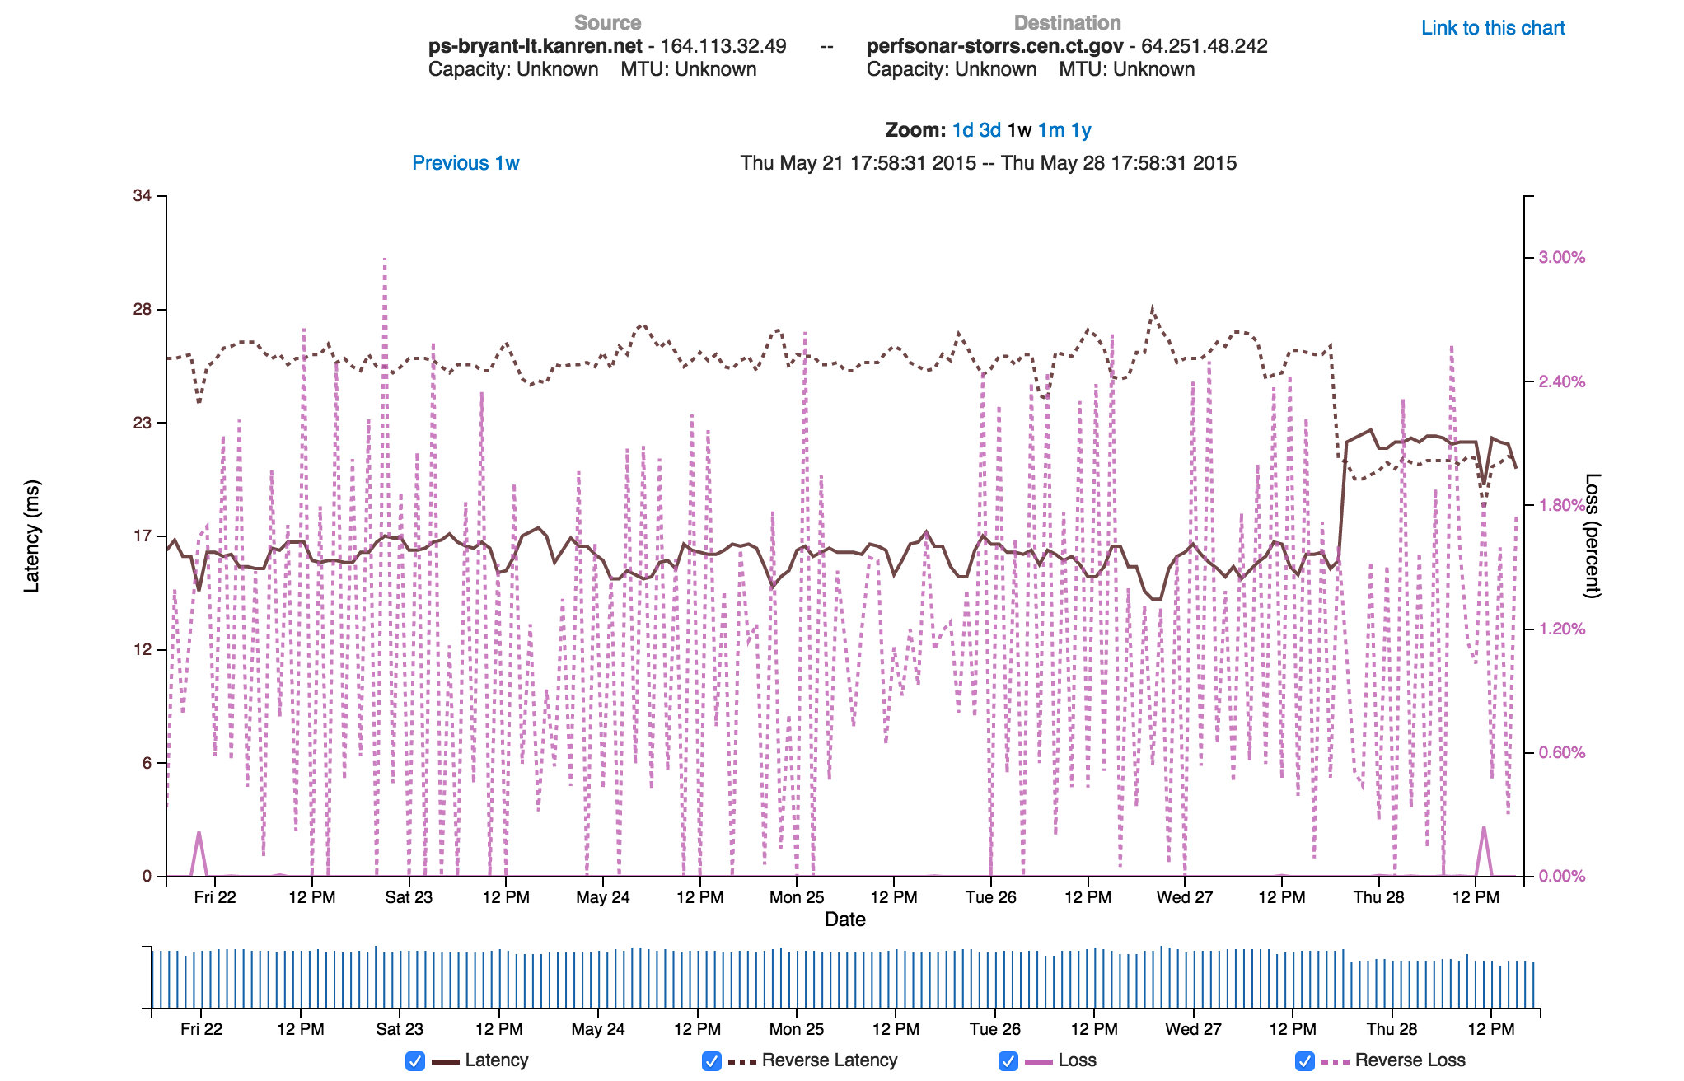
Plotting owamp results
Add new owamp plot here

Slide 91
BWCTL (Traceroute)
> bwtraceroute -T traceroute -s sacr-pt1.es.net –c wash-pt1.es.net
bwtraceroute: Using tool: traceroute
traceroute to 198.124.238.34 (198.124.238.34), 30 hops max, 60 byte packets
1 sacrcr5-sacrpt1.es.net (198.129.254.37) 0.490 ms 0.788 ms 1.114 ms
2 denvcr5-ip-a-sacrcr5.es.net (134.55.50.202) 21.304 ms 21.594 ms 21.924 ms
3 kanscr5-ip-a-denvcr5.es.net (134.55.49.58) 31.944 ms 32.608 ms 32.838 ms
4 chiccr5-ip-a-kanscr5.es.net (134.55.43.81) 42.904 ms 43.236 ms 43.566 ms
5 washcr5-ip-a-chiccr5.es.net (134.55.36.46) 60.046 ms 60.339 ms 60.670 ms
6 wash-pt1.es.net (198.124.238.34) 59.679 ms 59.693 ms 59.708 ms
> bwtraceroute -T traceroute -c sacr-pt1.es.net –s wash-pt1.es.net
bwtraceroute: Using tool: traceroute
traceroute to 198.129.254.38 (198.129.254.38), 30 hops max, 60 byte packets
1 wash-te-perf-if1.es.net (198.124.238.33) 0.474 ms 0.816 ms 1.145 ms
2 chiccr5-ip-a-washcr5.es.net (134.55.36.45) 19.133 ms 19.463 ms 19.786 ms
3 kanscr5-ip-a-chiccr5.es.net (134.55.43.82) 28.515 ms 28.799 ms 29.083 ms
4 denvcr5-ip-a-kanscr5.es.net (134.55.49.57) 39.077 ms 39.348 ms 39.628 ms
5 sacrcr5-ip-a-denvcr5.es.net (134.55.50.201) 60.013 ms 60.299 ms 60.983 ms
6 sacr-pt1.es.net (198.129.254.38) 59.679 ms 59.678 ms 59.668 ms

Slide 92
BWCTL (Tracepath)
bwtraceroute -T tracepath -s sacr-pt1.es.net –c wash-pt1.es.net
bwtraceroute: Using tool: tracepath
bwtraceroute: 36 seconds until test results available
SENDER START
1?: [LOCALHOST] pmtu 9000
1: sacrcr5-sacrpt1.es.net (198.129.254.37) 0.489ms
1: sacrcr5-sacrpt1.es.net (198.129.254.37) 0.463ms
2: denvcr5-ip-a-sacrcr5.es.net (134.55.50.202) 21.426ms
3: kanscr5-ip-a-denvcr5.es.net (134.55.49.58) 31.957ms
4: chiccr5-ip-a-kanscr5.es.net (134.55.43.81) 42.947ms
5: washcr5-ip-a-chiccr5.es.net (134.55.36.46) 60.092ms
6: wash-pt1.es.net (198.124.238.34) 59.753ms reached
Resume: pmtu 9000 hops 6 back 59
SENDER END

Slide 93
BWCTL (Tracepath with MTU mismatch)
> bwtraceroute -T tracepath -c nettest.lbl.gov -s anl-pt1.es.net
bwtraceroute: Using tool: tracepath
1?: [LOCALHOST] pmtu 9000
1: anlmr2-anlpt1.es.net (198.124.252.118) 0.249ms asymm 2
1: anlmr2-anlpt1.es.net (198.124.252.118) 0.197ms asymm 2
2: no reply
3: kanscr5-ip-a-chiccr5.es.net (134.55.43.82) 13.816ms
4: denvcr5-ip-a-kanscr5.es.net (134.55.49.57) 24.379ms
5: sacrcr5-ip-a-denvcr5.es.net (134.55.50.201) 45.298ms
6: sunncr5-ip-a-sacrcr5.es.net (134.55.40.6) 47.890ms
7: et-3-0-0-1411.er1-n1.lbl.gov (198.129.78.22) 50.093ms
8: t5-4.ir1-n1.lbl.gov (131.243.244.131) 50.772ms
9: t5-4.ir1-n1.lbl.gov (131.243.244.131) 52.669ms pmtu 1500
9: nettest.lbl.gov (131.243.24.11) 49.239ms reached
Resume: pmtu 1500 hops 9 back 56

Slide 94
BWCTL (Ping)
>bwping -c nettest.lbl.gov -s anl-pt1.es.net
bwping: Using tool: ping
PING 131.243.24.11 (131.243.24.11) from 198.124.252.117 : 56(84) bytes of data.
64 bytes from 131.243.24.11: icmp_seq=1 ttl=56 time=49.1 ms
64 bytes from 131.243.24.11: icmp_seq=2 ttl=56 time=49.1 ms
64 bytes from 131.243.24.11: icmp_seq=3 ttl=56 time=49.1 ms
64 bytes from 131.243.24.11: icmp_seq=4 ttl=56 time=49.1 ms
64 bytes from 131.243.24.11: icmp_seq=5 ttl=56 time=49.1 ms
To test to a host not running bwctl, use “-E”
>bwping -E -c www.google.com
bwping: Using tool: ping
PING 2607:f8b0:4010:800::1013(2607:f8b0:4010:800::1013) from 2001:400:2201:1190::3 : 56 data bytes
64 bytes from 2607:f8b0:4010:800::1013: icmp_seq=1 ttl=54 time=48.1 ms
64 bytes from 2607:f8b0:4010:800::1013: icmp_seq=2 ttl=54 time=48.2 ms
64 bytes from 2607:f8b0:4010:800::1013: icmp_seq=3 ttl=54 time=48.2 ms
64 bytes from 2607:f8b0:4010:800::1013: icmp_seq=4 ttl=54 time=48.2 ms

Slide 95
BWCTL (owamp)
> bwping -T owamp -4 -s sacr-pt1.es.net –c wash-pt1.es.net
bwping: Using tool: owamp
bwping: 42 seconds until test results available
--- owping statistics from [198.129.254.38]:5283 to [198.124.238.34]:5121 ---
SID: c67cee22d85fc3b2bbe23f83da5947b2
first: 2015-01-13T08:17:58.534
last: 2015-01-13T08:18:17.581
10 sent, 0 lost (0.000%), 0 duplicates
one-way delay min/median/max = 29.9/29.9/29.9 ms, (err=0.191 ms)
one-way jitter = 0.1 ms (P95-P50)
Hops = 5 (consistently)
no reordering

