Slide 1
FaaS
Nebojša Ilić
eduGAIN service All-Hands meeting, Rome
27.02.2019

Slide 2
FaaS
Hosted set of tools for simplified management of Identity Federation metadata.
Goal: easing the learning curve for connecting to eduGAIN and metadata management.
Each FaaS customer gets its own FaaS instance hosted on separate VM:
  Jagger – Federation Registry
  pyFF – python Federation Feeder
  HSM – Hardware Security Module

Slide 3
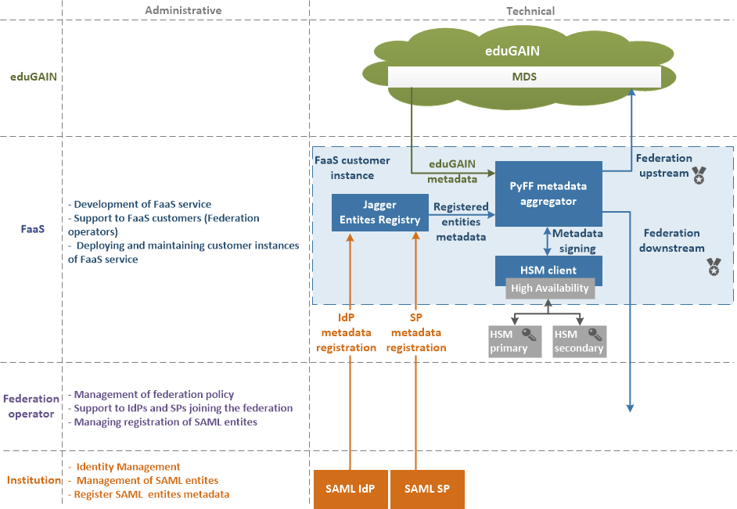
FaaS architecture

Slide 4
FaaS users
FaaS is offered to all GEANT partners (NRENs that have not yet deployed identity federation, or are in early stage of operating identity federation).
Nine NRENs are using FaaS:
  LitNET
  ASNET
  GRENA
  MARNET
  CyNET
  MREN
  AMRES
  RicerkaNet
  RASH

Slide 5
FaaS
Plans for the future
  Jagger UI improvement
  Integration with toolkit
  Offering FaaS to non-GEANT partners

